Slide 1
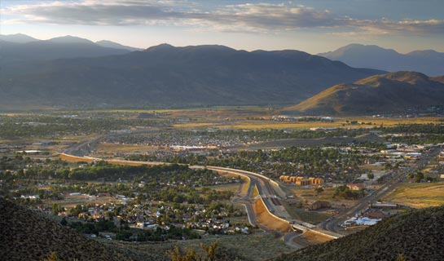
TRAFCC
(Transportation Resource Advisory Forum for
Carson City)
June 23, 2016
TRAFCC
(Transportation Resource Advisory Forum for
Carson City)
June 23, 2016

Slide 2
Overview
Street system of Carson City
Revenues for street maintenance
Use of existing funds
Other important projects
Freeway Project – Phase 2B-3
Downtown Project

Slide 3
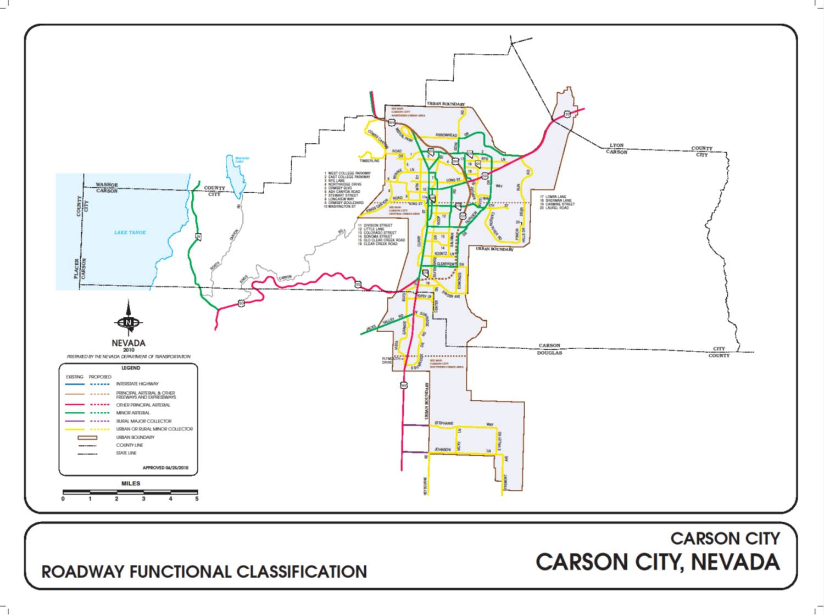
Street System of Carson City

Slide 4
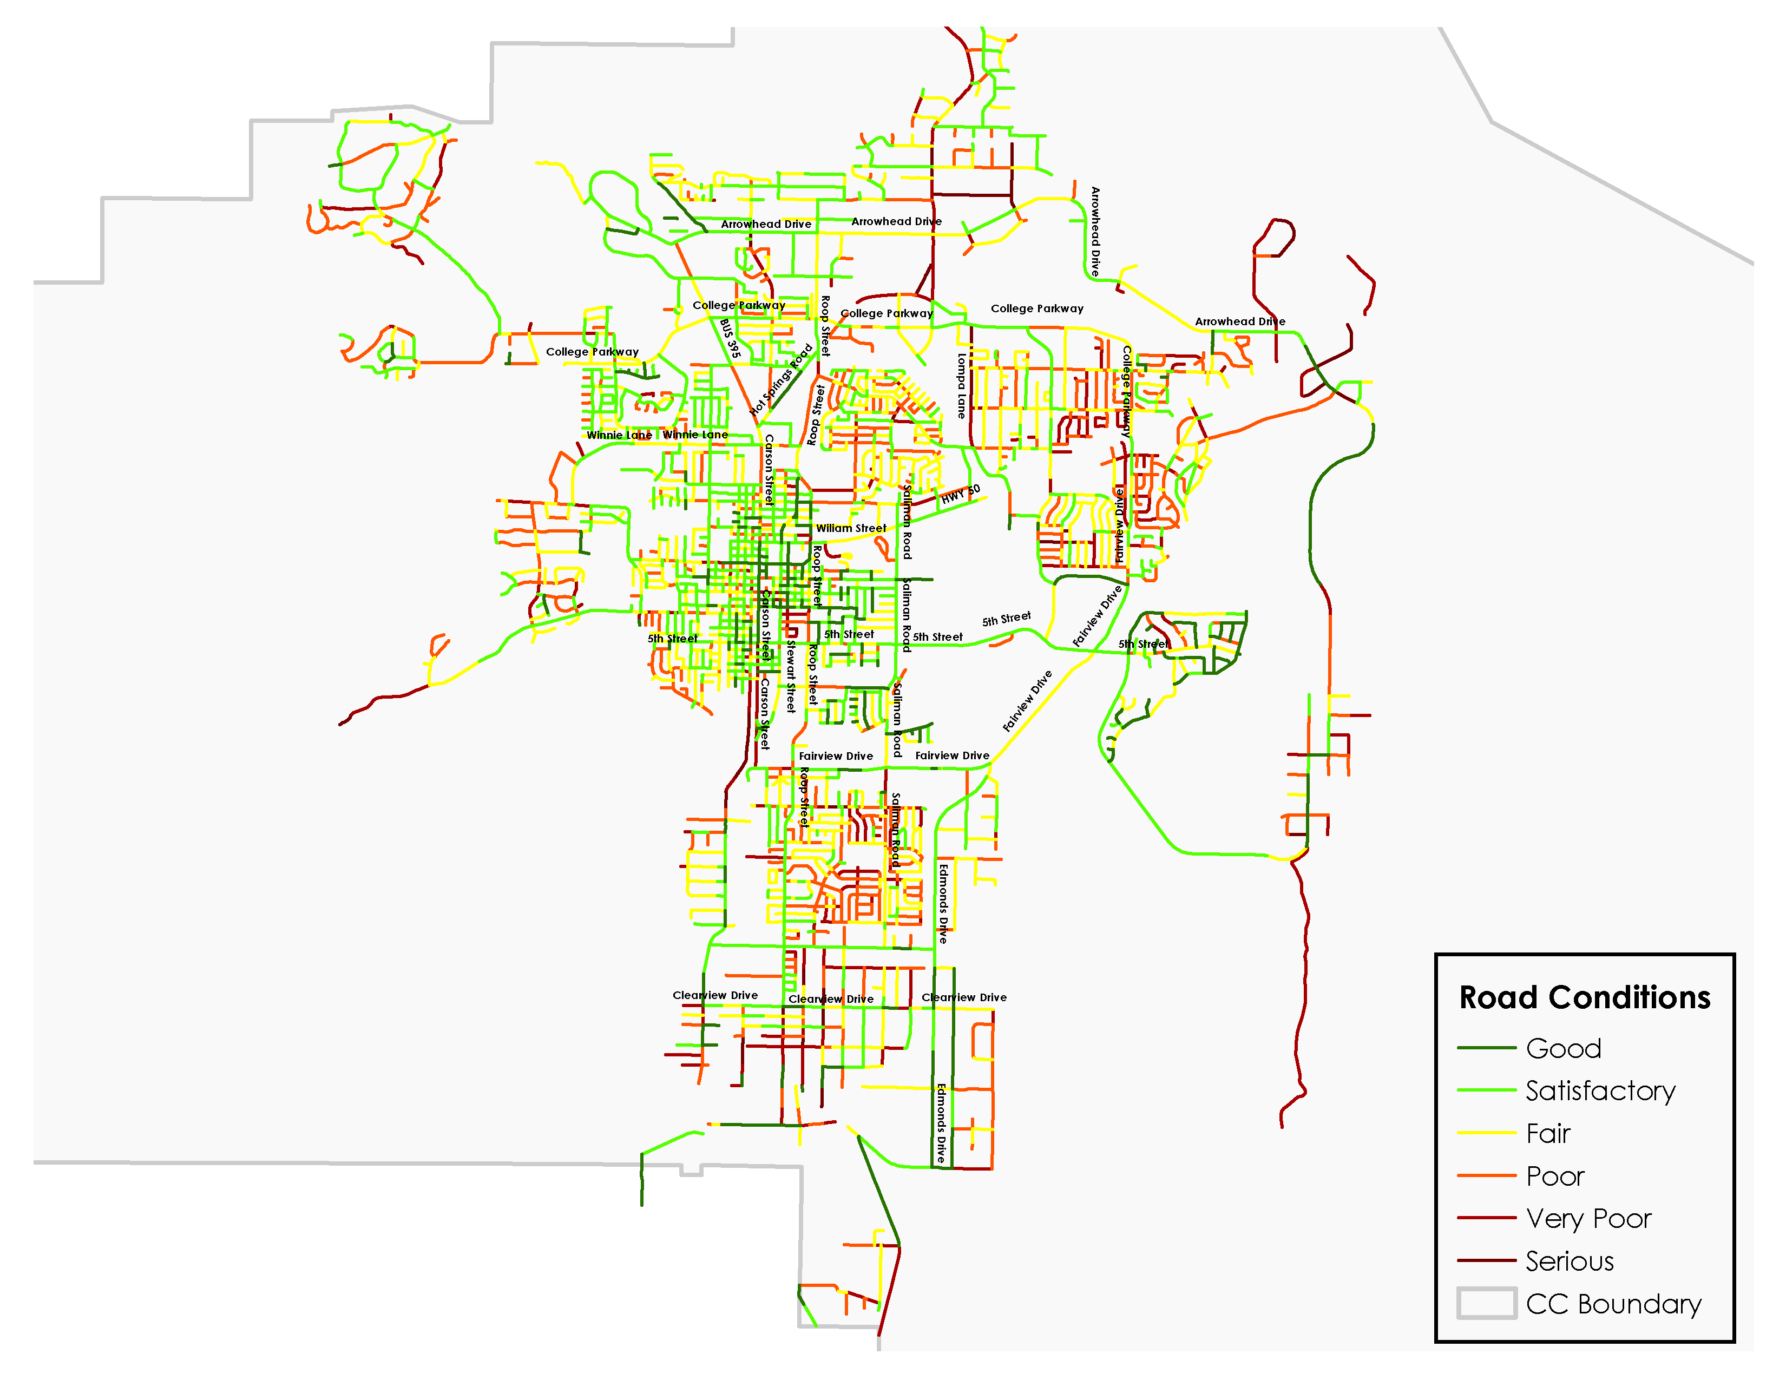
Current Conditions of Carson City
Average PCI in
June 2016: 62.9
City responsible for
approximately 274 miles
of roads. (State-owned
roads not shown on this map)

Slide 5
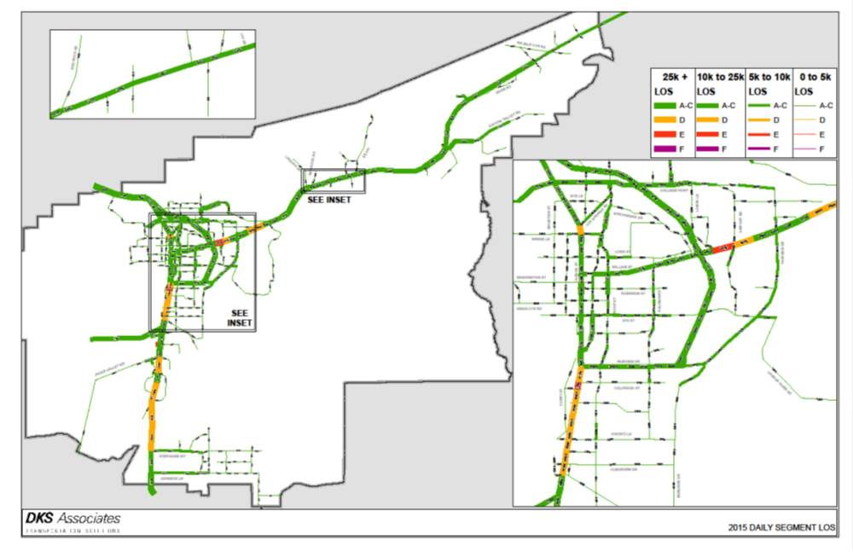
Level of Service (LOS)/Congestion in Carson City - Current

Slide 6
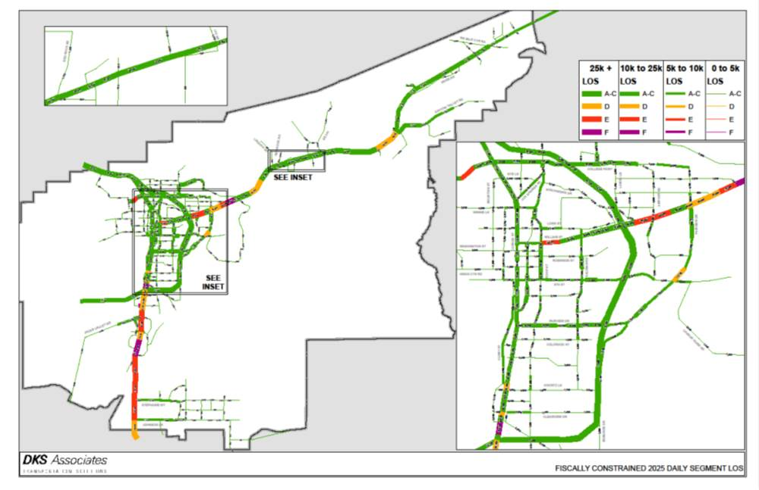
Level of Service (LOS)/Congestion in Carson City – Forecast 2025

Slide 7

Primary Revenue Sources for Street Maintenance in Carson City
City budget includes two funds which pay for street maintenance – RTC and Street Maintenance Funds
RTC Fund: Motor Fuel Tax is primary funding source for RTC Fund – 9 cents per gallon
Street Maintenance Fund:
Motor Fuel Tax – 6.35 cents per gallon (varies with gallons of fuel sold)
Sales Tax – ¼ cent citywide sales and use tax (varies with sales tax revenue in the City, generally more variable than motor fuel tax revenue)
7

Slide 8
Amount of Fuel Sold in Carson City
Fiscal Year

Slide 9
Revenues Reflect Fuel Sold and Dedicated Streets Sales Tax
Fiscal Year

Slide 10
Other Revenue Sources for Street Maintenance in Carson City
Grants – Many grants, primarily Federal, have been received in recent years. However, vast majority were dedicated to bicycle and pedestrian projects. While very useful for sidewalk repairs and improving safety, they primarily do NOT address pavement system preservation. Exception is upcoming Sierra Vista Lane grant project.
City General Fund – Board of Supervisors acted to transfer $370,000 from General Fund to Streets fund for additional street repairs in FY 2016.
1/8 cent sales tax for capital projects – reconstruction of downtown Carson Street primarily with 1/8 cent sales tax
Significant improvements with recent utility projects:
Washington Street
Long, Division, Mountain, and Fleischmann
Clear Creek Avenue
10

Slide 11
Use of Existing Funds for Street Maintenance
11 years of expenditures – 2005-2015 (handout)
How are current tax dollars used?
What do Streets employees do?
Street maintenance projects in 2016
How is funding prioritized?

Slide 12
How are Current Tax Dollars Used?
Approximately $8 million is budgeted in the RTC and Streets fund for next fiscal year (July-June)
RTC fund – Approximately $3.7 million
Capital projects - $1.45 million
Transfers out (bond payments with no significant decrease until after fiscal year 2027) – $1.65 million
Services and supplies (primarily internal service charge and professional services) - $0.36 million
Salaries and benefits - $0.16 million

Slide 13
How are Current Tax Dollars Used?
Streets fund – Approximately $4.4 million
Services and supplies – $2.03 million
Equipment and vehicle repair and maintenance
Long line striping contract
Sidewalk repair
Signs and striping
Street light power
Traffic signal maintenance
Trees, brush, and ditch maintenance
Capital projects (including traffic signal equipment and uncommitted funds) – $0.30 million
Salaries and benefits – $2.00 million

Slide 14
What do Streets Employees do?
A LOT!!!
Streets funds can only be used for maintenance of the streets system. That is what Streets employees do.
There are typically 18 employees of the Streets Division who conduct street maintenance activities: Crack filling, street patching and pothole repair, operating street sweepers and snow plows, signal maintenance, sign and striping maintenance, maintenance of unpaved roads, concrete repair (sidewalks/ curbs and gutters), traffic control, shoulder maintenance, emergency response, etc.

Slide 15
What do Streets Employees do?
Streets employees are dedicated to serving this community every day.
While not all of the work done by Streets employees improves the pavement of the streets, the work they do relates to the maintenance of many elements of the street system.

Slide 16
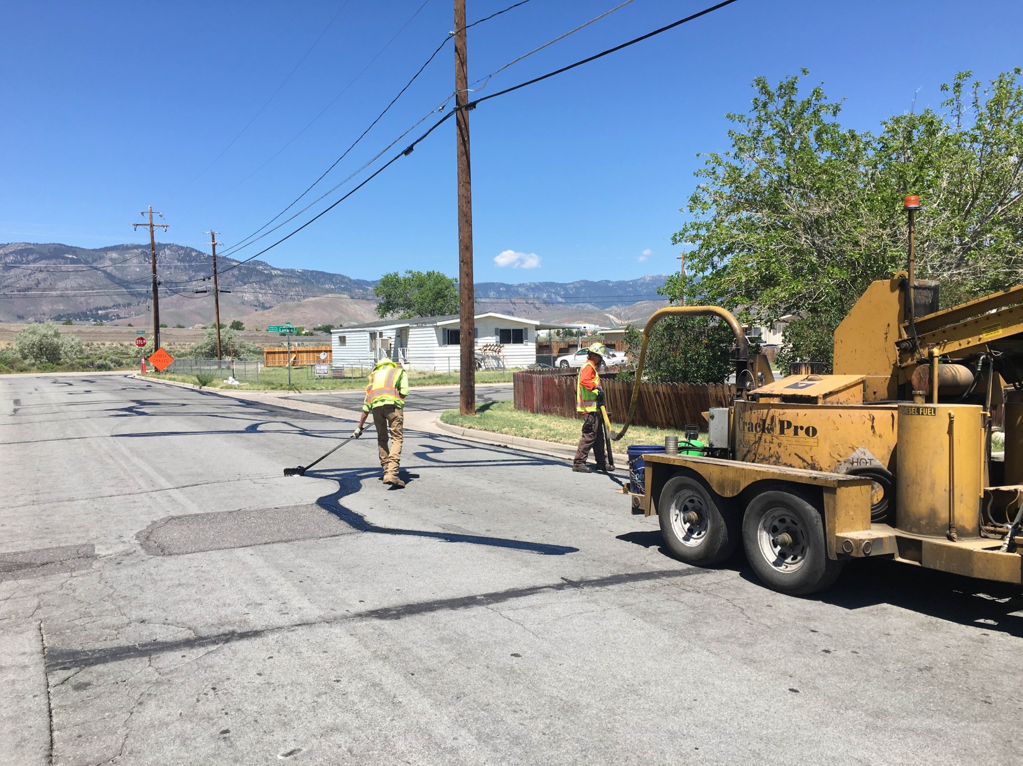
Streets Employees –
Crack Fill Operations (June 6)

Slide 17
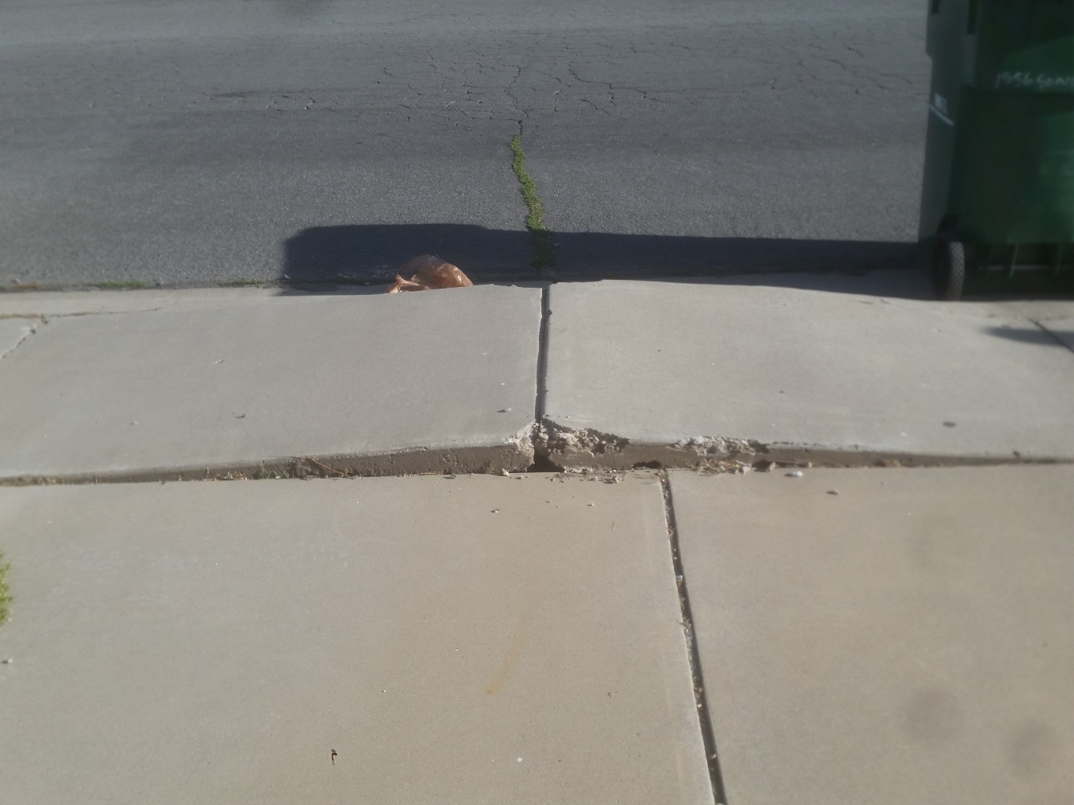
Sidewalk Failure – Safety/ADA issue (June 7)

Slide 18

Street Maintenance Projects in 2016
Reconstruction Projects
Downtown Carson Street (Reconstruction - Complete Streets)
Airport Road Reconstruction (~$200k)
Appion Way (~$500k)
Goni Road/Convair Drive (public/private partnership ~$575,000)
Maintenance Projects
Wide Crack Repair Project (~$250k)
Lompa Lane and Curry Street Cape and Slurry Seal (~$175k)
City Wide Patching Project (~$200k)
Fifth Street loop at Riverview Park (pavement repair~$86k)
Shouldering Project (~$96k)
Traffic Line Markings (Long Line ~$150k)
Signal Construction/Maintenance
College Parkway/Research Way Intersection Improvements (Public/Private Partnership ~$500k)
Flashing Yellow Arrow Intersection Improvement Project (~$300k)
Active Transportation Projects
Carson City Freeway Multi-Use Path (~$700k)
Empire Area ADA Sidewalk Improvements (~$265k)

Slide 19
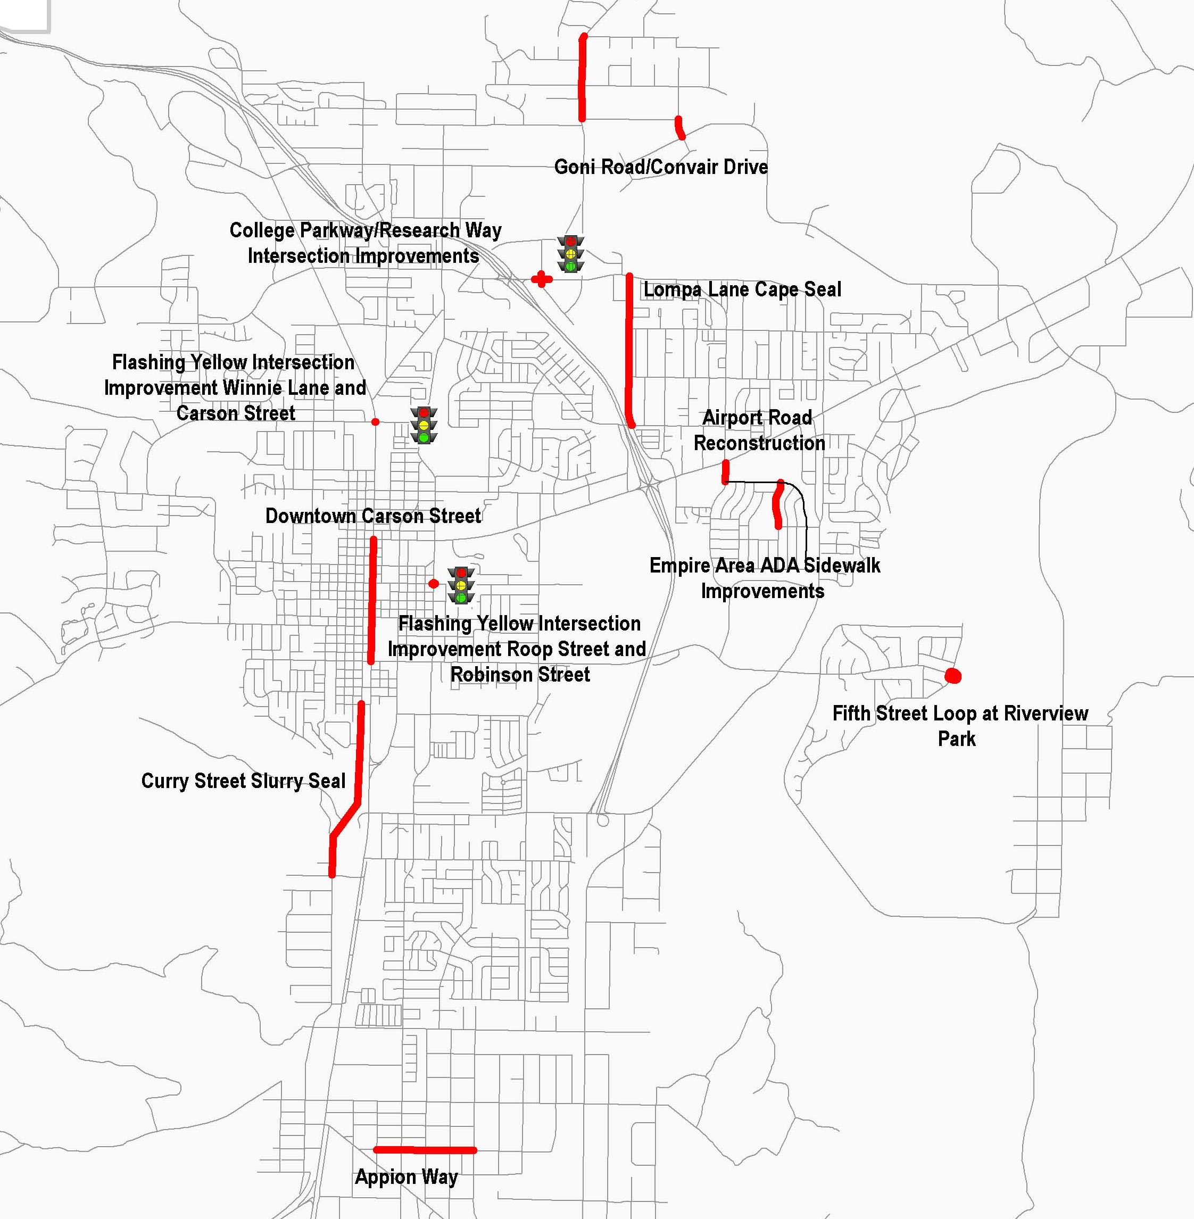
Calendar Year
2016 Projects
*Citywide projects have not been mapped:
Wide Crack Repair Project
City Wide Patching Project
Shouldering Project
Traffic Line Markings

Slide 20
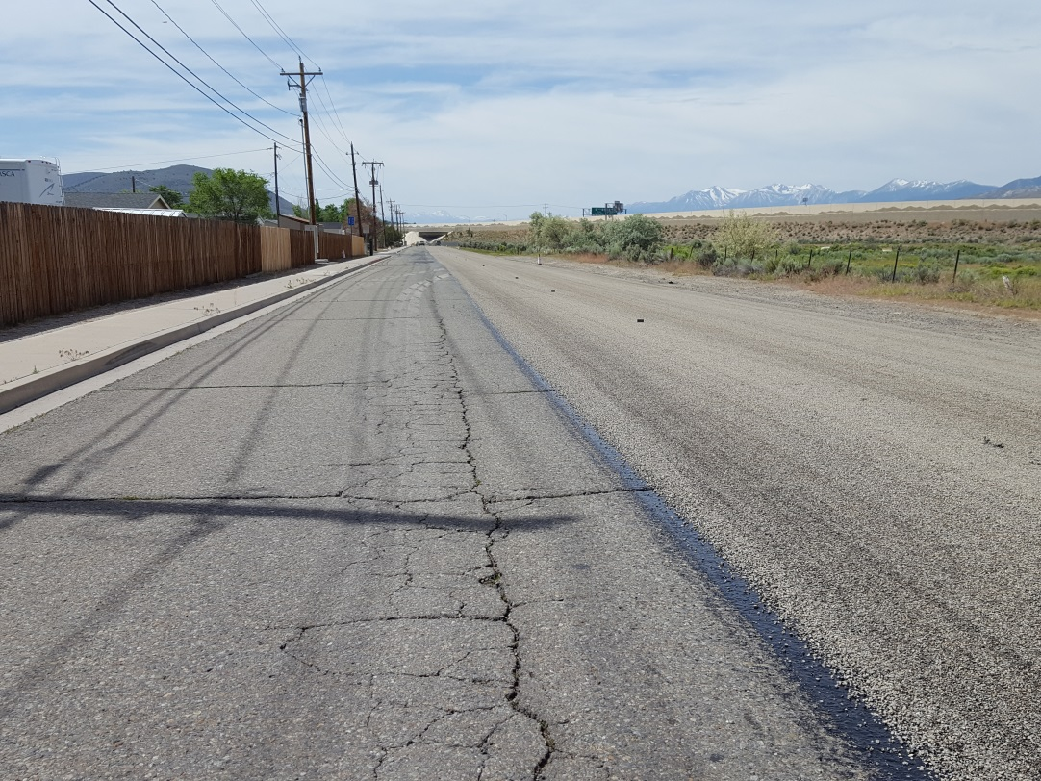
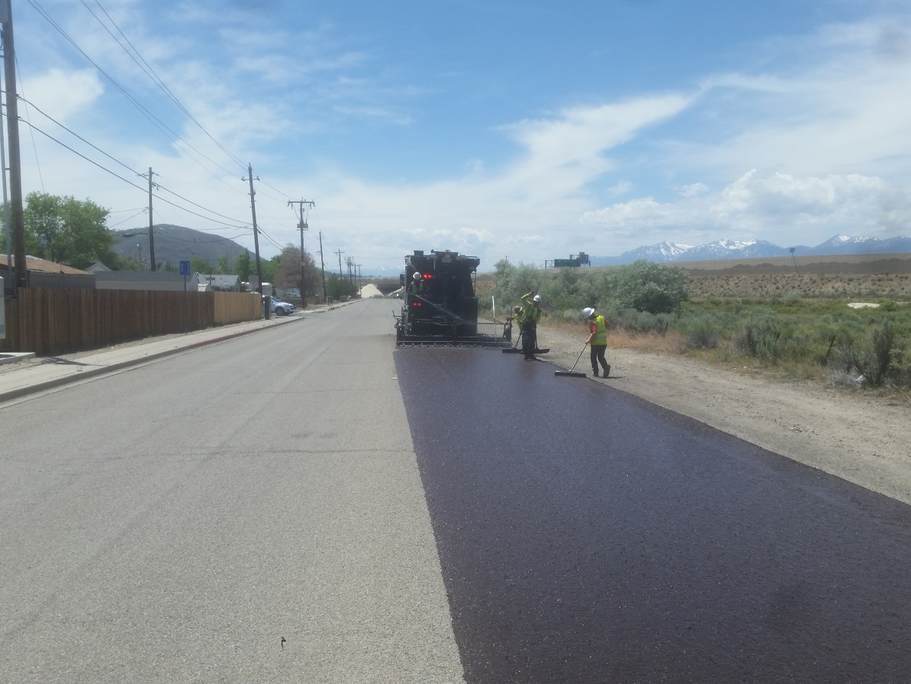
Lompa Lane – Cape Seal
Chip Seal (June 4)
Micro Seal (June 11)

Slide 21
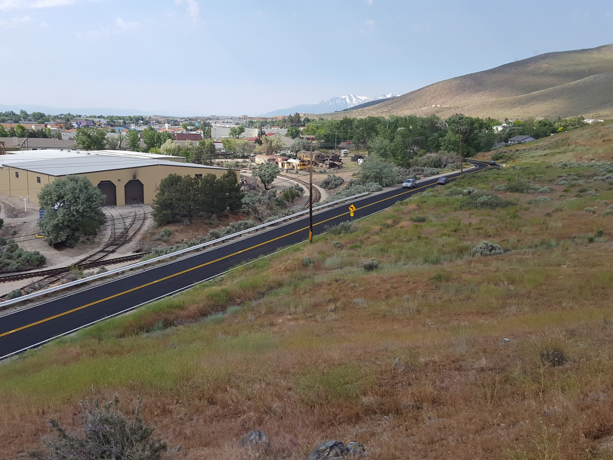
Curry Street– Slurry Seal (June 11)

Slide 22
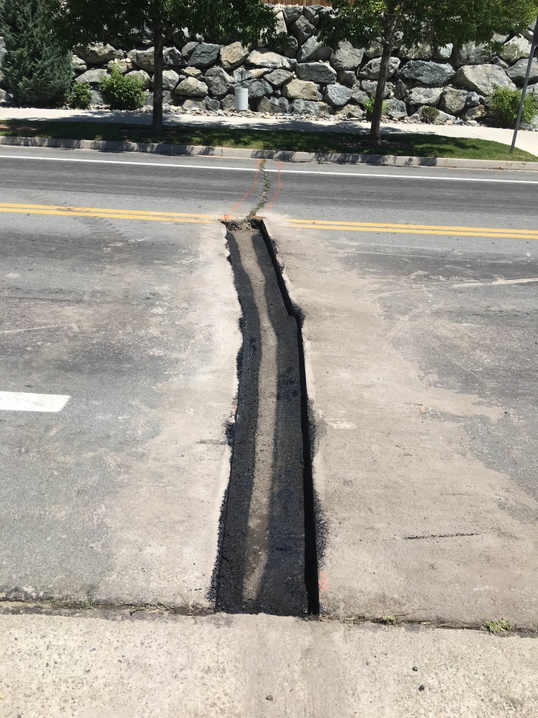
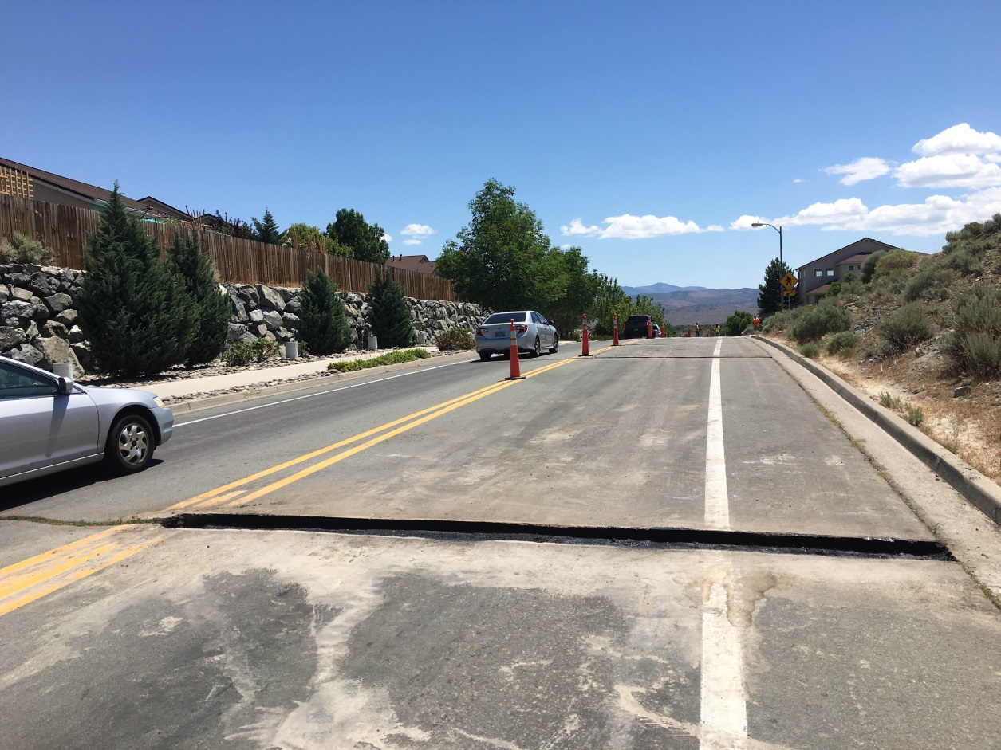
Wide Crack Repair Project – Northridge Drive (June 6)

Slide 23
How is funding prioritized?
Complex process with needs exceeding resources
Required fixed costs
Essential services and supplies (safety-related)
Other essential maintenance activities.
Street maintenance activities.
Capital projects for street maintenance require engineering design and oversight.

Slide 24
Prioritization of Work for Ongoing Maintenance (non-capital) Projects
Adjust to numerous, and sometimes competing demands for improvements and service. Need flexibility to react.
Considerations when prioritizing ongoing maintenance projects:
Emergencies
Safety concerns
Available funding
Americans with Disabilities Act (ADA) requirements
Risk management concerns and input
Pavement condition/ pavement management system
Staffing availability
Public input including through the Carson City Connect system
Input of elected officials
Coordination with other departments or outside agencies/ utilities
Weather
24

Slide 25
Prioritization of Capital Projects
Capital projects require engineering design and oversight and are brought to the Carson City Regional Transportation Commission (RTC) for award to private contractors.
Primary significant considerations when prioritizing capital projects:
Safety
Available funding
Pavement condition/ pavement management system input
Funding opportunities through grants
Planning studies
Public input including through the Carson City Connect system
Input of elected officials
Coordination with other departments or outside agencies including utilities
Economic Development
Coordination with other significant projects regarding traffic impacts of construction

Slide 26
Prioritization of Capital Projects
Three most important factors have quantifiable measures:
Safety
Available funding
Pavement condition - overall conditions and specific pavement distresses.
Pavement management system:
Includes data on pavement conditions citywide.
A tool used to evaluate alternative options for utilizing available funds to improve and manage pavements citywide.

Slide 27
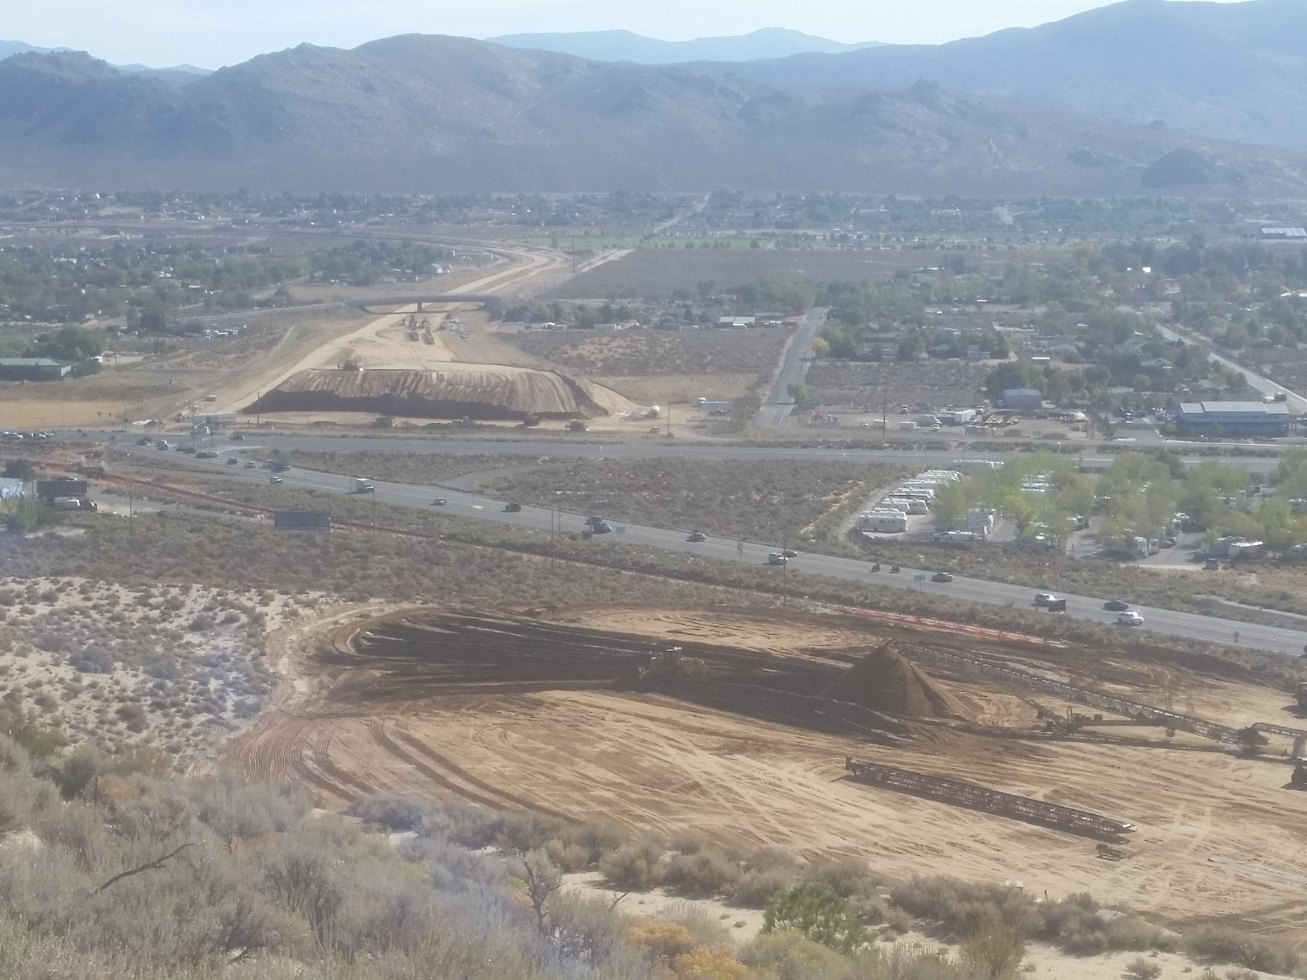
Carson City Freeway
NDOT and RHB Making Progress on Phase 2B-3 of Carson Freeway

Slide 28

Carson City Freeway - Progress
Phases 1A & 1B open to U.S. Highway 50 - 2006
Phase 2A open to Fairview Drive - 2009
Phase 2B-1 (bridges & drainage) - 2011
Phase 2B-2 (bridge & drainage) – 2014
Phase 2B-3 (earthwork, sound walls, & roadway) – under construction; open to traffic 2017
Phase 2B-4 (Spooner interchange) - planned, not scheduled at this time. Estimated cost: $20-25 million

Slide 29
Carson City Freeway Agreement (agreement and amendments all approved by action of the Board)
Original agreement with NDOT on 4/1/97. Carson City to fund $19M (plus interest) of Phase 1 of freeway through 5-cent increase in fuel tax.
Amendment 1 (10/14/04) suspended payment for 3 years to allow for construction of improvements on Fairview Drive. City also agreed to fund additional $15M for Phase 2 of freeway through 3-cents of fuel tax and for future transfer of S. Carson Street to the City.
11/10/04 Board of Supervisors voted to remove sunset of 5-cent fuel tax to fund roadway projects into the long term future.

Slide 30
Carson City Freeway Agreement (continued)
Amendment 2 (12/27/07) deferred 3-cent payment to 7/1/09 to complete Fairview Drive improvements and City agreed to take ownership of several State roads in lieu of remaining payments for Phase 1 ($4.8M).
Amendment 3 (9/4/09) provided for City to take over remaining State roads and forego pavement rehab of Carson Street by NDOT in exchange for a $7.8M reduction in the $15M owed for Phase 2 of freeway. Deferred 3-cent payment for remaining $7.127M until completion of freeway.

Slide 31
Carson City Freeway Agreement– Future Amendment
The Freeway agreement and amendments did not anticipate NDOT phasing of remainder of Freeway. Phase 2 2A, 2-B1/2/3/4
1/8 cent sales tax implemented by Carson City in 2014 for capital improvements included funding for corridors including S. Carson Street.

Slide 32
Carson City Freeway Agreement– Future Amendment
S. Carson Street transfer to the City (as already agreed upon in amendment #1) after completion and opening of Phase 2B-3.
NDOT would perform minor maintenance activities only on s. Carson Street before transfer.
NDOT would provide $5.1 million payment to City in lieu of resurfacing project. Funds restricted to use on S. Carson Street (Fairview - Snyder) for project to begin by 2019.
Remaining $7.127M in payments through 3 cent RTC gas tax do not begin until Phase 2B-4 complete.

Slide 33
Potential Design of S. Carson Street
City developed limited complete streets concepts previously.
Carson City RTC will develop conceptual design and cost estimates through CAMPO-funded complete street corridor study.
Additional grant funding will be pursued.
Design will be completed through a separate effort and then construction initiated.

Slide 34

Complete Street Project - Carson Street
First complete streets project in Carson City
10+ years in the making
Lack of understanding
Funded primarily with 1/8 cent sales tax implemented in 2014 (no gas tax used)
Part of capital program – other projects
Contract awarded (CMAR) Feb. 4, 2016

Slide 35
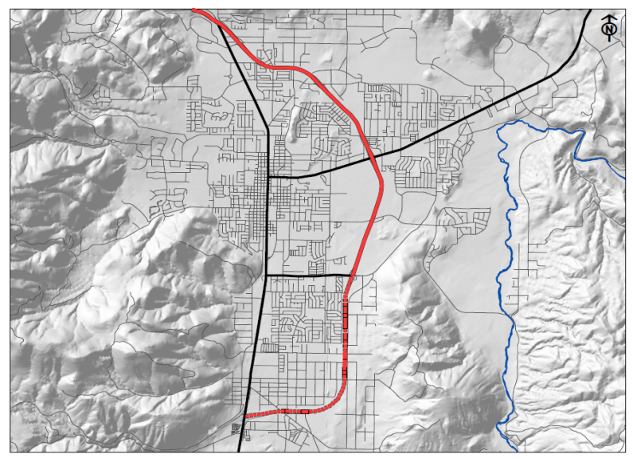
Carson Street Project - Location
Project Area

Slide 36
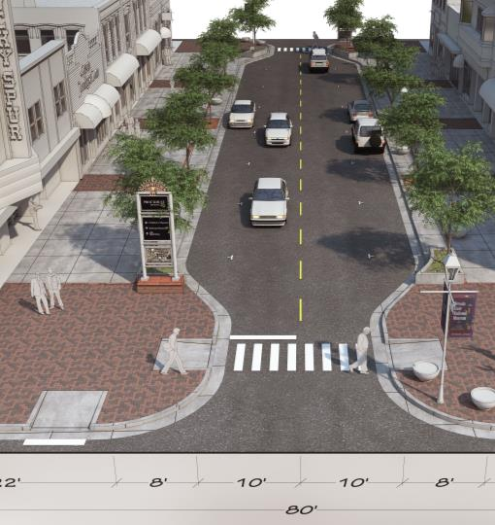
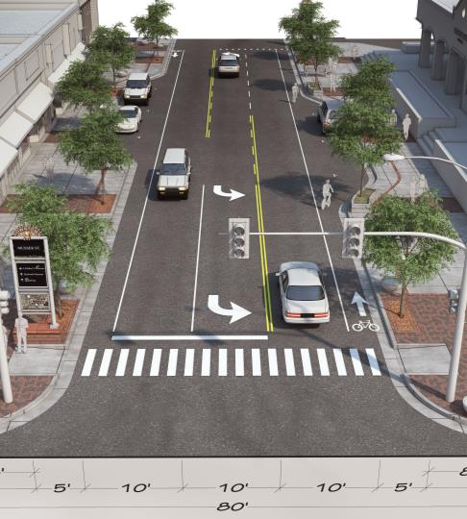
Carson Street Project – Where We’re Going
2005 Design
2014 Design

Slide 37
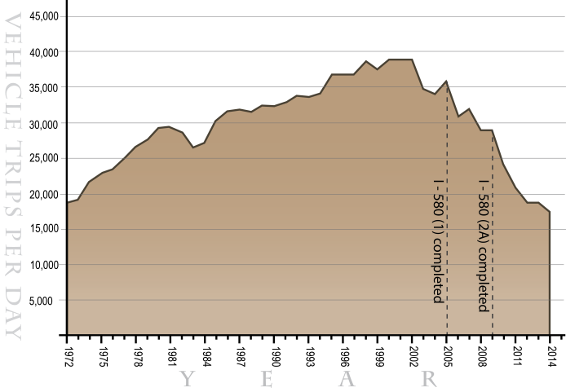
Carson Street Project – Traffic Decline
Average number of vehicles per day on Carson Street (at 150 feet north of Ann Street)

Slide 38
Carson Street Project – Highlights of Final Design
Standard Sidewalk width – 20’
Standard Roadway width – 40’
No medians, but far more trees on sides
Limited parking
Bike lanes
Third Street – McFadden Plaza
Schedule – open for use on Nevada Day
Carsonproud.com/#carsonproud

Slide 39
Topics for Next Meeting – July 28, 2016
Pavement Management System – presentation by Dr. Elie Hajj
Further discussion on the prioritization of projects with available funds
Discussion of Fuel Revenue Indexing – difference in available funding

Slide 40
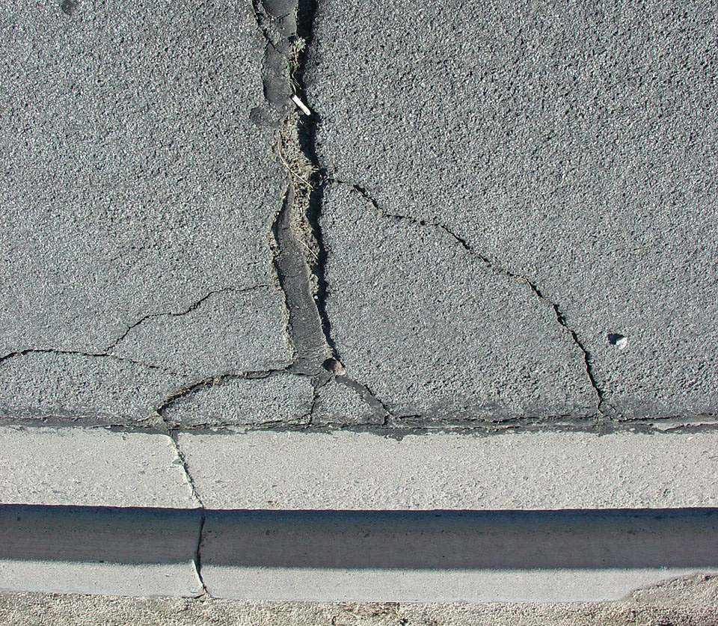
Contact Information
Contact Information
Patrick Pittenger, M.S., AICP, PTP
Transportation Manager, Carson City Public Works
775-283-7396
ppittenger@carson.org
Patrick Pittenger, M.S., AICP, PTP
Transportation Manager, Carson City Public Works
775-283-7396
ppittenger@carson.org
Thank you!
Thank you!

