Slide 1

Camp Carson

Slide 2
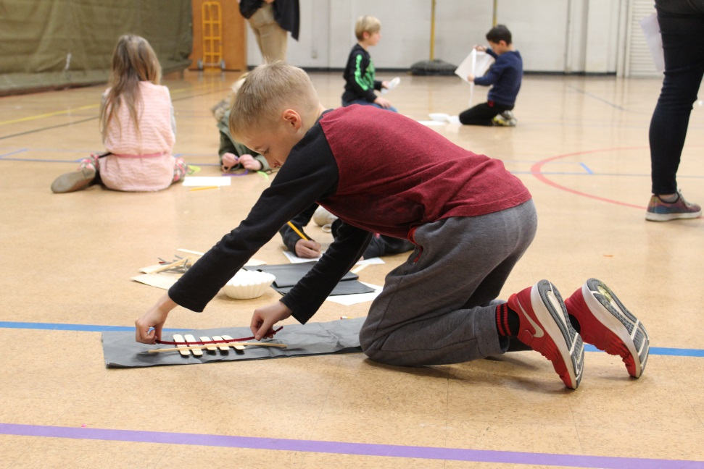
Camp Carson
Camp Carson-Why the Change?
Who can attend?
How much and what is included ?
What are the days and hours of operation?
How do I register?
What makes us who we are?
Notes:
Children entering Kindergarten – 6th Grade.
We are licensed through the state for Out of School Recreation Programs
$100 per child/per week and includes open swim, meal day, guest speakers, local field trips, unique programs for each group
6:30am-6:00pm/Monday – Friday/ No Camp on July 4th.
You can register at www.carson.org/ccpr, at the Carson City Aquatic Center or on my office line at 775-283-7428.
Open Swim, Local Field Trips, 1 Meal day a week on Wednesdays.
Great Opportunity for kids to be involved in structured activities throughout the day, while meeting other kids their age. Camp Carson introduces kids to exciting indoor and outdoor activities with staff who really care about the kids and providing excellent program for them.

Slide 3

Staff
1 Recreation Program Manager (Eric Klug)
1 Recreation Program Supervisor (Andrew Menendez
3 Recreation Aide Site Supervisors (Taylor Garcia, Kaylin Marler & Charmaine Samaniego)
8 Recreation Aide Leads
30 Recreation Aides

Slide 4

What do we do at Camp?
Teambuilding
Group Games
Arts & Crafts
STEAM (Science. Technology, Engineering, Art and Design, and Math
Guest Speakers
Local Trips
Open Swim
Field Trips
Meal Days

Slide 5
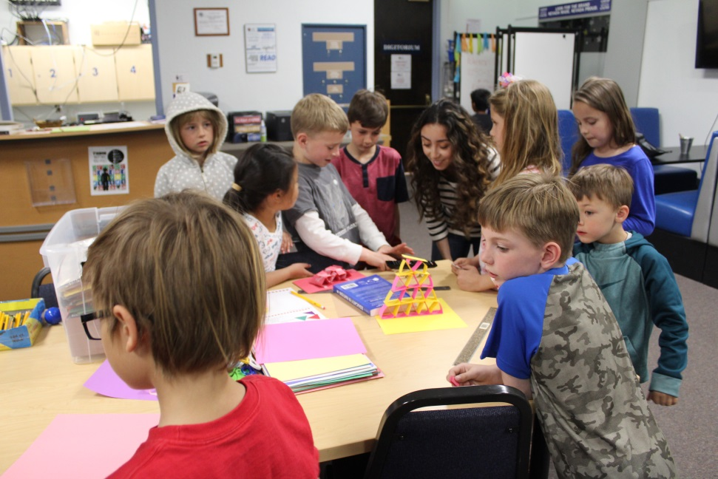
What's new at Camp?
PBS Summer Adventure
Character Counts
CATCH
NRPA Wildlife Explorers
Energy Coalition
Camp Quest
Food for Thought

Slide 6
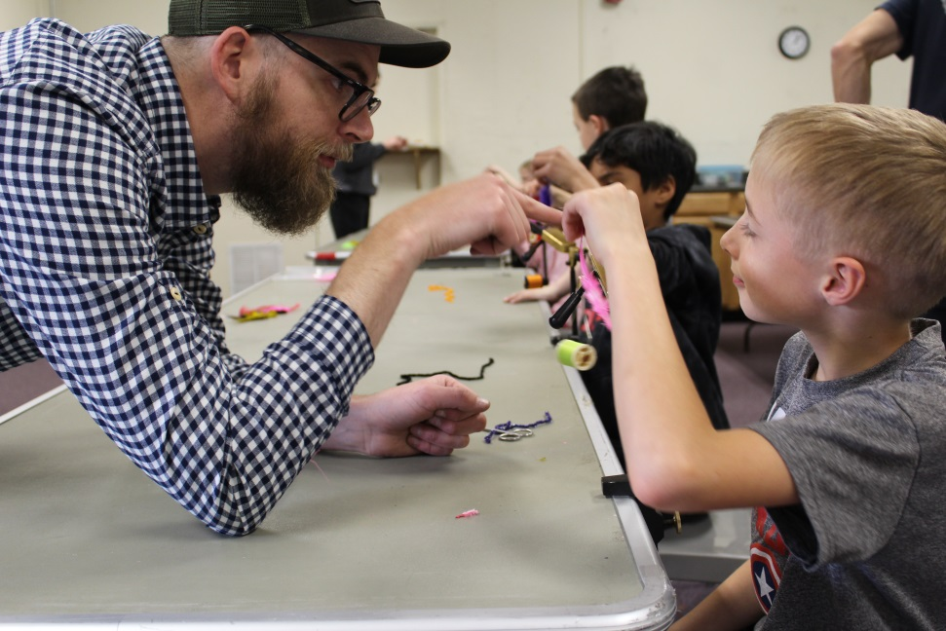
New Technology
Ipads
ActiveNet App
When To Work
Electronic Time Clock

Slide 7

Summer Camp Dates
Camp Carson:
1 week of staff training (40 hours).
June 11th-15th
8 weeks (39 days) of summer camp.
June 18th-August 10th
Notes:
Number of Participates:
2015 – Average 155
2016 – Average 175
2017 – Average 150
Revenue:
2015 - $155,199.98
2016 - $147,856.45
2017 - $128,058.20

Slide 8

The Children’s Cabinet
Who is The Children’s Cabinet?
What's The Children’s Cabinet Subsidy Program?
How are they helping the families in our community with our program?
Notes:
The Children’s Cabinet exists to keep children safe and families together. They offer services and resources that address unmet needs. And we represent a unique and effective cooperative effort between the private sector and public agencies in Northern Nevada.
The Children’s Cabinet Subsidy Program is a financial assistance program for eligible parents who are working or seeking employment.
Carson City Parks and Recreation are working with Children’s Cabinet to offer new Child Care Provider Subsidy. Once Children's Cabinet receives an application, the applicant will be notified if they are eligible for subsidy.

Slide 9
