Slide 1

South Carson Complete Streets Project Regional Transportation Commission March 13, 2019

Slide 2
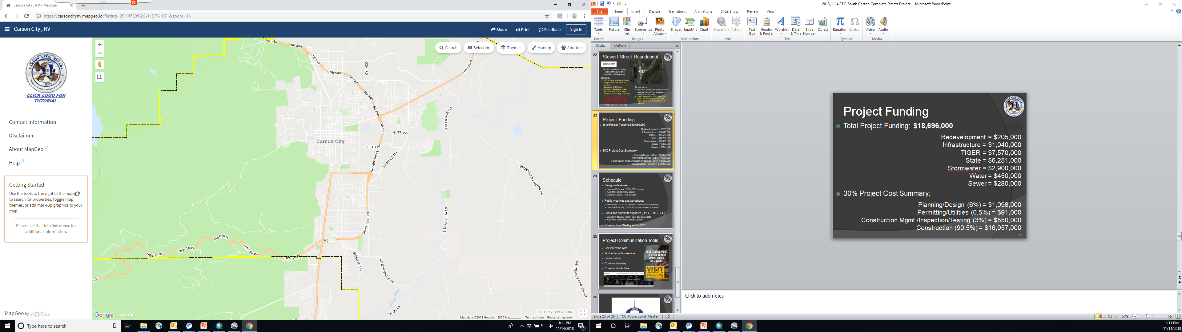
Presentation Outline
Project status update
30% RTC comment resolution
Review updated illustrative drawings
Project schedule update
Communication tools
Project Limits

Slide 3
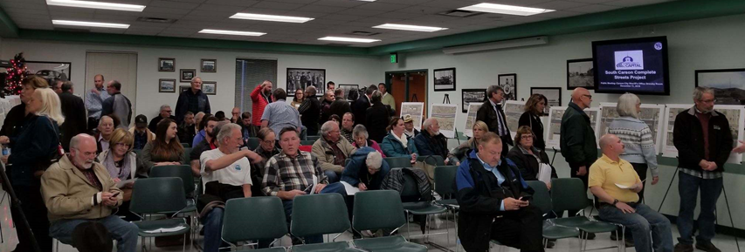
Project Status Update
Public meeting on 12/11
30% update to RACC (12/3) and BOS (12/20)
Meeting with Historical Resources Commission on 1/10
Design progression from 30% to 60%
Carson Proud website updates, including illustrative plans and flyover video

Slide 4
30% RTC Comment Resolution
Deceleration lanes/turn pockets:
Adding northbound right turn pocket at Koontz
Lengthening northbound right turn pocket at 5th
Extending southbound left turn at Eagle Station
Extending northbound left at Clearview
Utilization of low plants for sight distance, safety, business visibility
Yes, incorporated into design
Stop signs at driveways?
The driver of a vehicle about to enter or cross a highway from a private way shall yield the right-of-way to all vehicles approaching on such highway. (NRS 484B.260)

Slide 5
30% RTC Comment Resolution
Northbound sweeping right at Stewart roundabout encourages high speeds
Decreased radius on NB right to Stewart
Concerns about ending multi-use path mid-block
Addressed in 60% design- extends to Stewart
Refined transition for cyclists from multi-use path to lane at Stewart roundabout
People don't drive roundabouts well at first
Developing roundabout educational video and other educational material

Slide 6
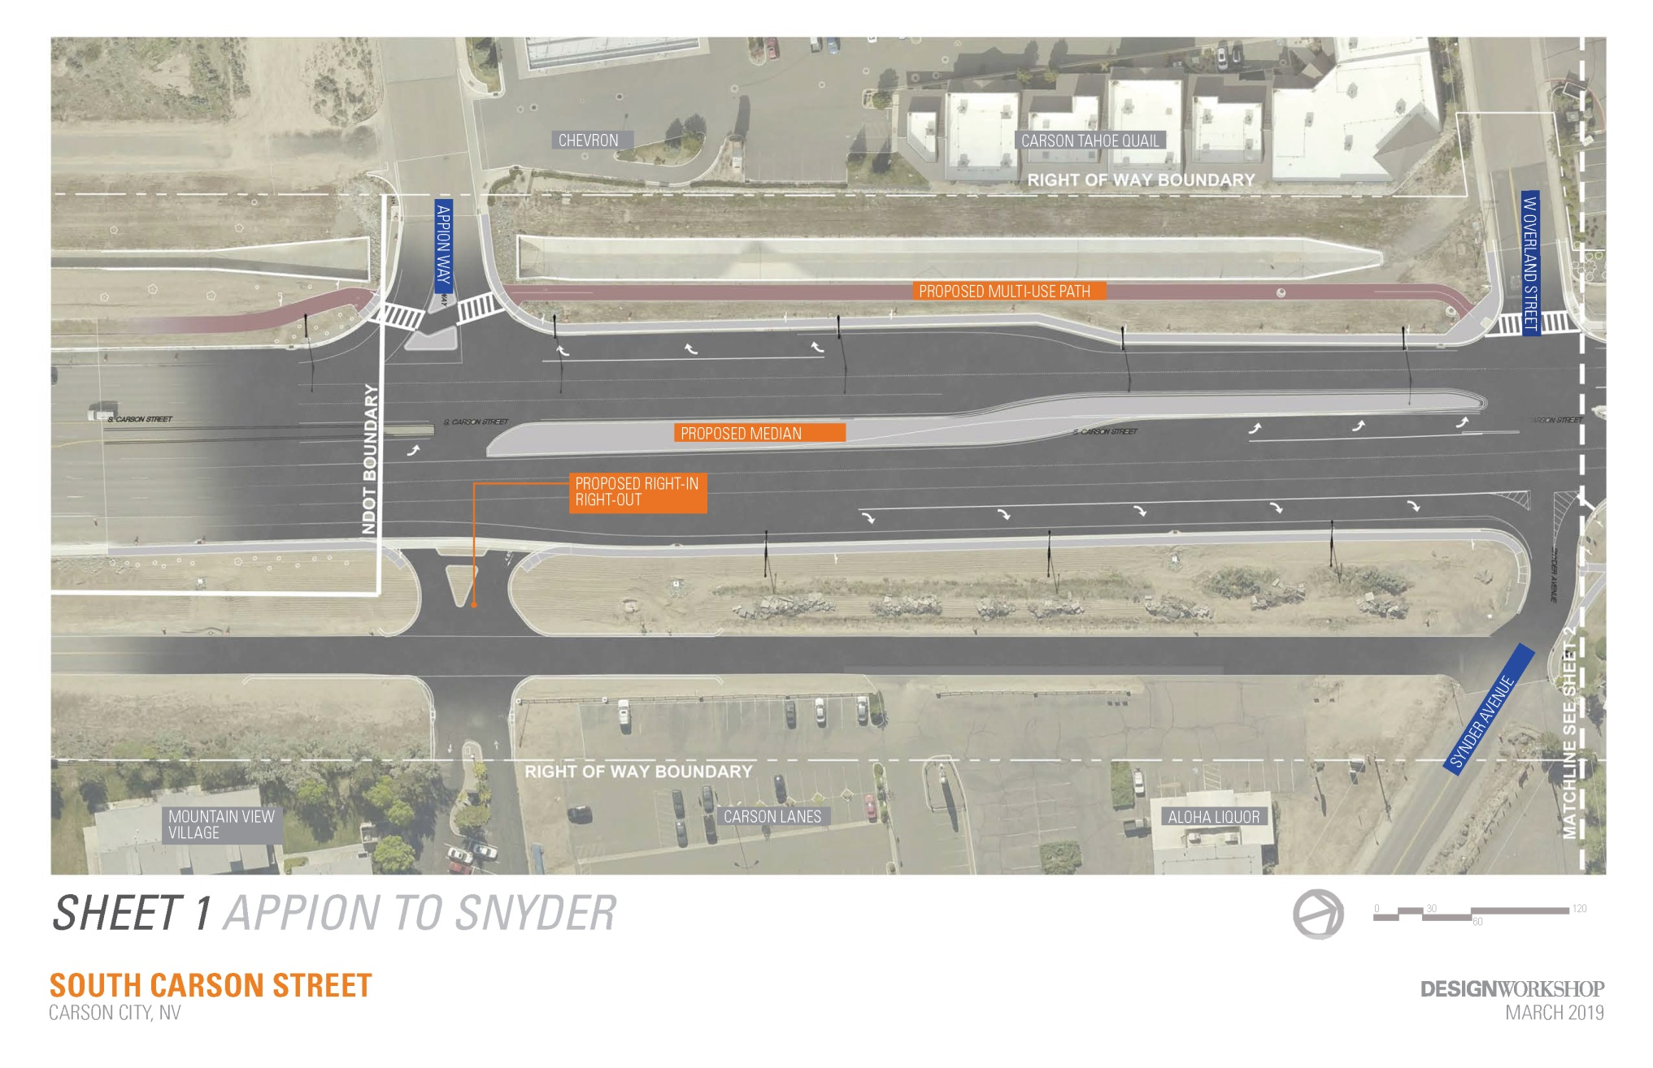
60% Design Exhibit

Slide 7
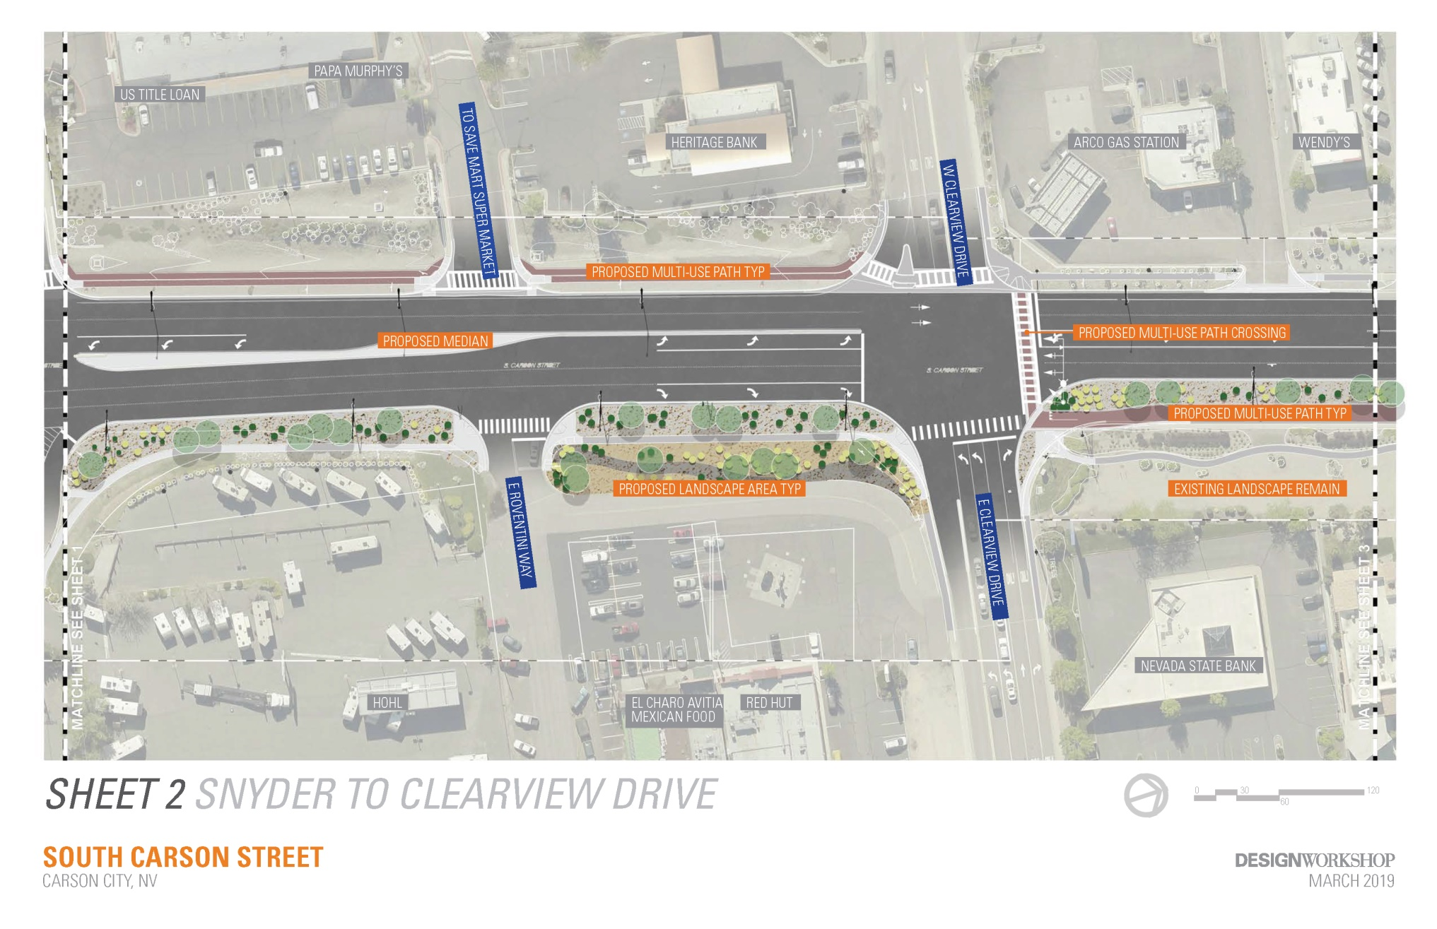
60% Design Exhibit

Slide 8
60% Design Exhibit

Slide 9
60% Design Exhibit

Slide 10
60% Design Exhibit

Slide 11
60% Design Exhibit

Slide 12
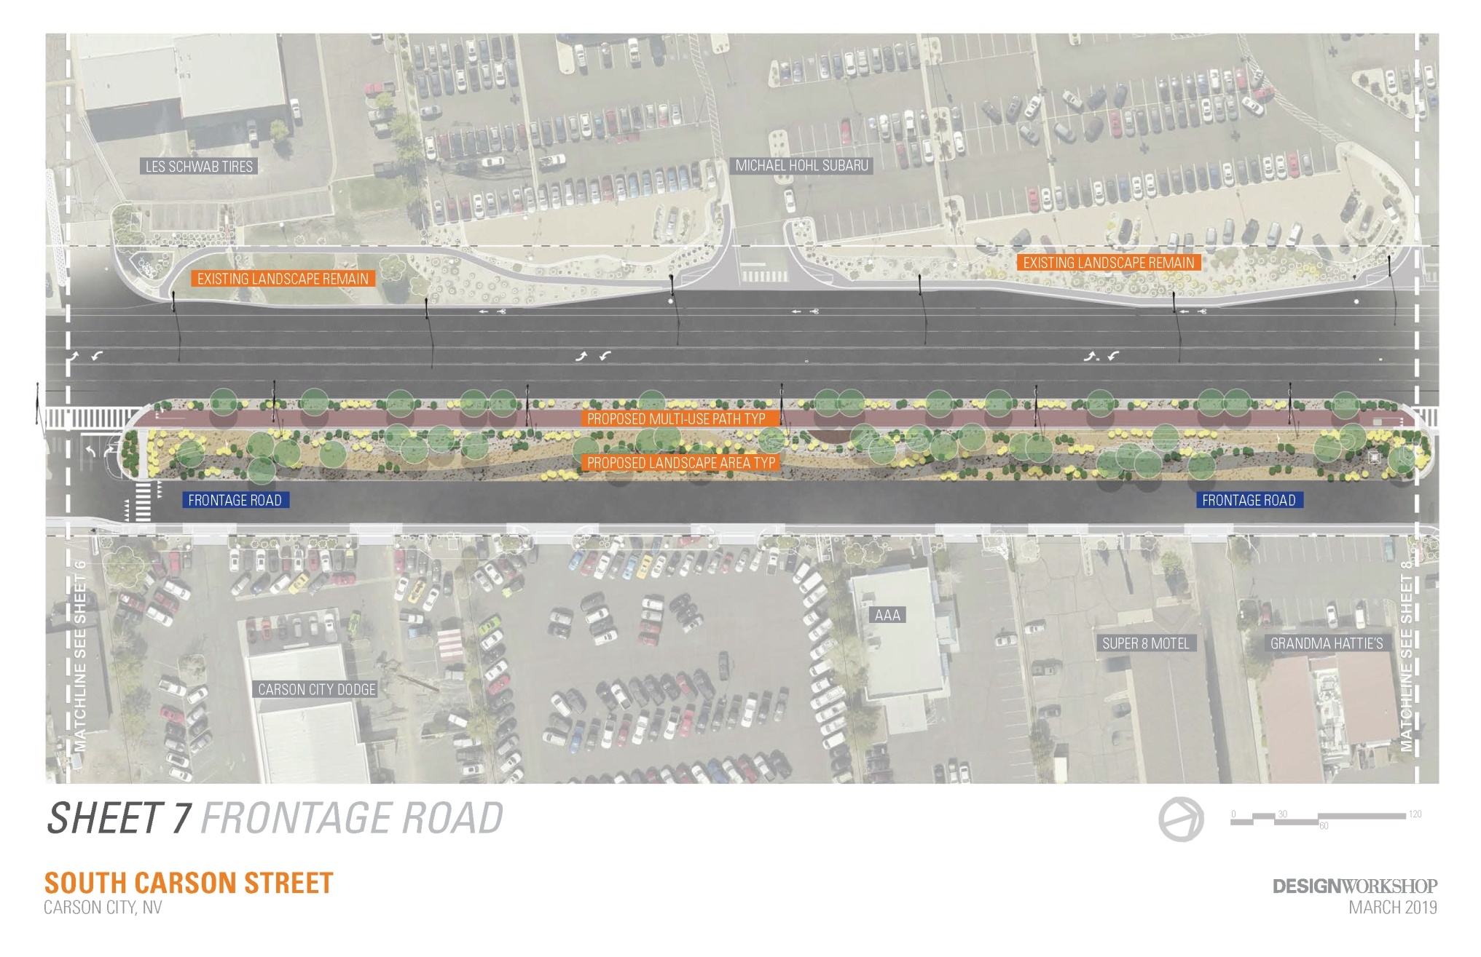
60% Design Exhibit

Slide 13
60% Design Exhibit

Slide 14
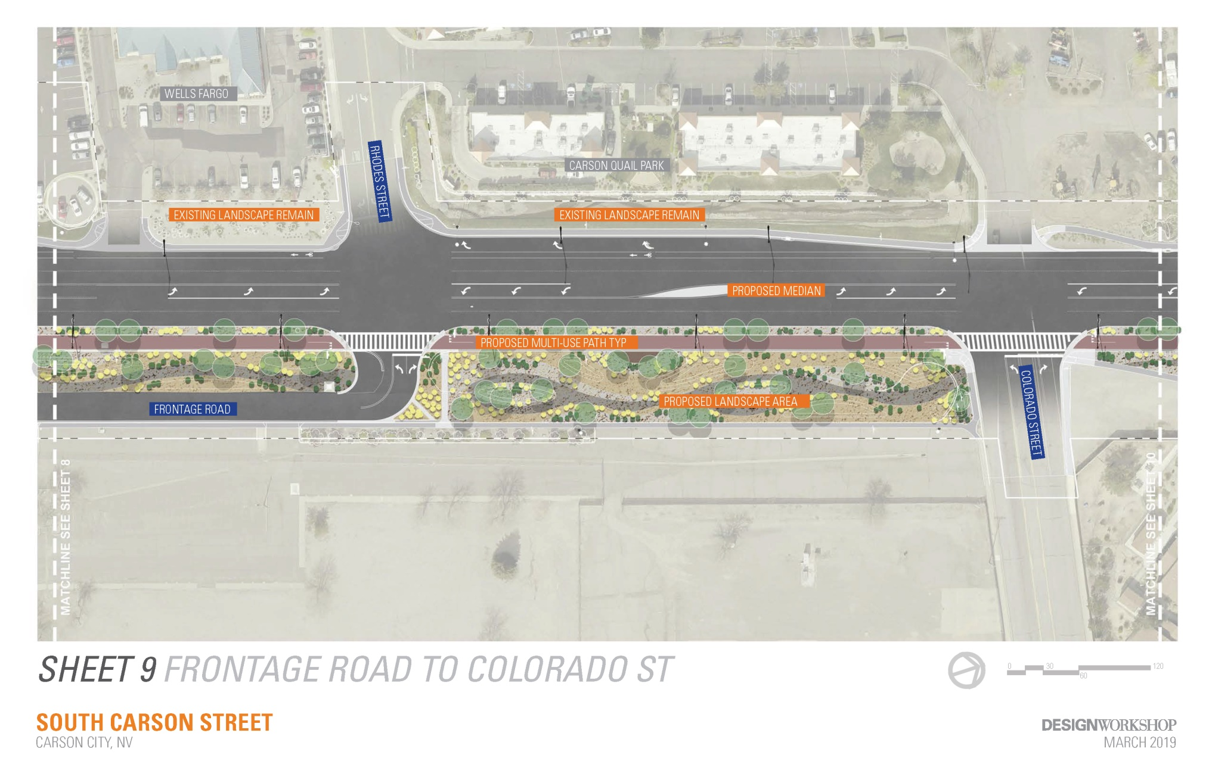
60% Design Exhibit

Slide 15
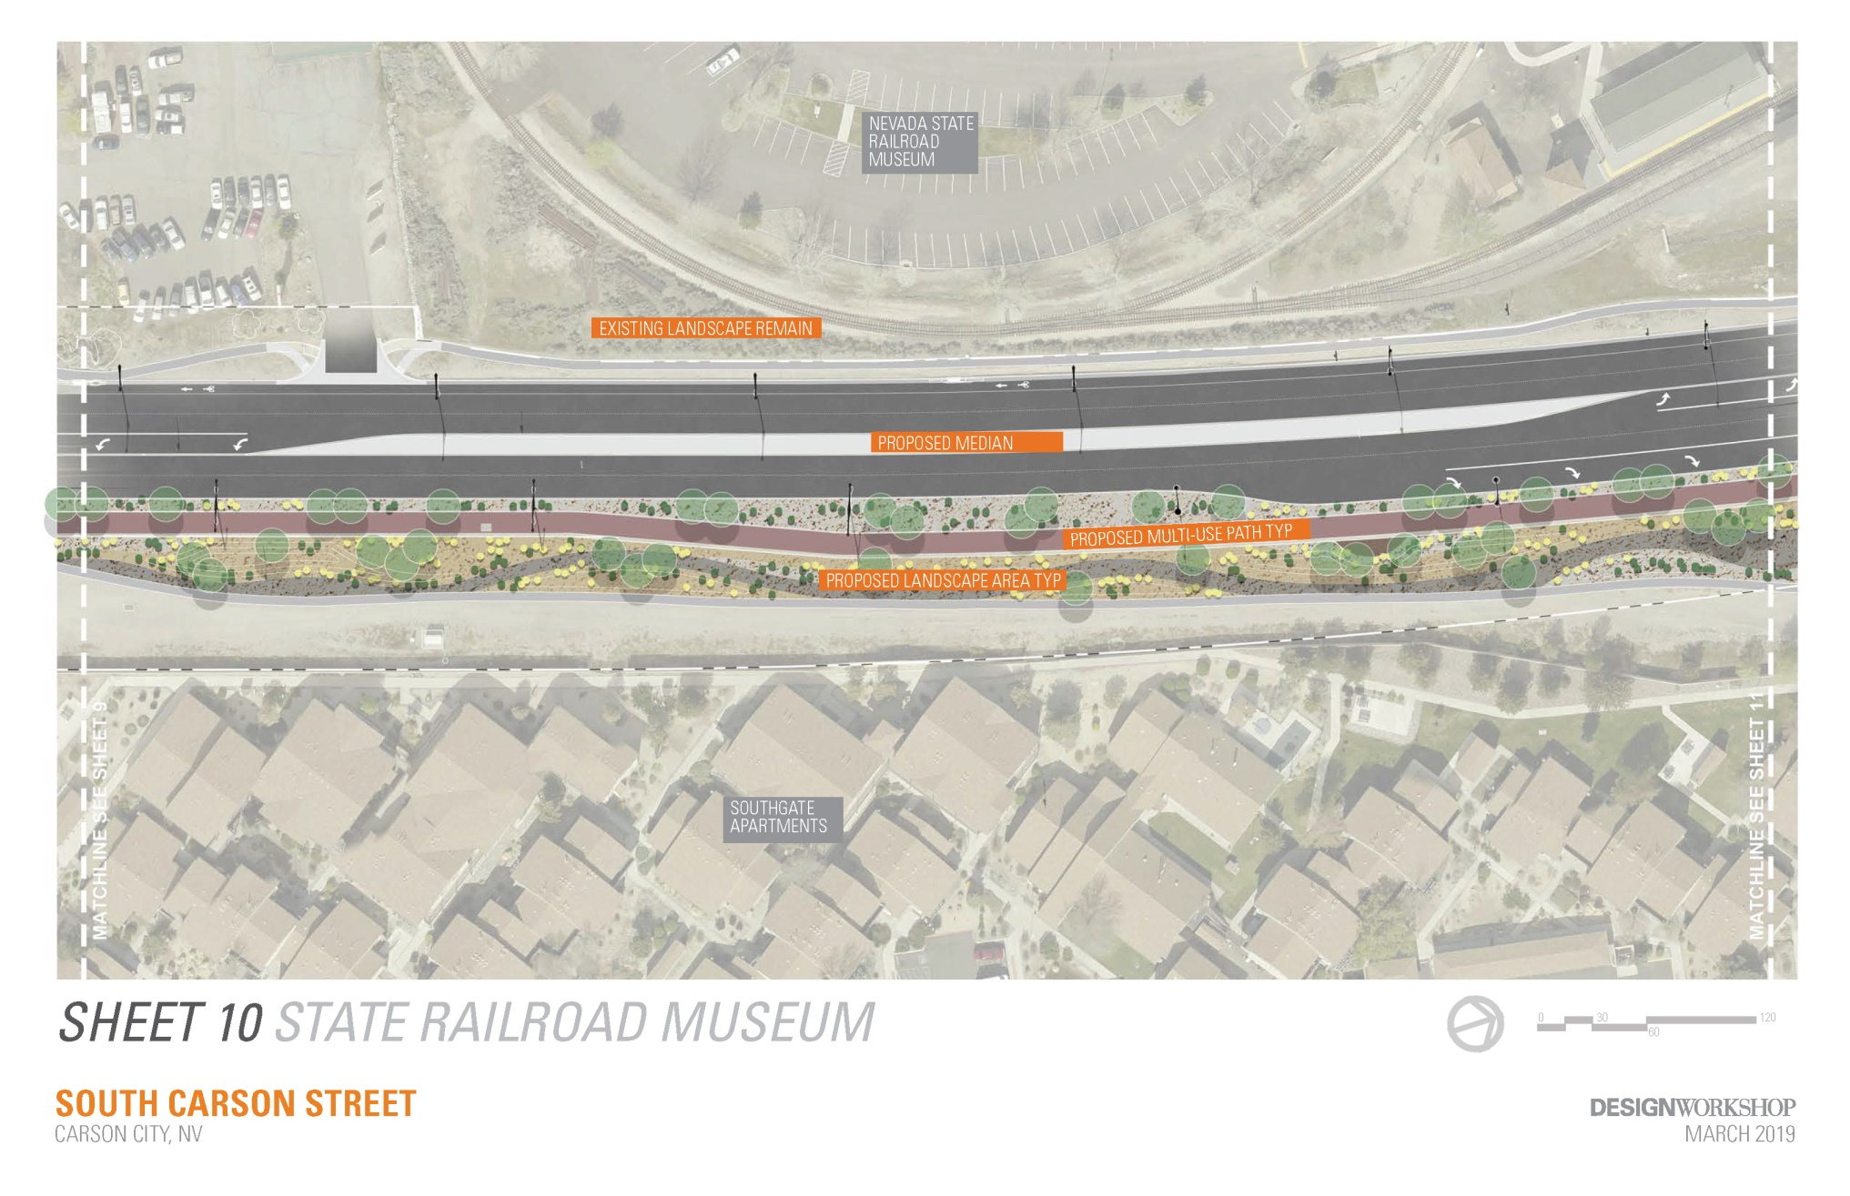
60% Design Exhibit

Slide 16
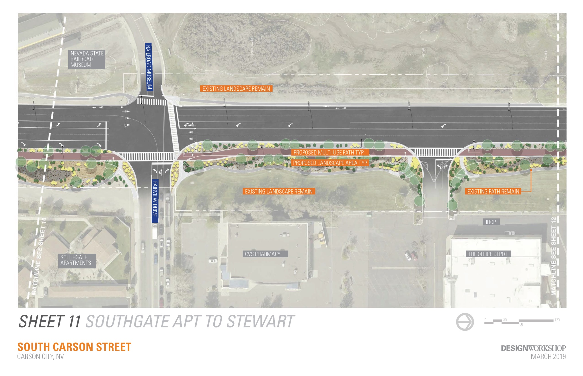
60% Design Exhibit

Slide 17
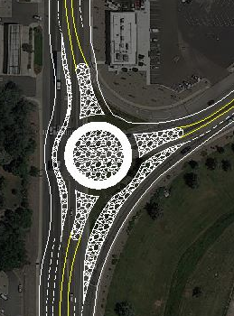
Design Exhibit- Roundabout
10% Design
(Nov. 2018)
20% Design
(Dec. 2018)

Slide 18
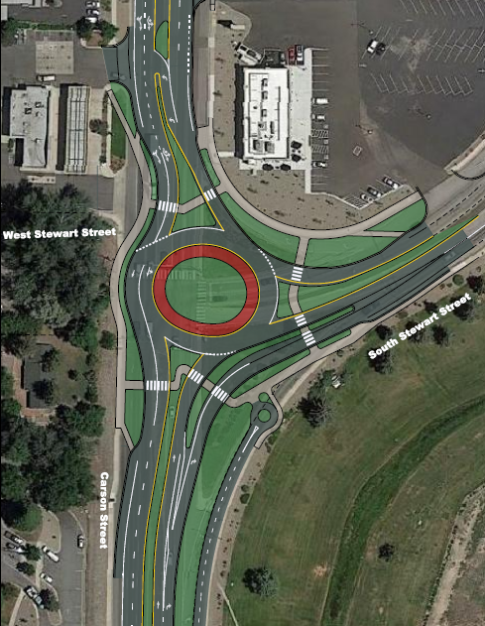
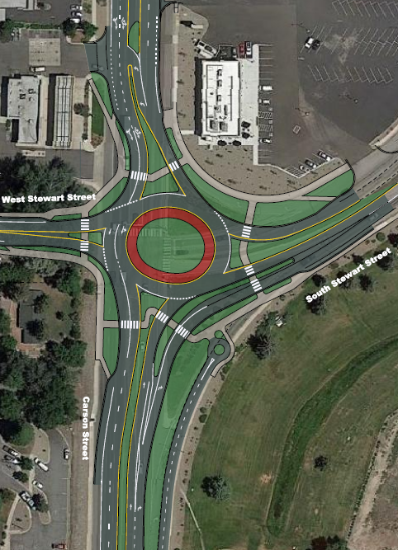
Design Exhibit- Roundabout
30% Design
(Feb. 2018)
Future Curry Connection

Slide 19
60% Design Exhibit

Slide 20
60% Design Exhibit

Slide 21
60% Design Exhibit

Slide 22
Schedule
Design milestones:
May/June 2019- 90% design
July/August 2019- Final design
Public meetings and workshops:
April 12, 2019- Project workshop at BRIC
Board and committee updates (RACC, RTC, BOS):
April 2019- 60% design update
June/July 2019- 90% design update
Construction
Start mobilizing end of 2019, construction early 2020
9 to 12 month construction duration

Slide 23

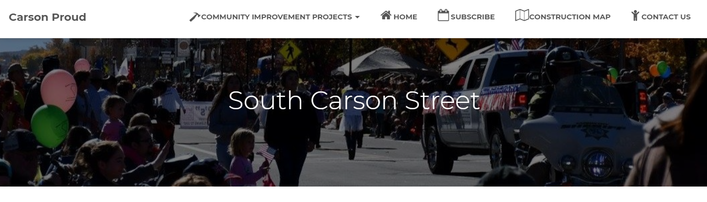
Project Communication Tools
CarsonProud.com
Text subscription service
Social media
Tom Grundy, Project Manager tgrundy@carson.org
775-283-7081

Slide 24
South Carson Complete Streets Project

