Slide 1
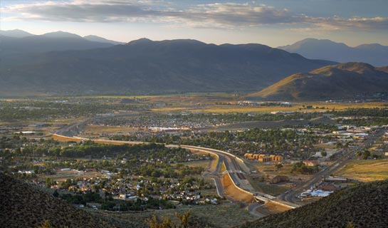
Carson City
Regional Transportation
Commission
September 11, 2019

Slide 2
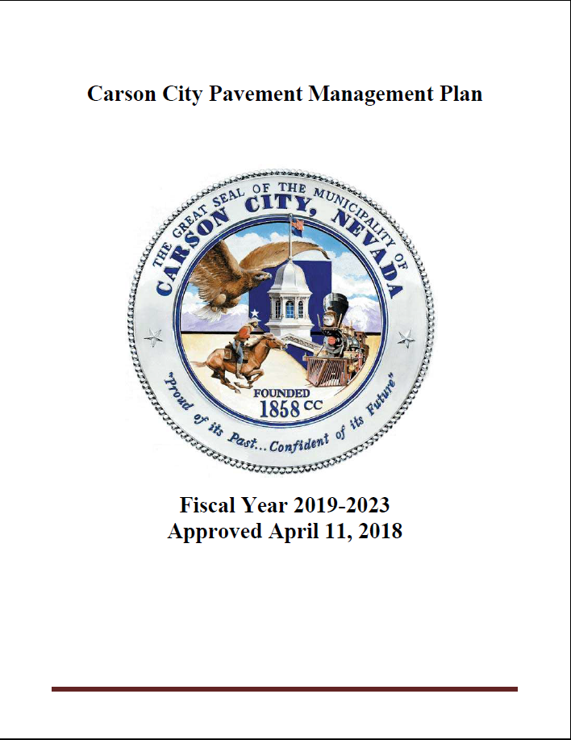
Pavement Management Plan
RTC Approved April 11, 2018
Established an efficient and effective strategy to maintain the City’s roadways
Established five performance districts
Five year rotating schedule
www.Carson.org/transportation

Slide 3
Pavement Management Plan Objectives
Predictable use of roadway funding
Improves transparency for public and decision-makers
Maintains flexibility for unplanned City projects and “match” for grant opportunities
Targets cost-saving strategies
Provides a framework for:
Tracking pavement conditions
Setting performance targets
Better understanding and justifying funding needs

Slide 4
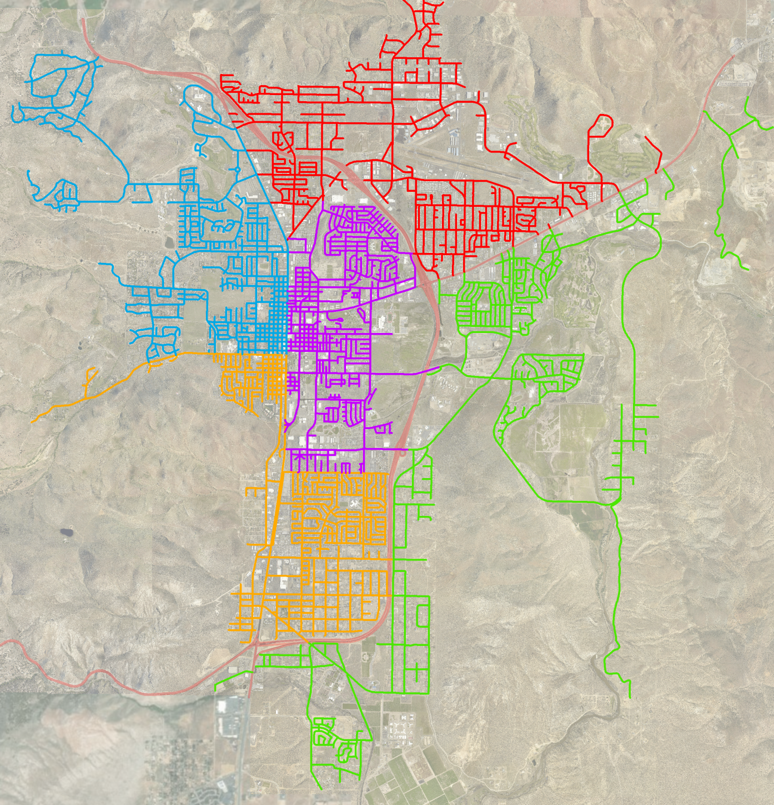

Five Performance Districts
Performance District Number | Year
1 (Red) | 2019
2 (Purple) | 2020
3 (Green) | 2021
4 (Orange) | 2022
5 (Blue) | 2023

Slide 5
Pavement Management Plan
Establishes an annual implementation schedule:
Pavement Inspections | May – June
Project Evaluation | July – August
Project Selection & Public Posting | September – October
Project Design | October – January
Advertise Project(s) for Bidding | January – February
Project Execution/Notice to Proceed | February – March
Project Construction | March – October

Slide 6
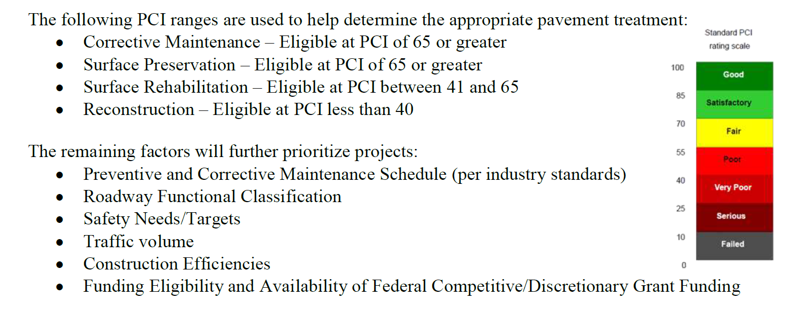
Pavement Management Plan Evaluation Criteria

Slide 7
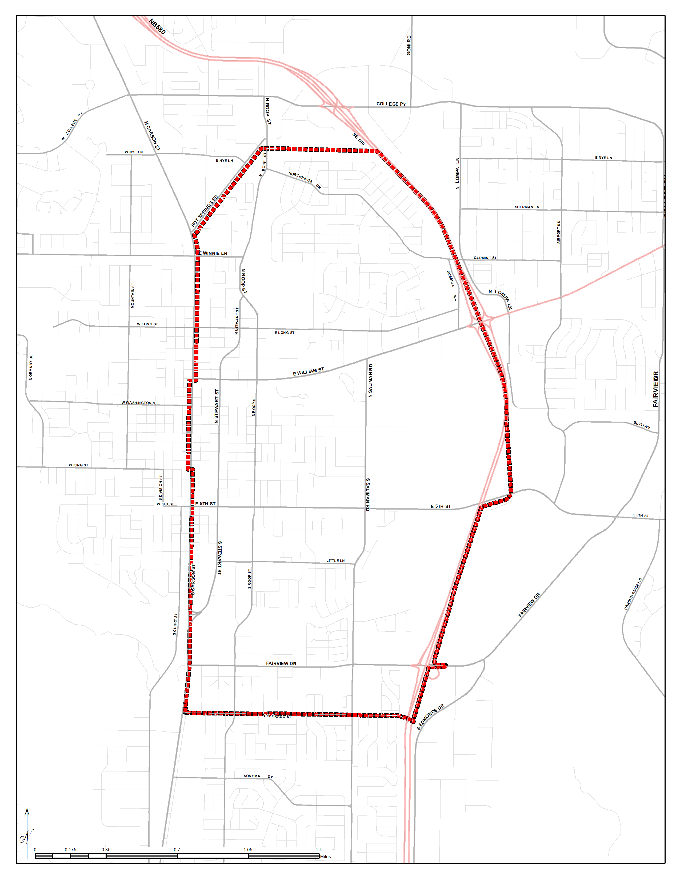
FY 2020
District 2
Hot Springs Road
District 2 | Current PCI | Target PCI
All Roads | 67 | n/a
Regional Roads | 69 | 75
Local Roads | 66 | 70
Carson Street
Colorado Street

Slide 8
Budget FY 2020
$1 million – Regional Transportation Commission (RTC), Transportation Infrastructure Fund (available funding for capital projects)
$516,550 – Surface Transportation Block Grant (STBG) funds available for fiscal year 2020 (2021, also available)
$650,000 – Virginia and Truckee (V&T) Railroad Sales Tax Plan of Expenditure
On November 1, 2018, the Carson City Board of Supervisors amended the Plan of Expenditure for the V&T Railroad Sales Tax to use excess revenue for the preservation and rehabilitation of the City’s regional roads. The plan expires July 1, 2027

Slide 9
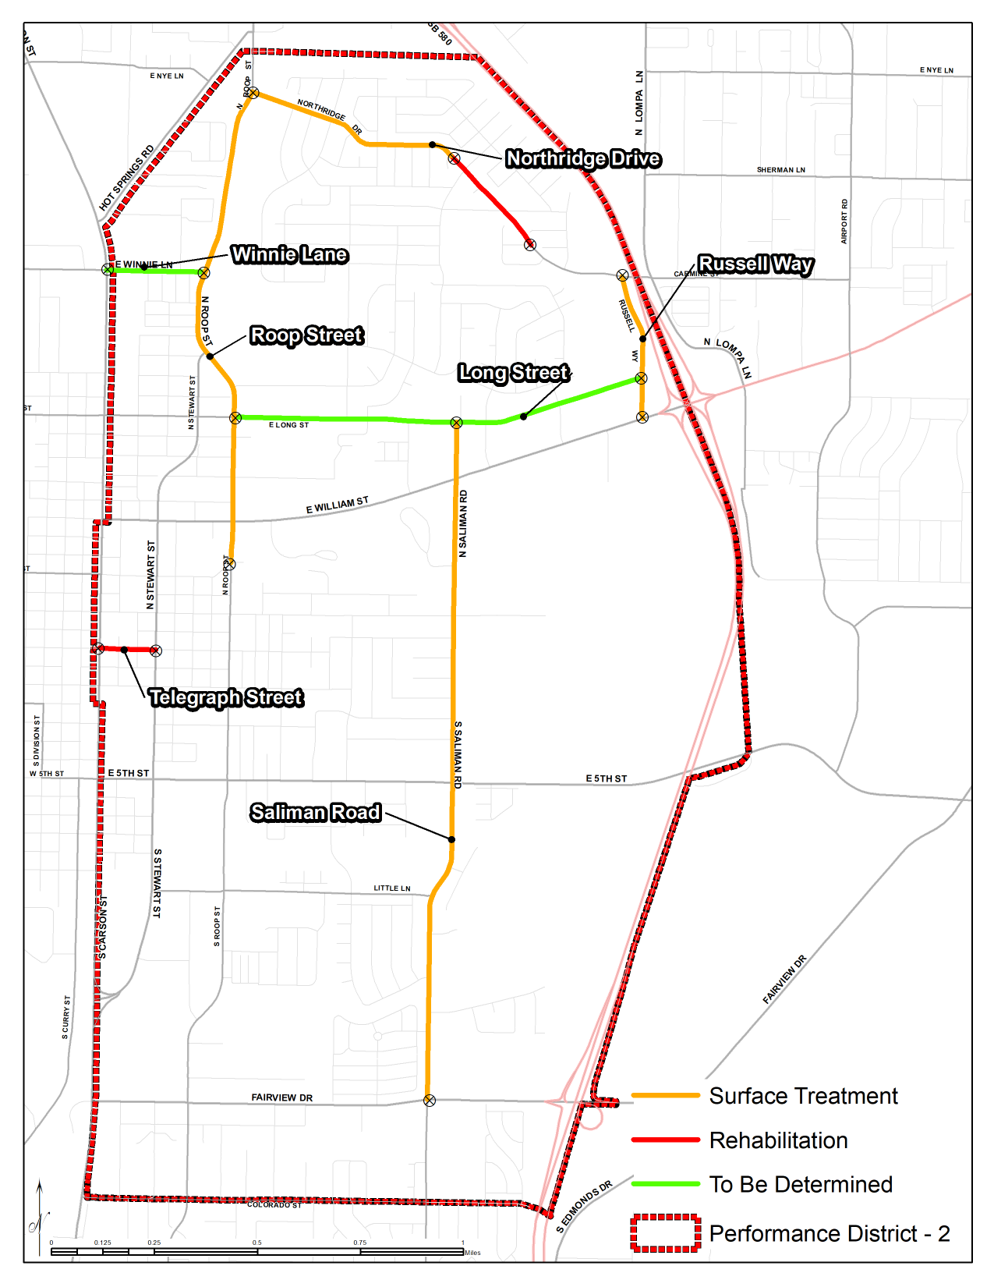
District 2
Proposed
Transportation Projects

Slide 10
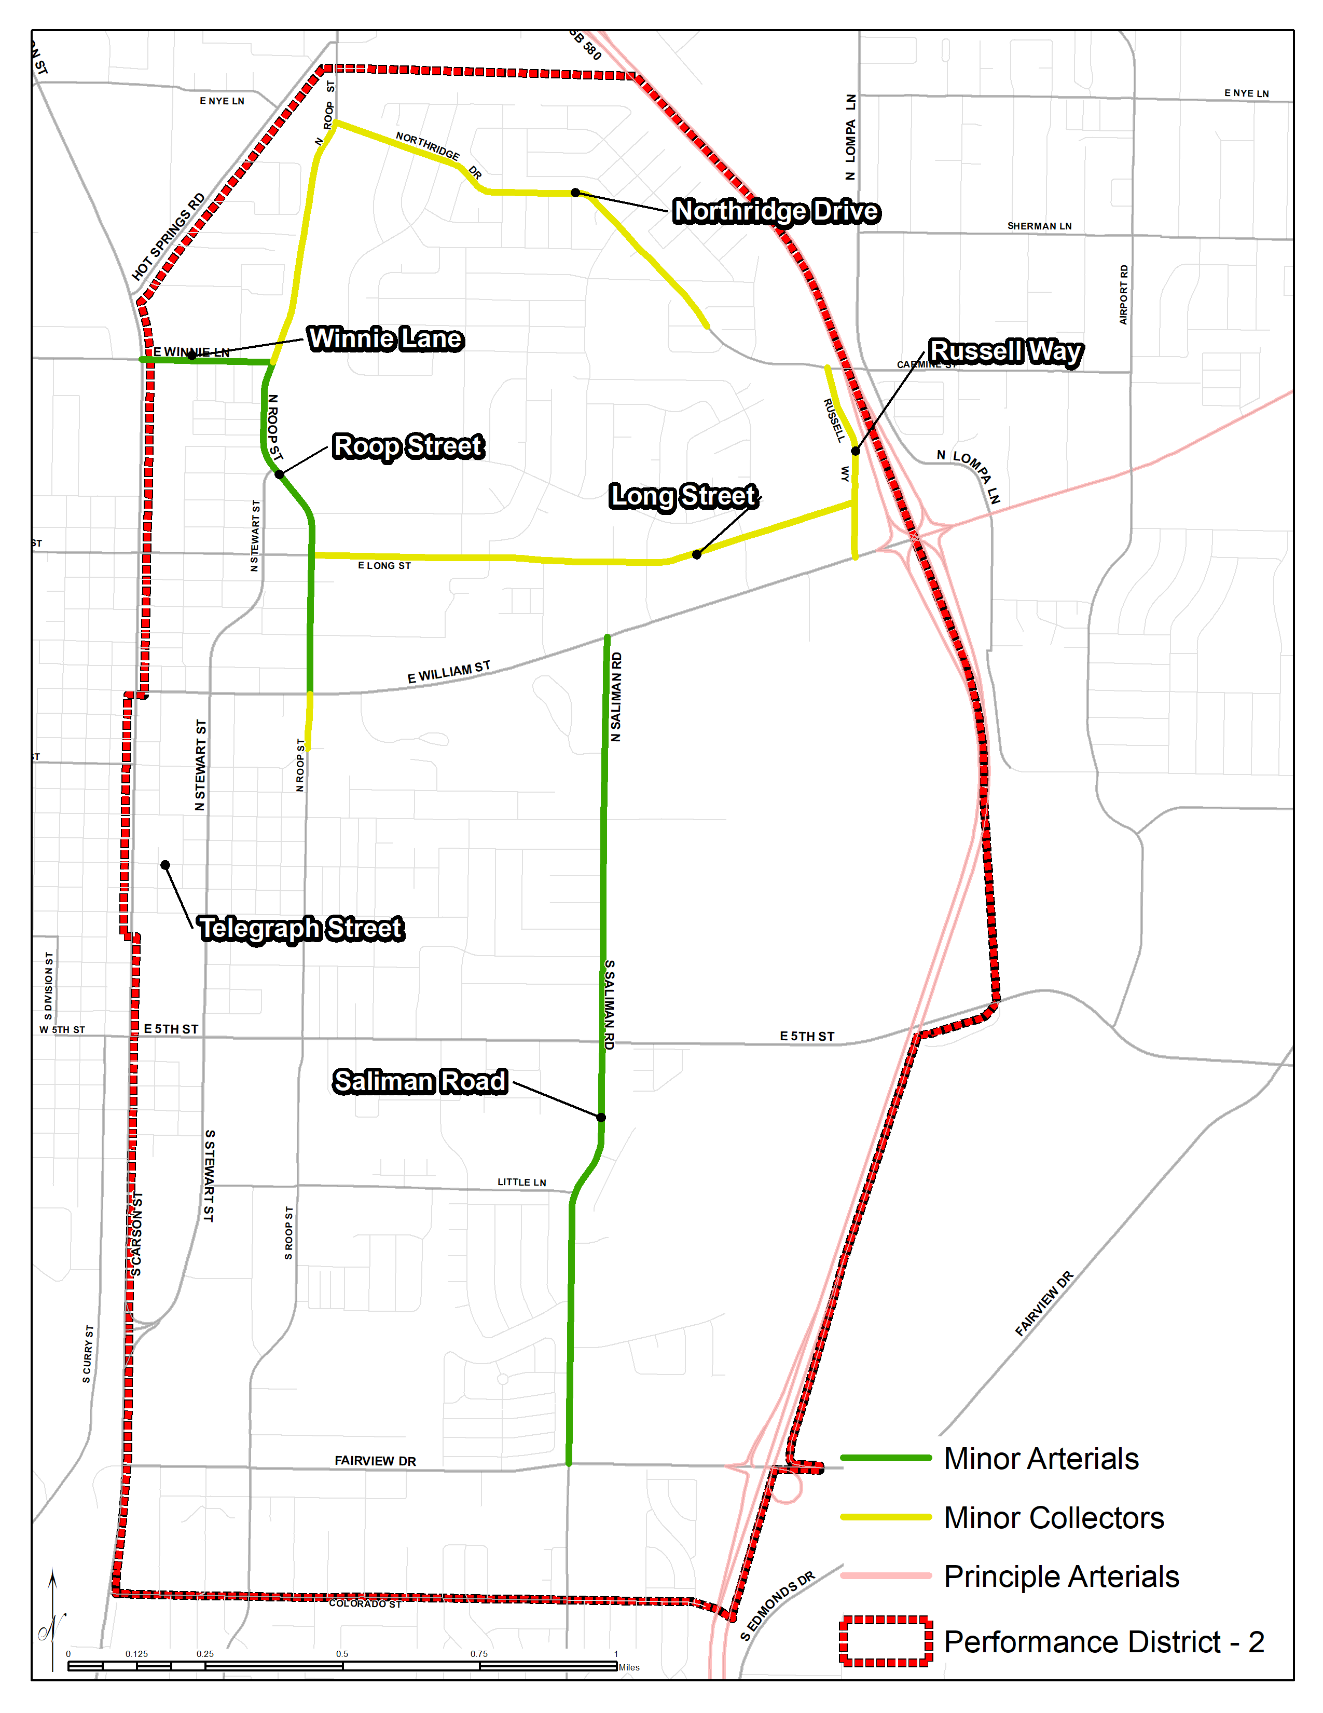
District 2
Roadway Functional Classification

Slide 11
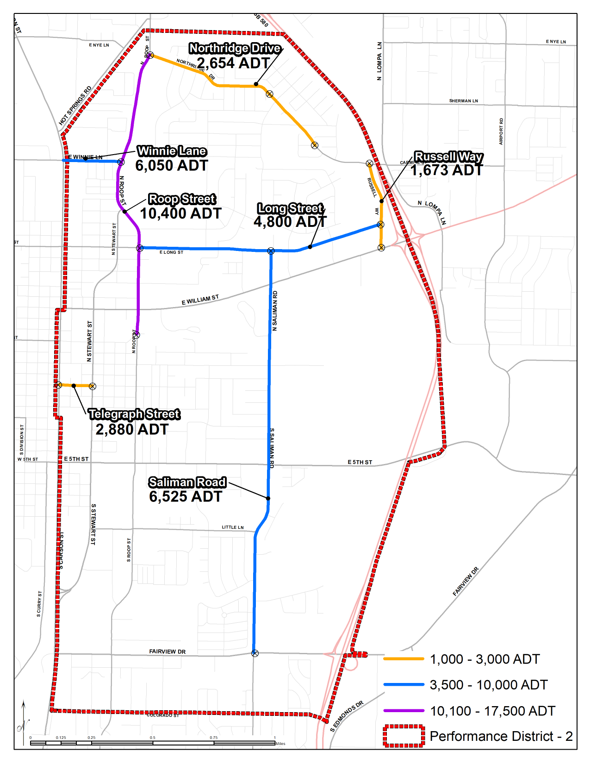
District 2
Traffic Volumes

Slide 12
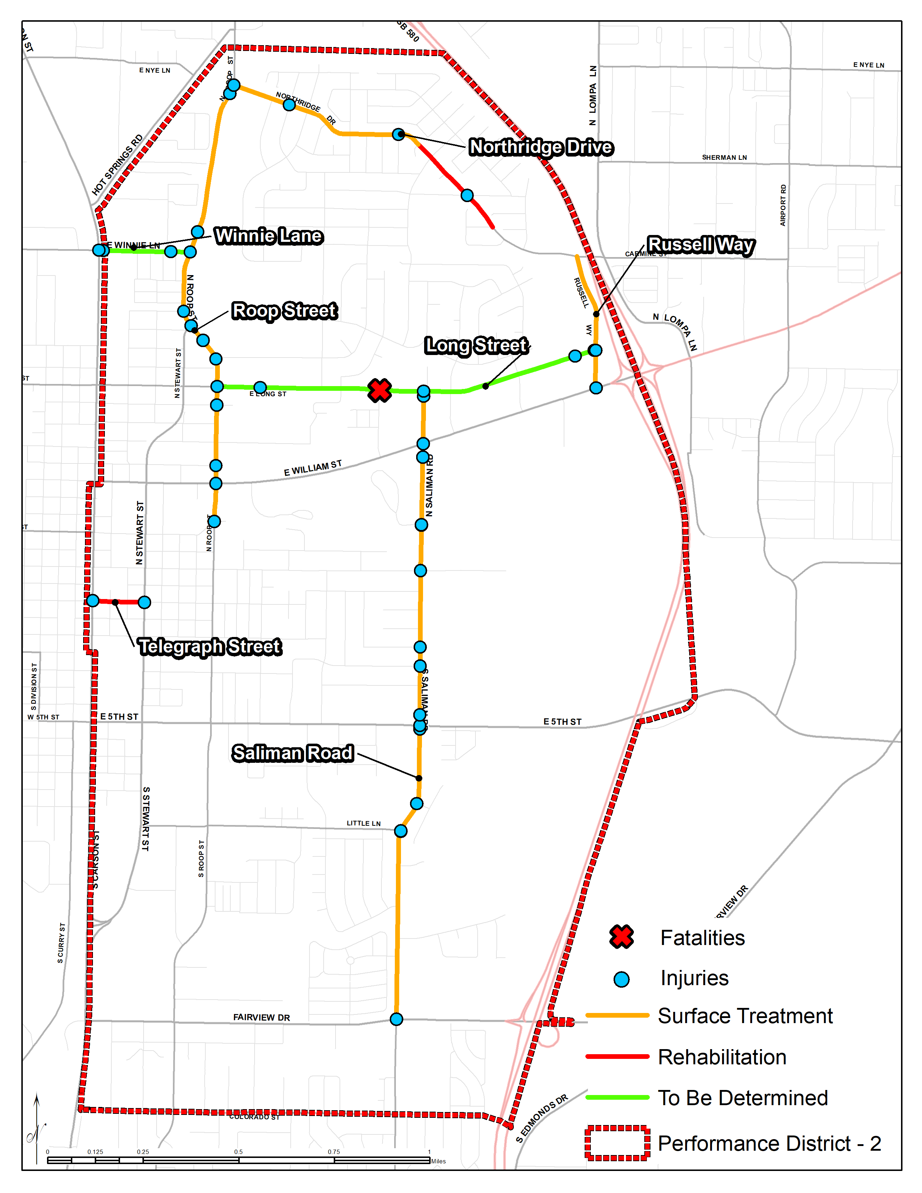
District 2
Fatalities
and
Injuries

Slide 13
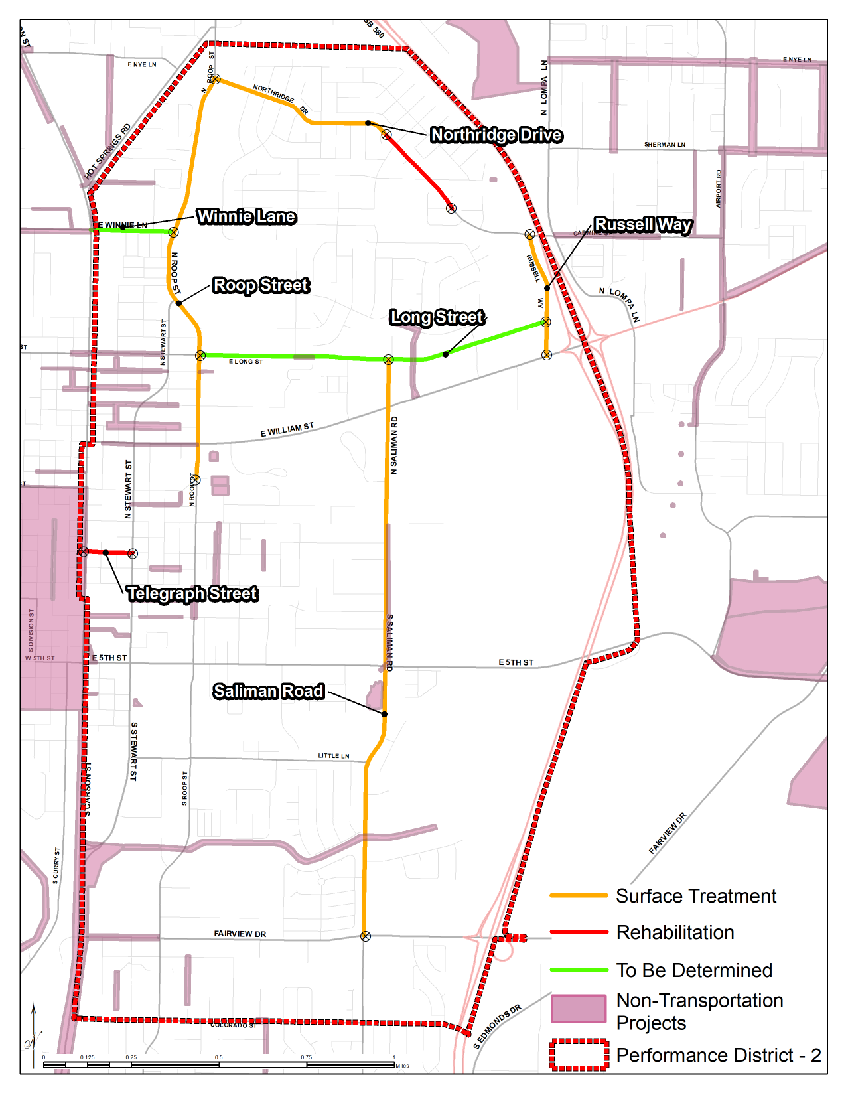
District 2
Long-Term
Public Works
Capital Improvement Projects (CIP)

Slide 14
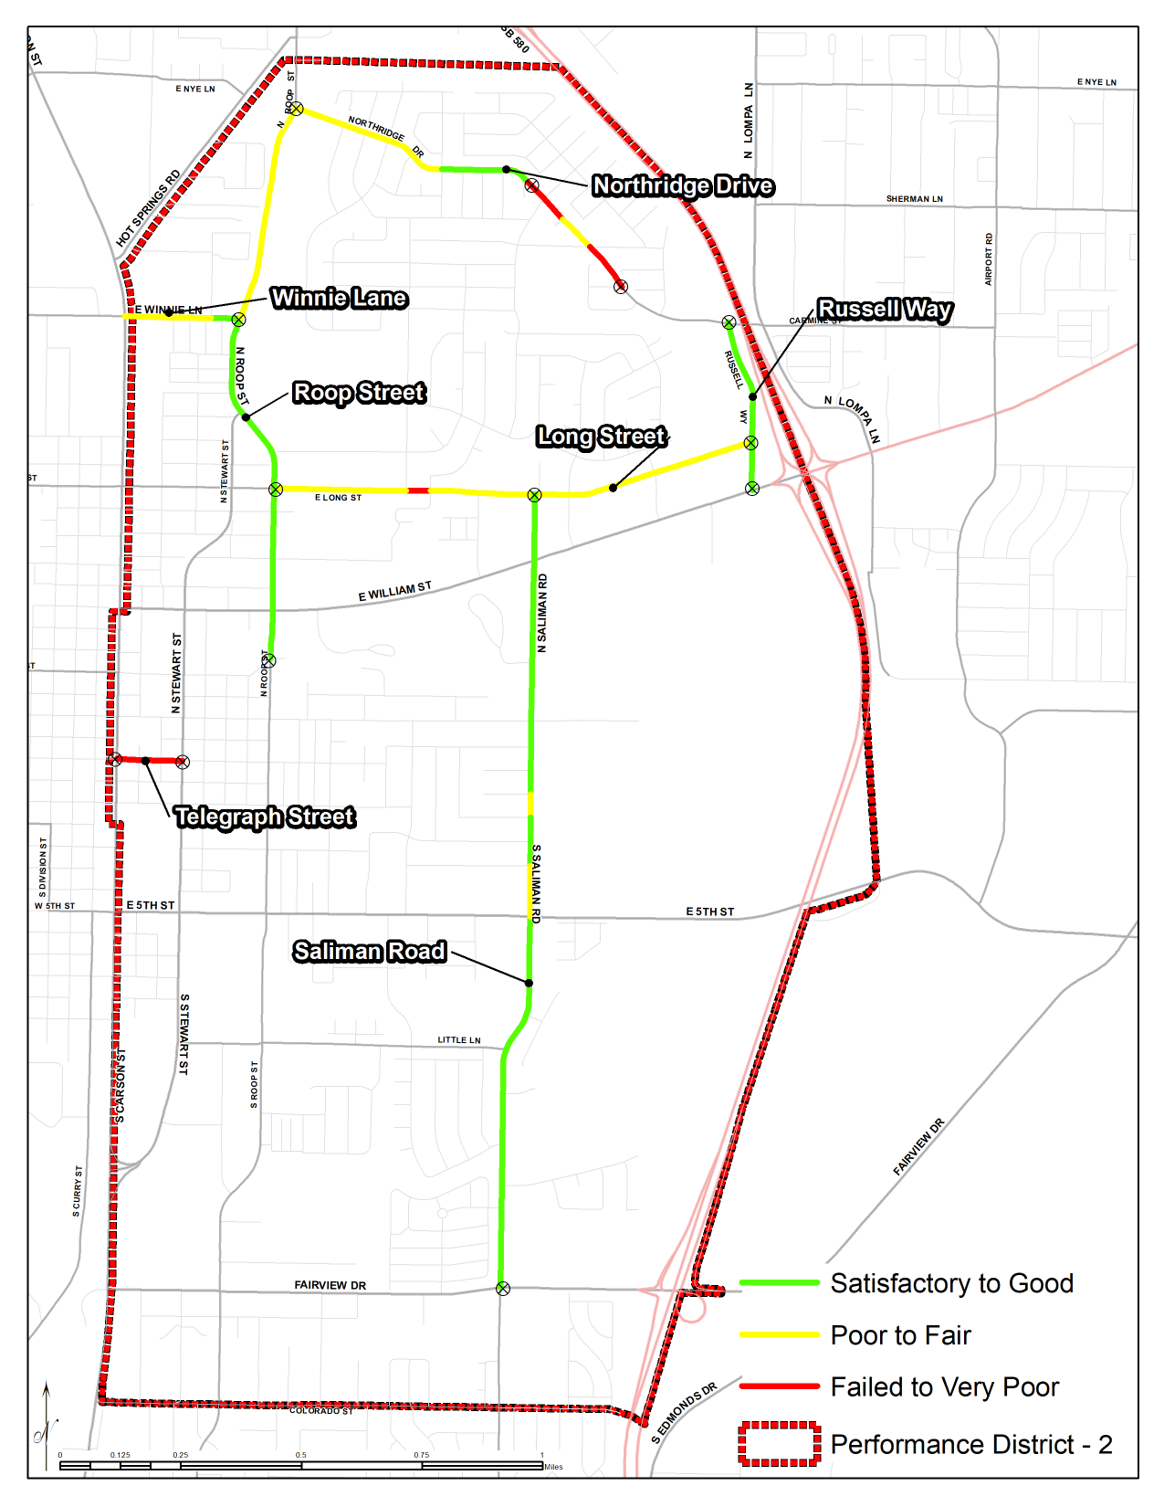
District 2
Pavement Condition
For Proposed Transportation Projects

Slide 15
District 2
Proposed
Transportation Projects

Slide 16
Fiscal Year 2020
District 2 Proposed Projects

