Slide 1




Carson City Regional Transportation Stakeholder Coalition (RTSC)
June 13, 2022

Slide 2
Agenda
JAC Fares – Reestablishment and Possible Changes – Alex Cruz
East William Complete Street Project – Kelly Norman and Marquis Williams
Project Prioritization – Bryan Byrne
Safe Routes to School Projects – Scott Bohemier
Safe Streets 4 All Grant Opportunity – Rebecca Bustos
Local Funding Initiative – Chris Martinovich
Open discussion – All

Slide 3
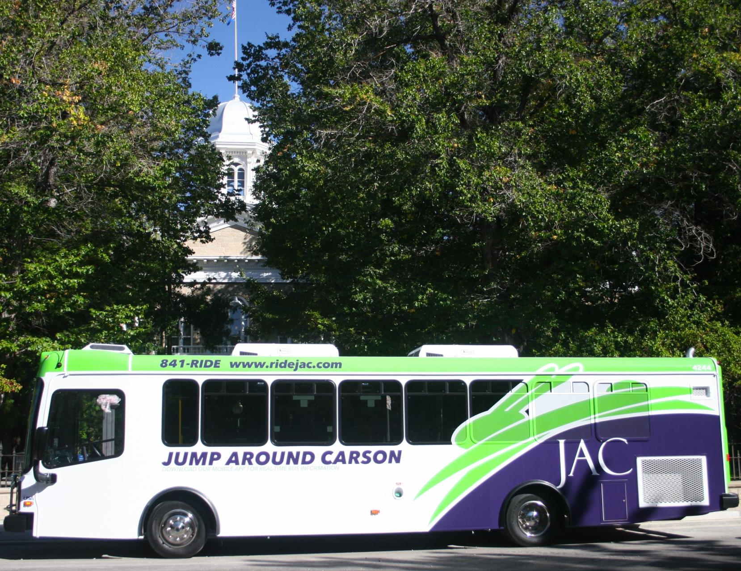
Jump Around Carson (jac)
Deployment of a new Contactless Payment system and Application
Free WiFi on each bus
Delivery of five new JAC buses – coming soon.
Other Future upgrades including
  New Downtown Transit Center
  Bus Stop shelter lighting
  Possible route changes to serve more areas

Slide 4
JAC – Possible Fare Changes
JAC Fixed Route | Current Fare | New Fares
Standard Adult One-Way | $1.00 | $1.50
Reduced Senior/ Military/Youth/Disabled One-Way | $0.50 | $0.75
Monthly Pass Standard | $25.00 | $40.00
Monthly Pass Reduced | $12.50 | $20.00
10-Ride Pass Standard | $8.00 | Removed
10 Ride Pass Reduced | $4.00 | Removed
Children Under 4 & Transfers | Free | Free
JAC Assist
One-Way Trip within ¾ mile of fixed route | $2.00 | $3.00
One-Way Trip between ¾ and 1 mile of fixed route | $4.00 | $6.00
JAC Assist Monthly | NA | $60.00
Personal Care Attendants | Free | Free
Notes: JAC is currently operating fare free.
Fare capping options are available when using the contactless payment system.

Slide 5
Ways to Comment
Comment Period through June 24, 2022
Attend the July 13 RTC Meeting
Complete a comment card and mail / email it
  Carson City Public Works
  Attn: Transportation Manager
  3505 Butti Way
  Carson City, Nevada 89701
Send an email to comments@carsonareampo.com
Call us! 775-887-2355
Visit the Website: carsonareampo.com or rideJAC.com

Slide 6

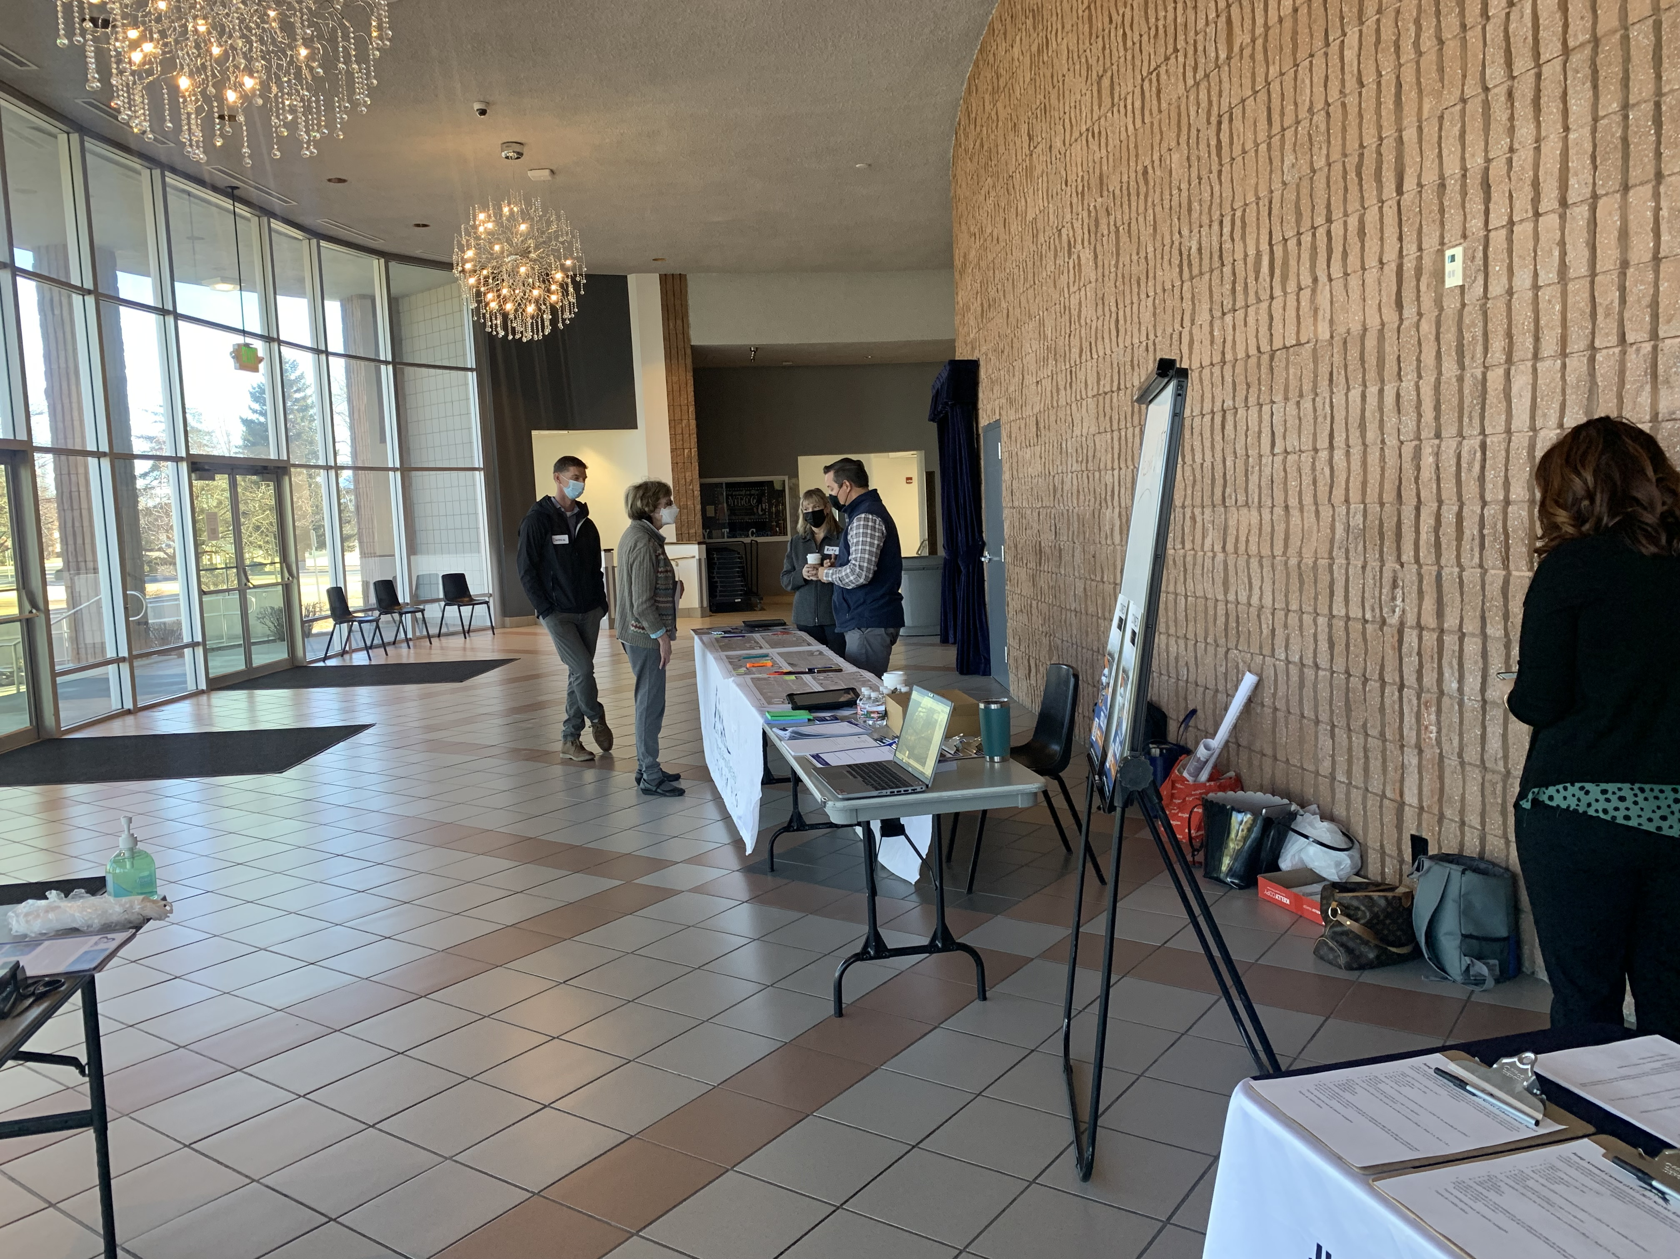
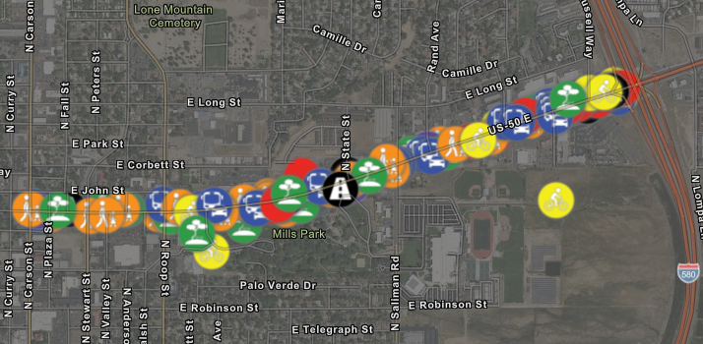
East William Complete Street Project
Complete streets treatment along East William Street between North Carson Street and I-580, approx. 1.5 miles.
Awarded $9.3 million of Rebuilding American Infrastructure with Sustainability and Equity (RAISE) Grant funds.
Outreach efforts include:
  Corridor walk to inform business owners of upcoming project.
  Two in-person community meetings.
  Survey and interactive comment map on CarsonProud.com.
  Partnership with Carson High School to design a project logo.
Next Steps:
  Initial comment period closes February 28th.
  Public comments will be incorporated into 15% design along with environmental and traffic impact studies.

Slide 7
Project Prioritization
District projects
ARPA Projects
Data Driven process and data we use to help inform the decision

Slide 8
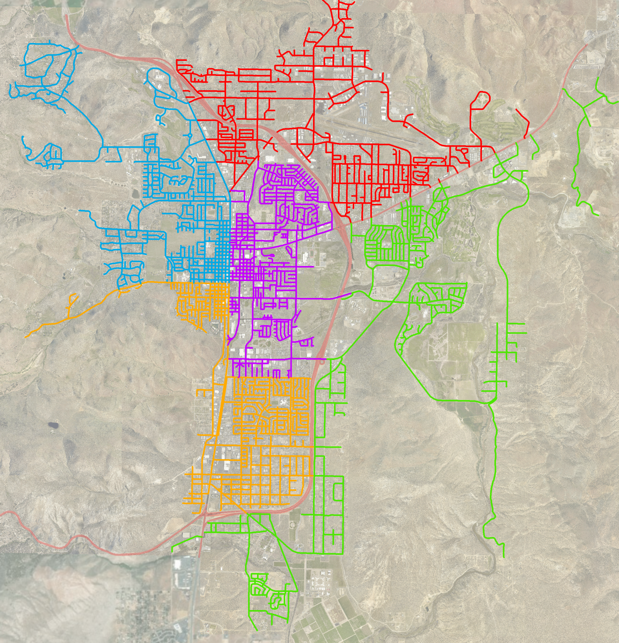

Performance Districts
Performance District Number | Year
1 (Red) | 2019
2 (Purple) | 2020
3 (Green) | 2021
4 (Orange) | 2022
5 (Blue) | 2023

Slide 9
Safe Routes to School Update
Recent Events
Douglas Co Plan
Champions

Slide 10
Safe Streets 4 All – New IIJA Grant Opportunity
Highlights of the grant
  Match, minimum amount, eligible uses, schedule, etc
City/Campo possible projects – describe or picture
Submittal deadline

Slide 11
Local Roadway Funding Update
This project is an education campaign designed to educate Carson City residents about current roadway conditions, preservation solutions, funding sources and what will happen if an investment is not made to preserve Carson City roads.
Development of a website and informational videos about Carson City Roads and the transportation system as a whole.

Slide 12
Local Funding
RTC and BOS approved investigation of 4 possible funding mechanisms
  NRS 318 (General Improvement District- GID)
  NRS 271 (Program of Local Improvements)
  NRS 377B (V&T Infrastructure Sales Tax)
  NRS 377A (Transportation Sales Tax)
Working with a consultant to evaluate the options for these mechanisms and how they can be combined or staked and how existing funding sources can be utilized differently in a more efficient manner.

Slide 13
Future meetings
Open discussion
Next meeting planned for Fall, 2022

Slide 14
Thank you!
Transportation division
Chris Martinovich, PE | transportation manager
775.283.7367
cmartinovich@carson.org

