Slide 1
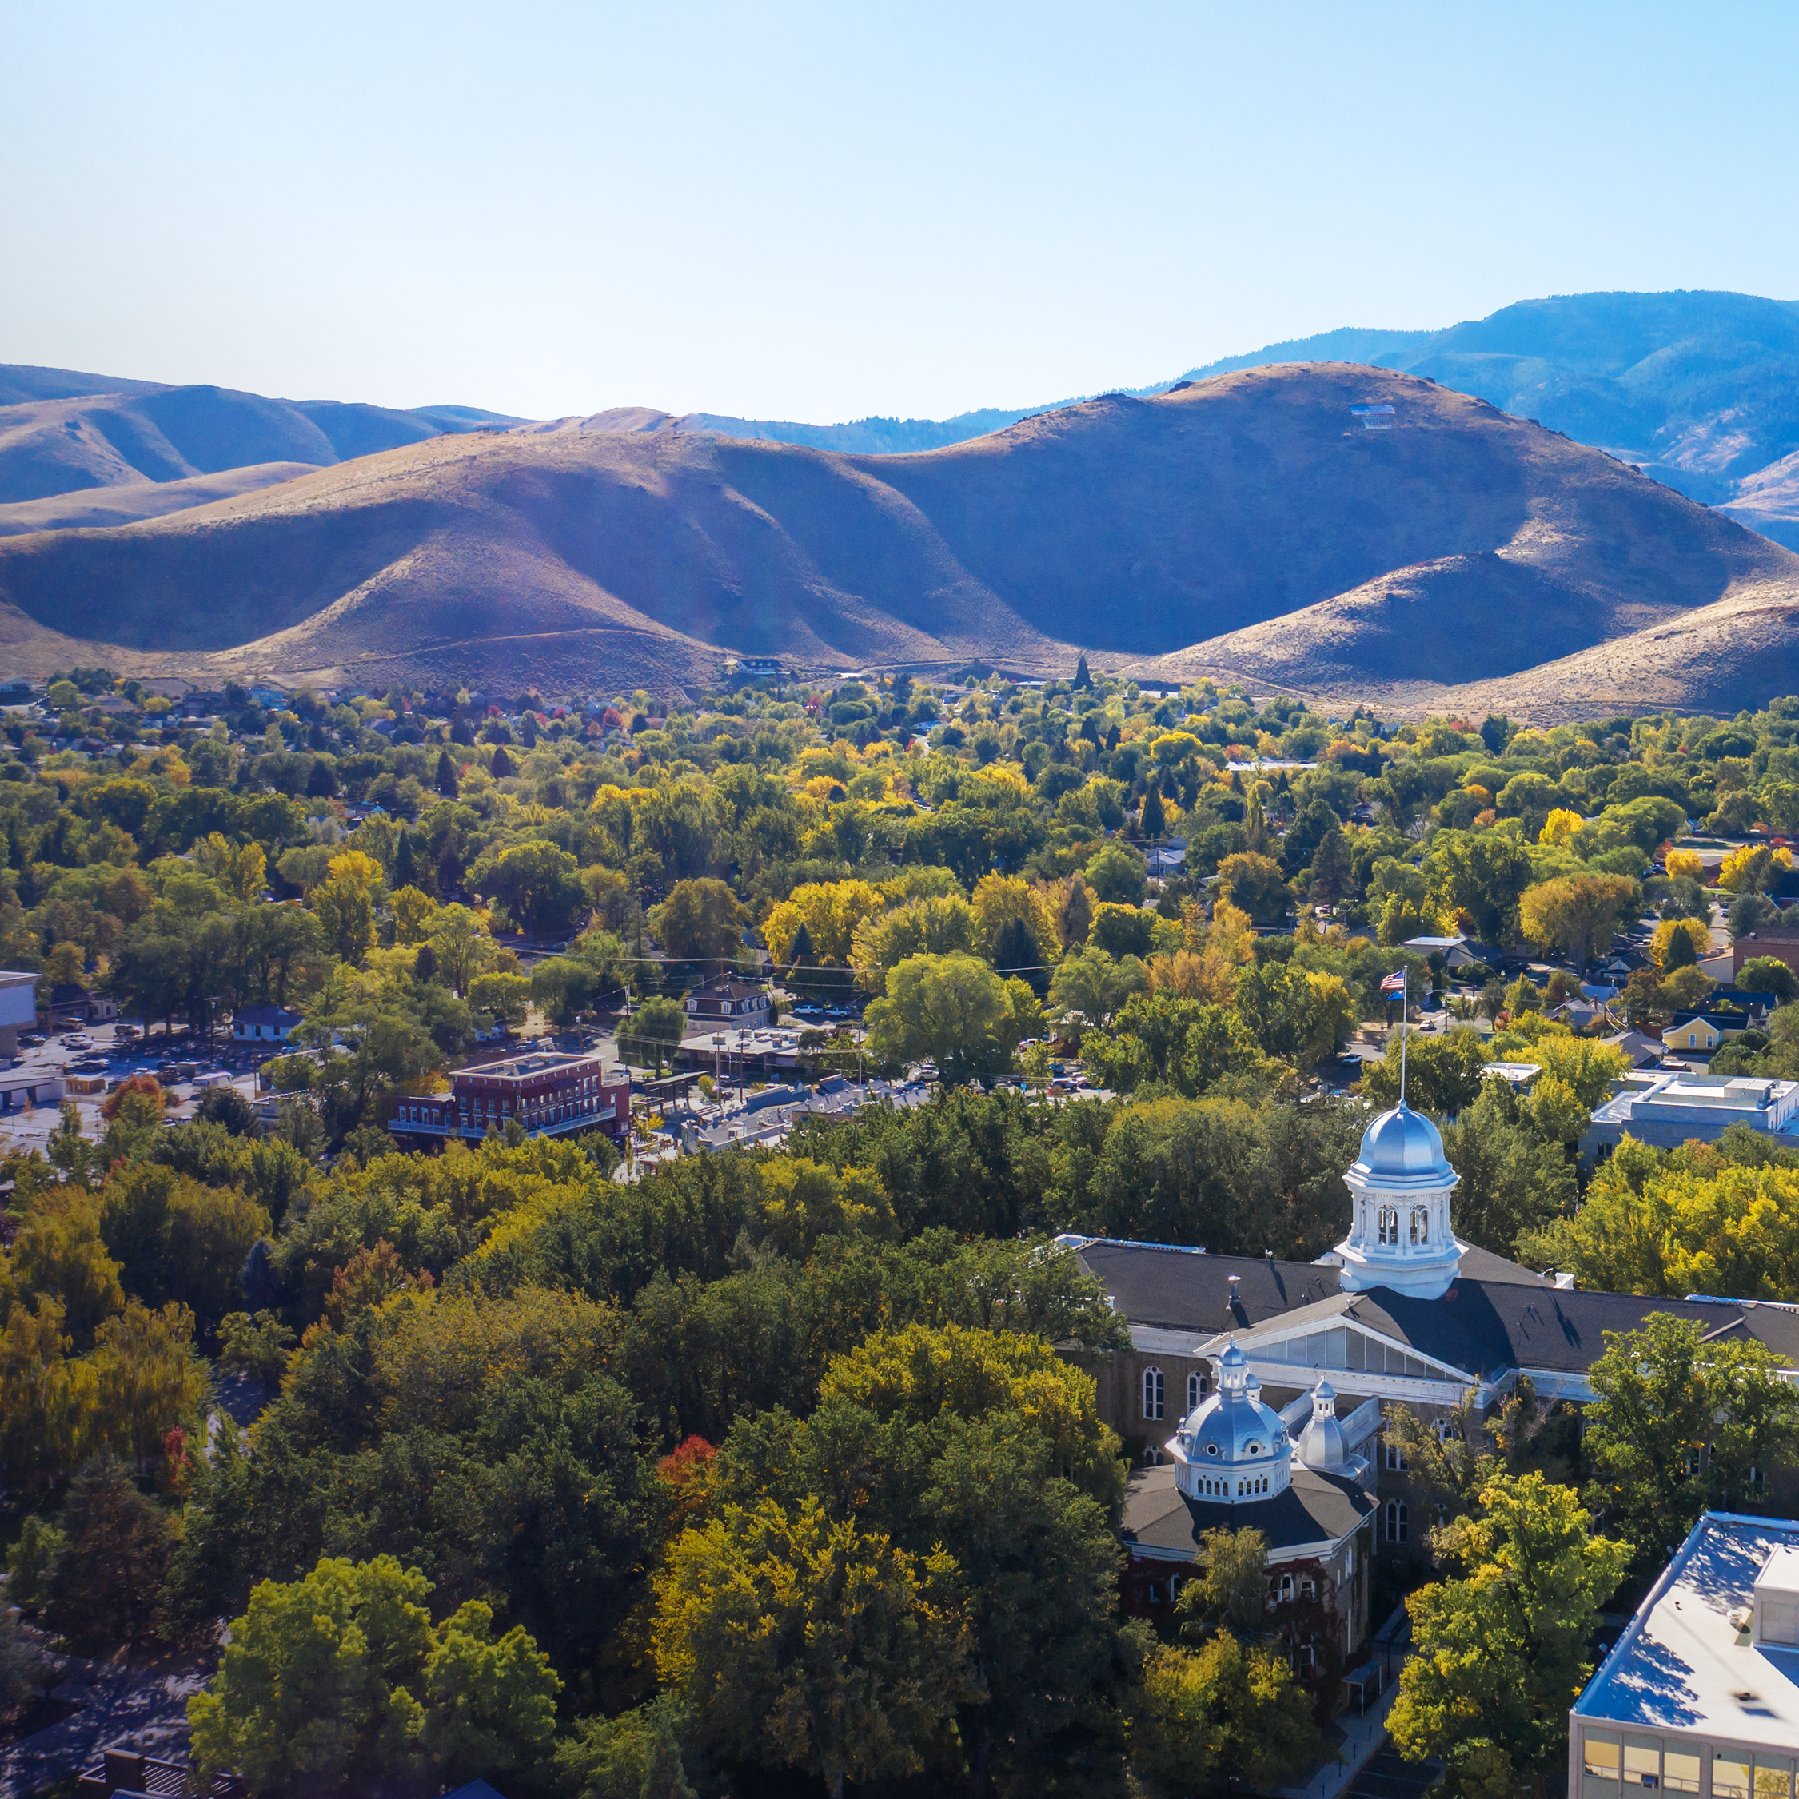
CAMPO 2050 RTP
November 17, 18, 20, 2025
Carson City, Lyon County, Douglas County, Nevada

Slide 2
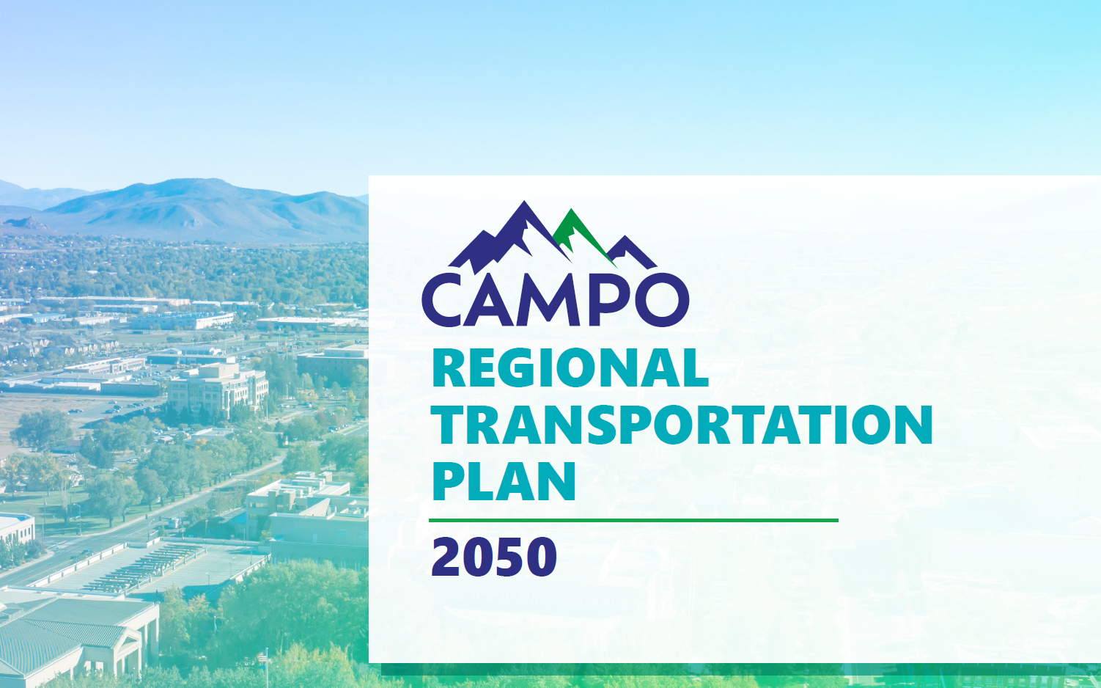

Slide 3
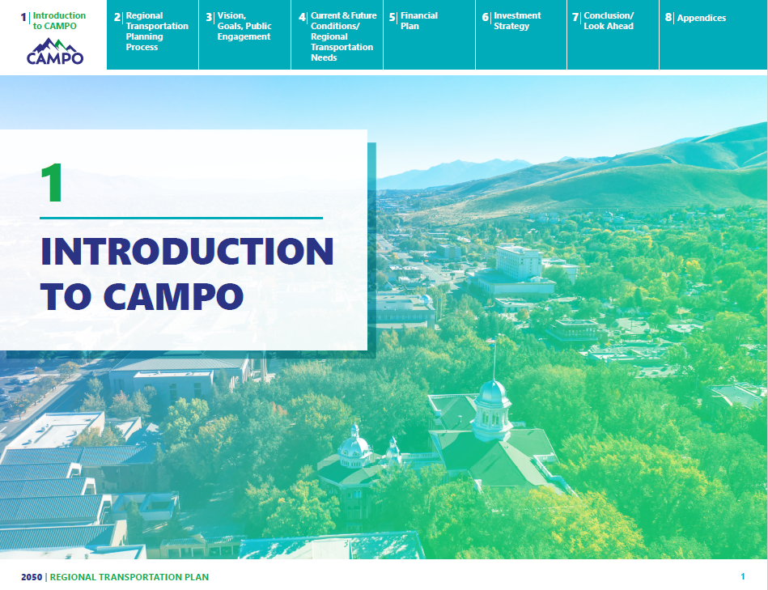

Slide 4
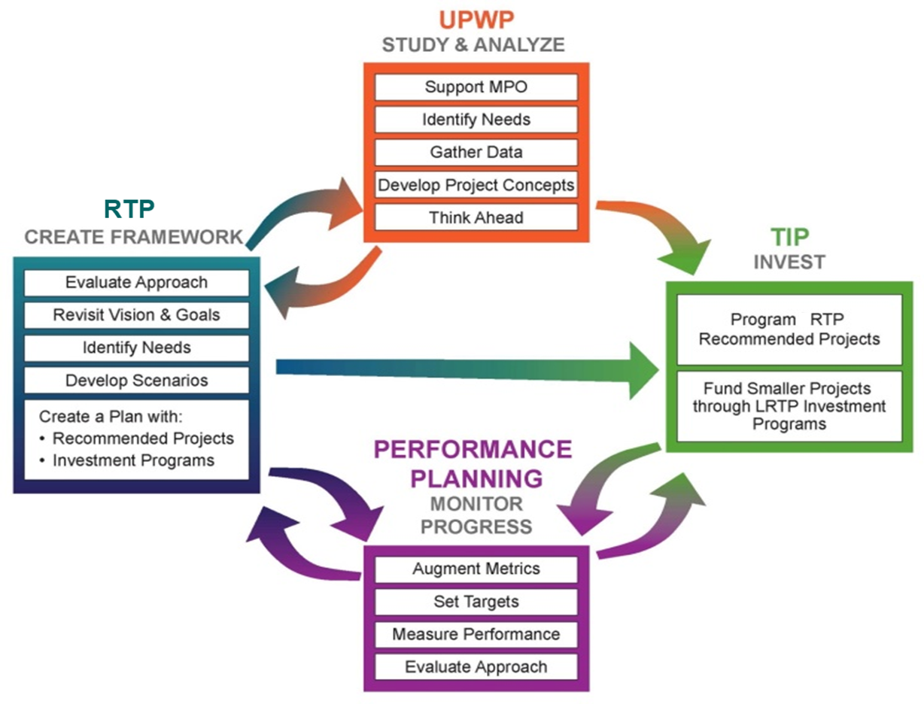
1: Introduction to CAMPO
The CAMPO 2050 RTP is a 20+ year transportation planning document.
This plan and its’ contents influence how transportation planners spend our time (UPWP) what & when projects move forward (TIP) and how we let the public know about it (PPP)

Slide 5
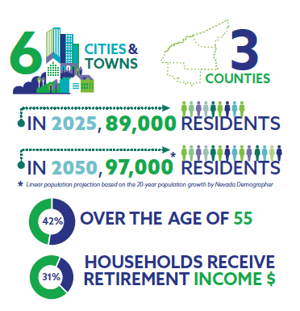
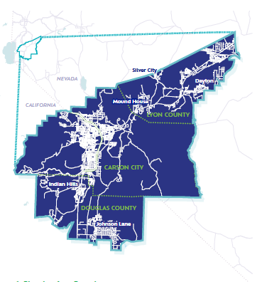
1: Introduction to CAMPO

Slide 6
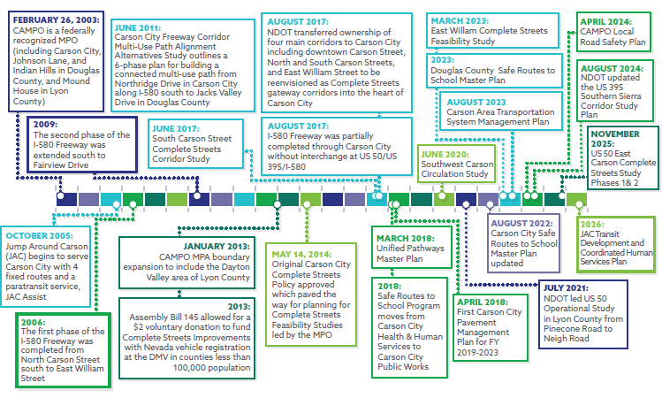
1: Introduction to CAMPO

Slide 7
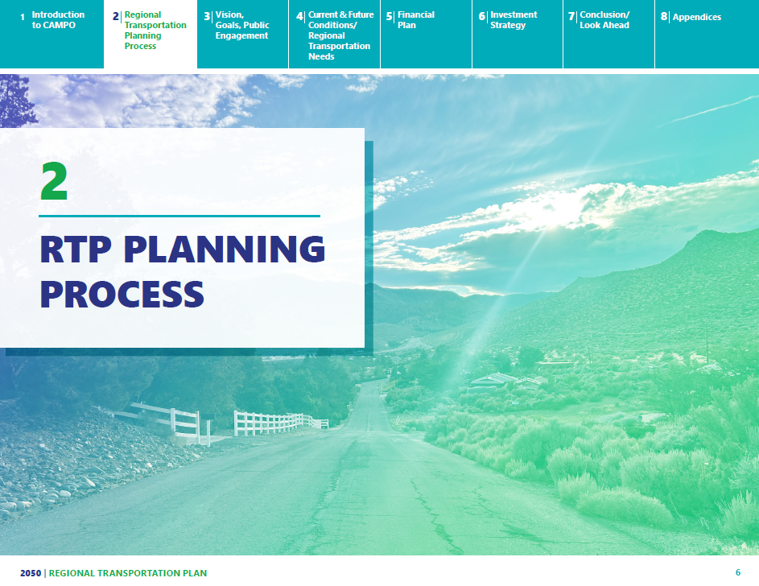

Slide 8
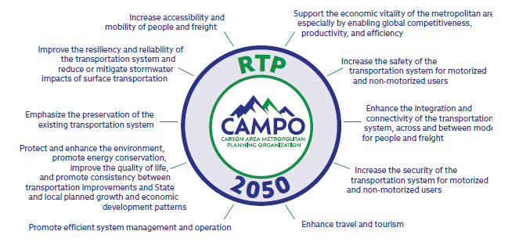
2: RTP Planning Process
23CFR 450.306(b)
23 USC § 134
49 USC § 5303

Slide 9
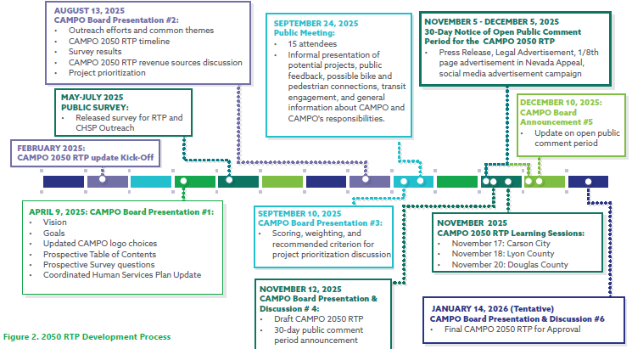
2: RTP Planning Process

Slide 10
2: RTP Planning Process
Federal law requires MPOs to establish goals, targets, and performance measures.
Safety; number and rate of fatalities & serious injuries
Pavement; % of interstate and non-interstate pavement in good or poor condition; PCI
Bridges; % Bridge deck area in good or poor condition
System Reliability, Freight Movement; interstate, non-interstate, freight travel time reliability
CAMPO Supports Nevada state targets. More in Appendix B!

Slide 11
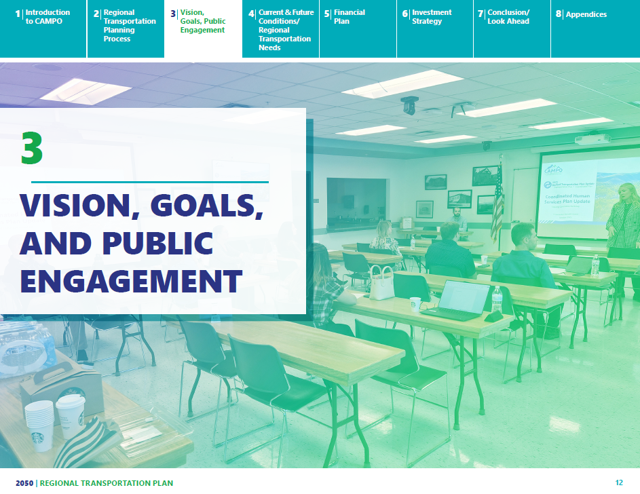

Slide 12
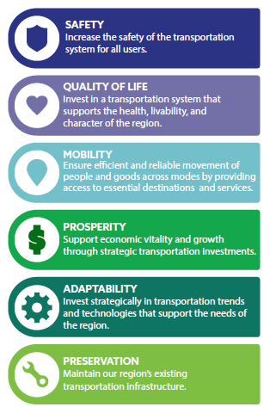
3: Vision, Goals, and Public Engagement
Goals
Vision
CAMPO strives to develop and maintain a transportation system that provides balanced, safe, reliable, and convenient transportation options for all members of our community.
More in Appendix C!

Slide 13
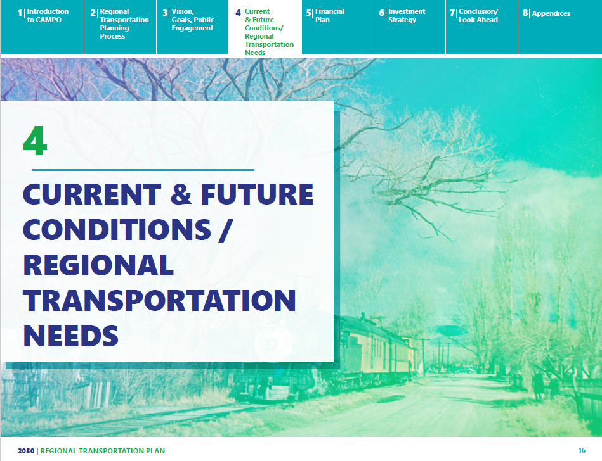

Slide 14
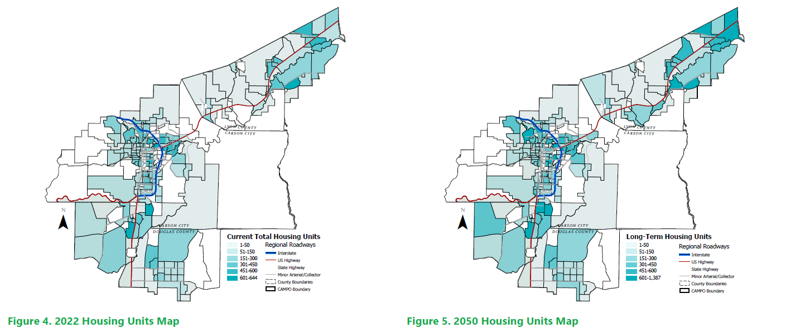
4: Current & Future Conditions/ Regional Transportation Needs

Slide 15
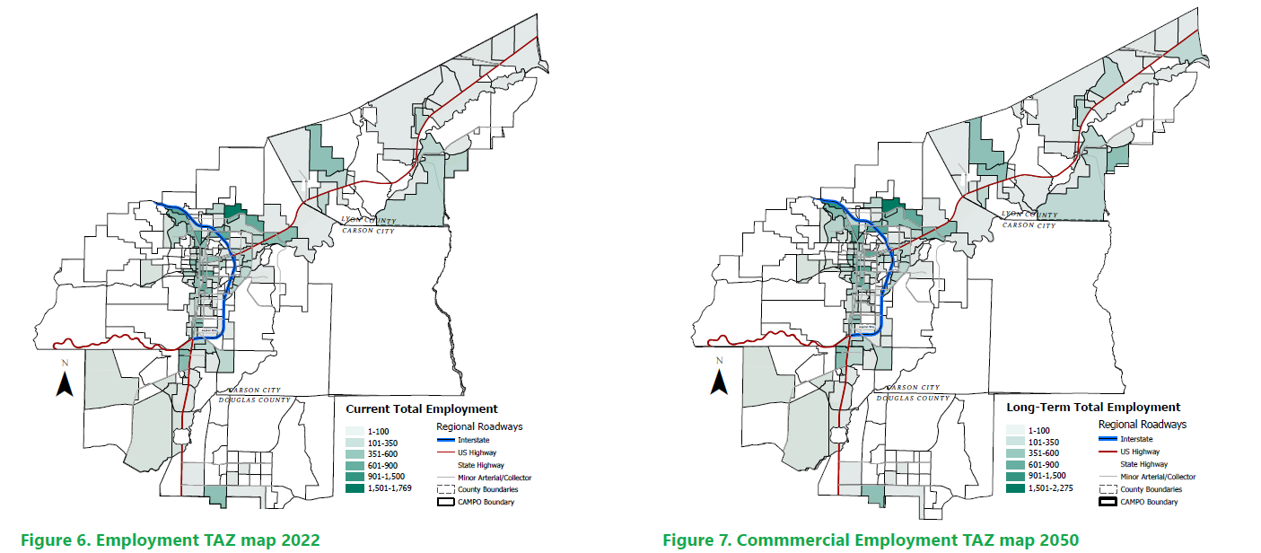
4: Current & Future Conditions/ Regional Transportation Needs

Slide 16
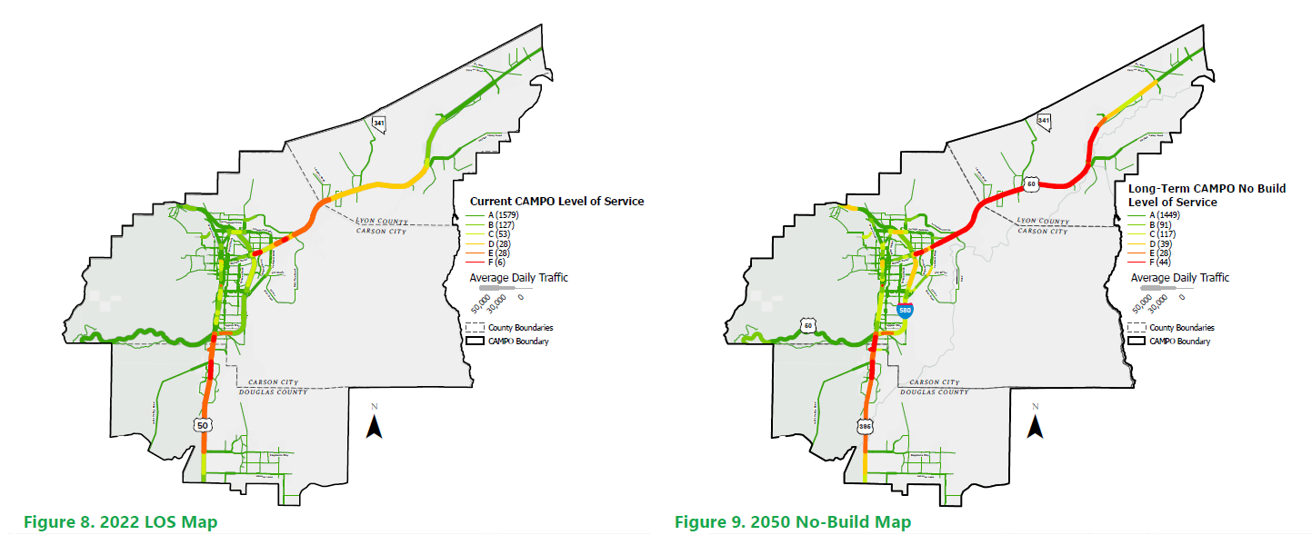
4: Current & Future Conditions/ Regional Transportation Needs

Slide 17
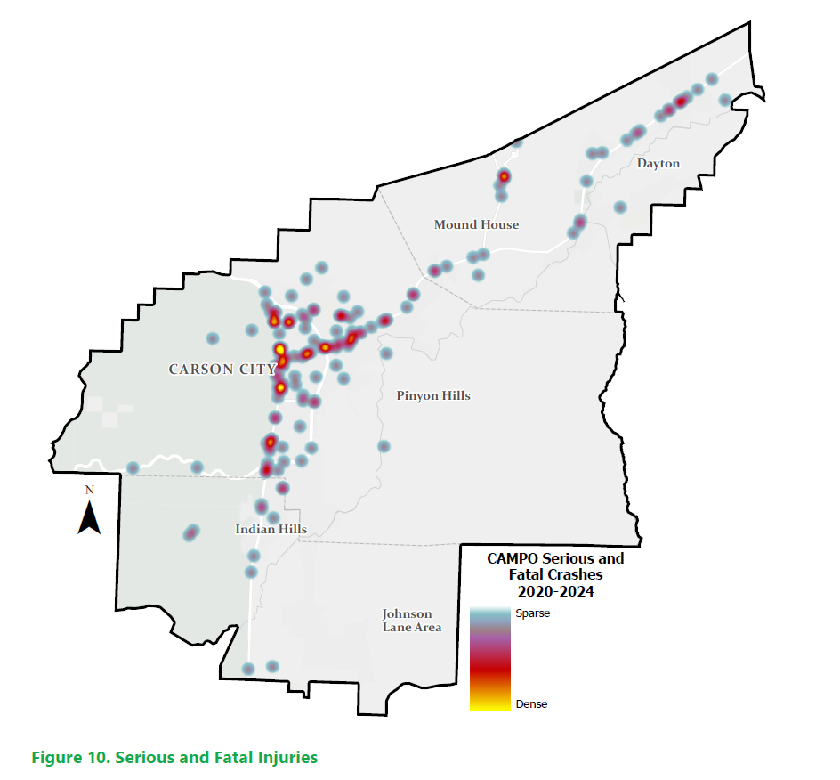
4: Current & Future Conditions/ Regional Transportation Needs
ADA
Transit
Safety
Complete Streets, SRTS

Slide 18
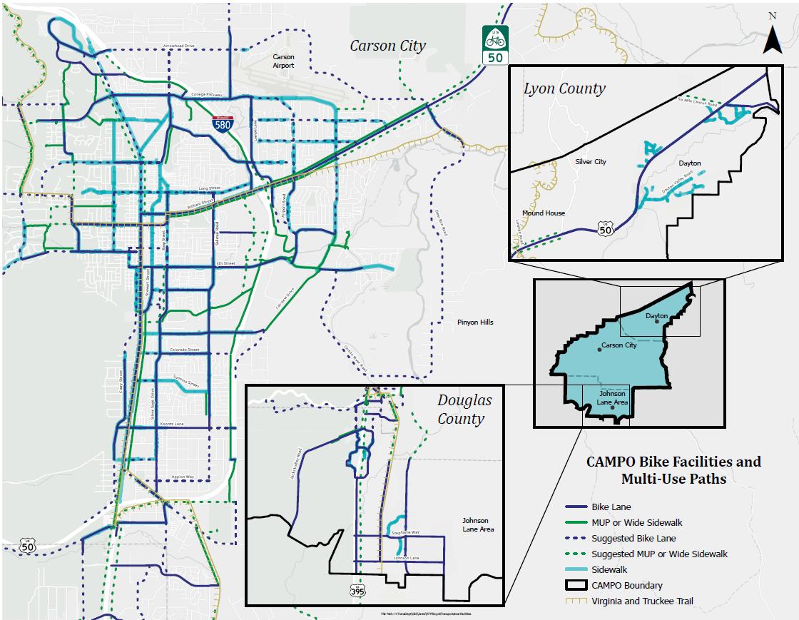
4: Current & Future Conditions/ Regional Transportation Needs

Slide 19
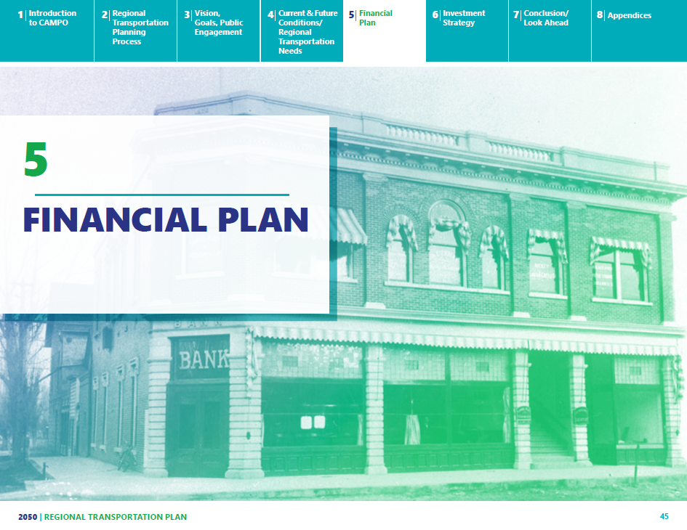

Slide 20
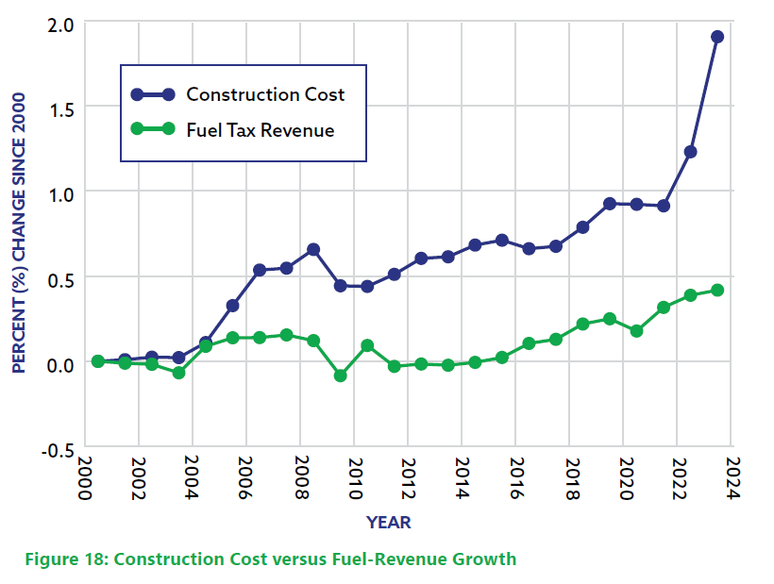
5: Financial Plan
The financial plan must:
• Demonstrate how the RTP can be implemented/funded.
• Identify resources from public and private sources that are
reasonably expected to be made available to carry out the
plan.
• Recommend any additional financing strategies for needed projects and programs.

Slide 21
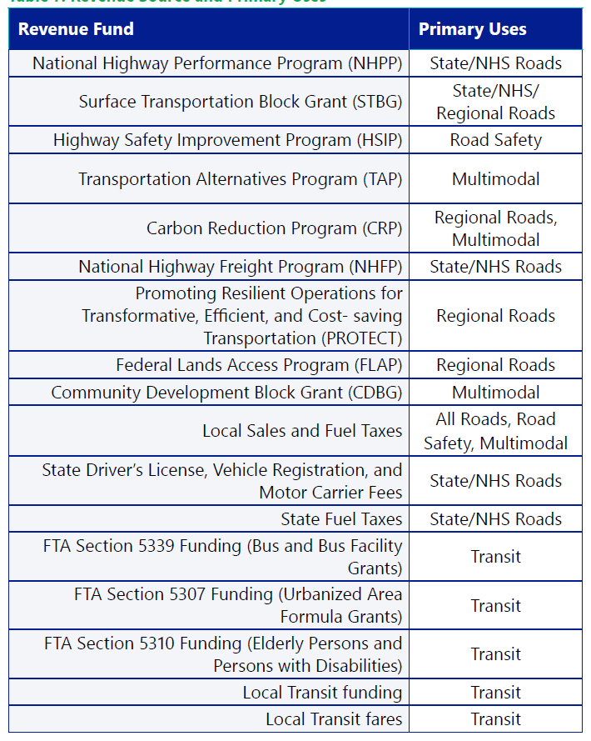
5: Financial Plan
Revenue for transportation projects comes from a variety of sources, and funding levels are subject to change over time. CAMPO is using the best available data as part of the RTP.

Slide 22
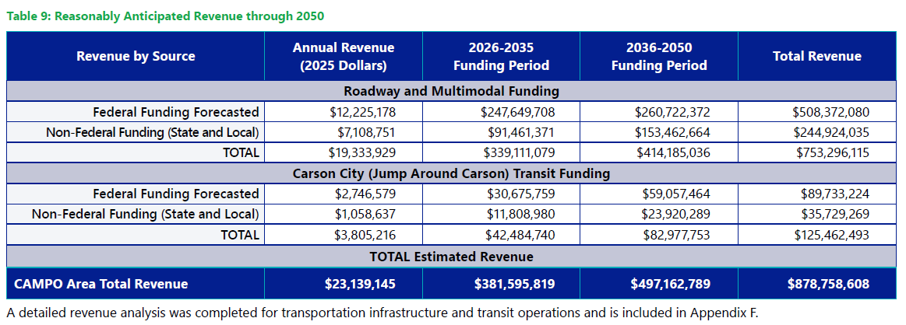
5: Financial Plan

Slide 23
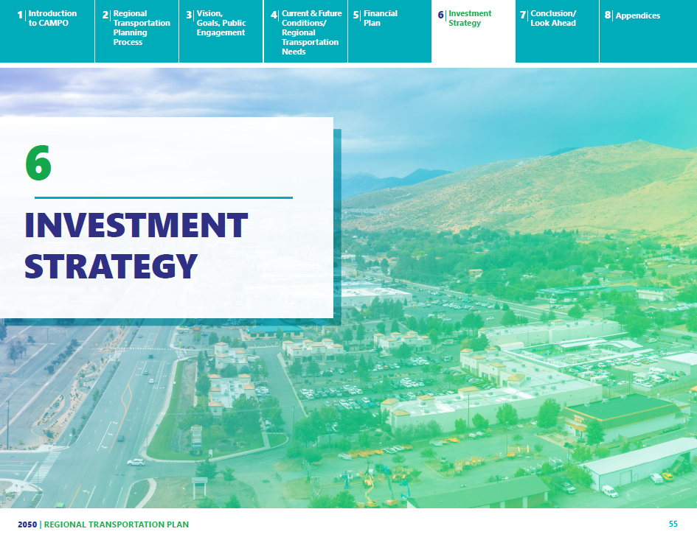

Slide 24
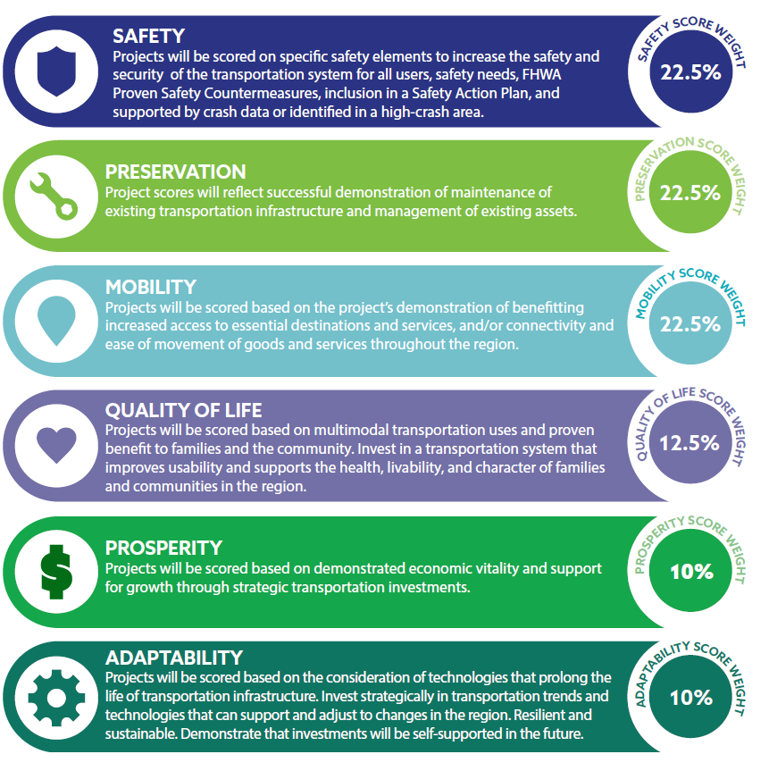
6: Investment Strategy

Slide 25
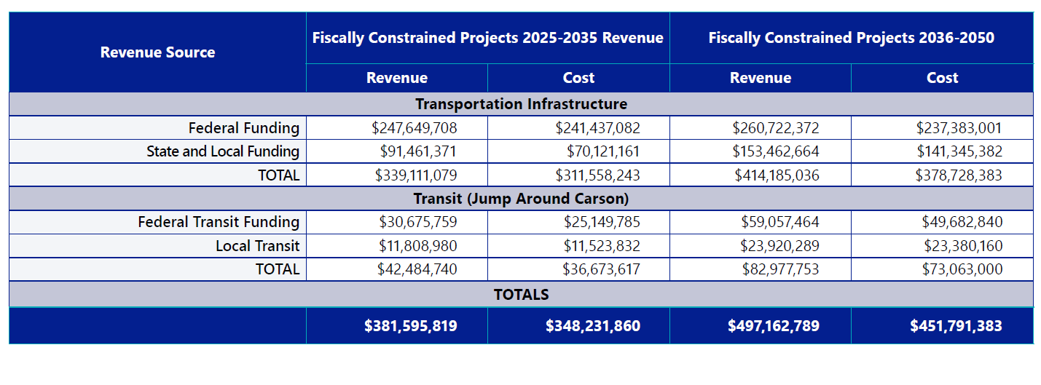
6: Investment Strategy
Total Fiscally Constrained Project Cost = $800 Million

Slide 26
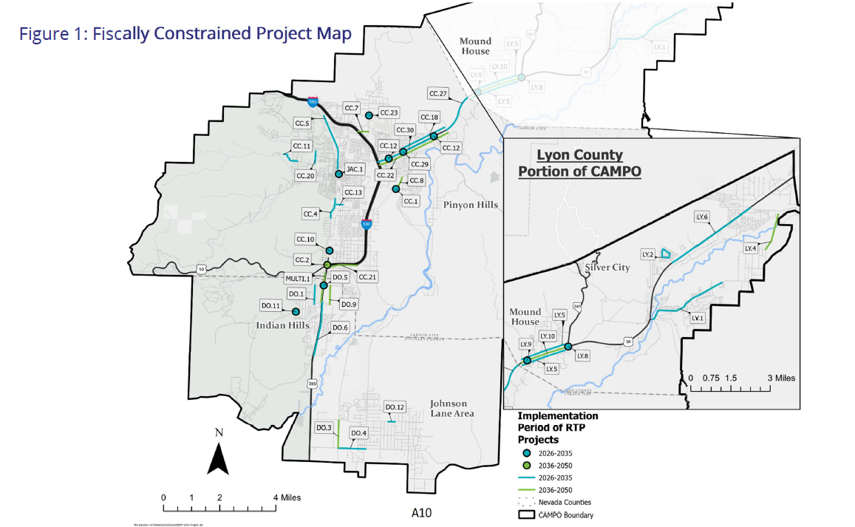
Appendix A

Slide 27
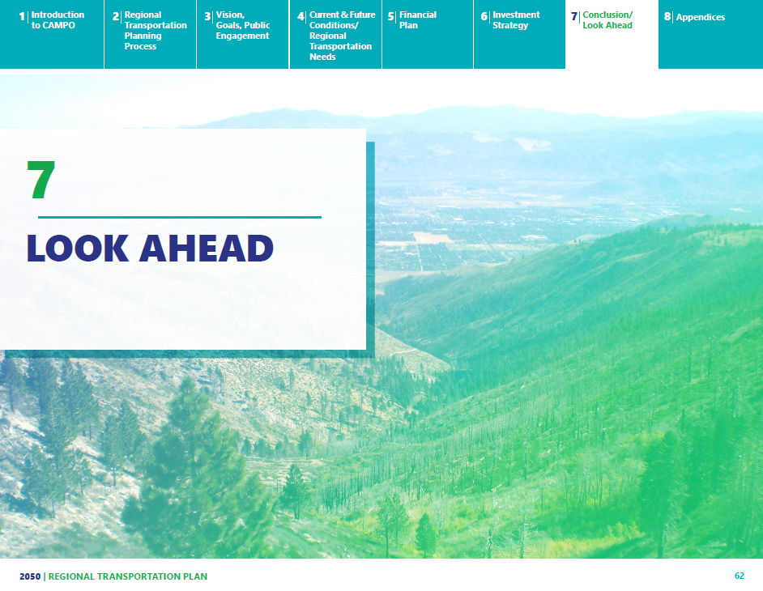

Slide 28
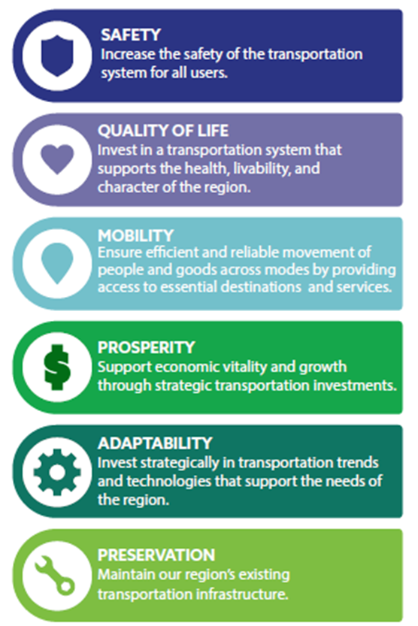
7: Looking Ahead

Slide 29
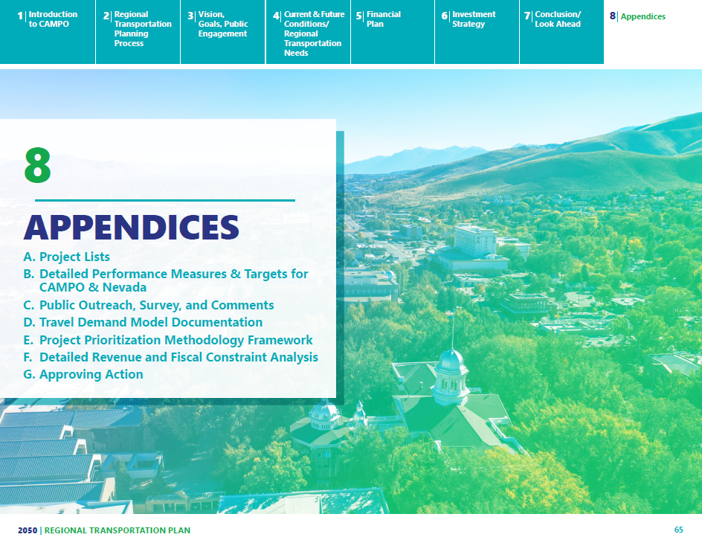
7: Looking Ahead

Slide 30
How to Make a Comment
Comment Card
Comments@CarsonAreaMPO.com
Please be sure to cite page numbers, or chapters
You can also mail your comments to:
CAMPO
3505 Butti Way
Carson City, NV 89701
Please submit a comment at this email address and cite specific page numbers, or chapter headings so staff can make sure your comments are captured correctly.

