Slide 1
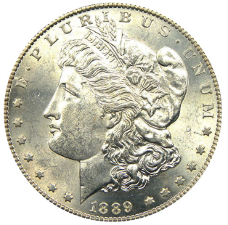
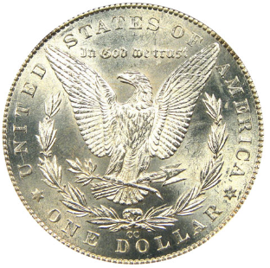
OFFICE OF THE TREASURER Consolidated Municipality of Carson City, Nevada 201 North Carson Street, Suite 5 Carson City, NV 89701 Office: (775) 887-2092 ●Fax: (775) 887-2102 Email: treasurer@carson.org

Slide 2

As the state capital, “county seat,” and now the only “city” for that matter, Carson City has a unique history and political situation different from other cities and counties in Nevada, all of which impact Carson City:
Carson City government
State government
Federal government
Businesses
Religious entities
Non-profit organizations
Taxpayers
This unique history and situation impacts Carson City and its finances in many ways

Slide 3
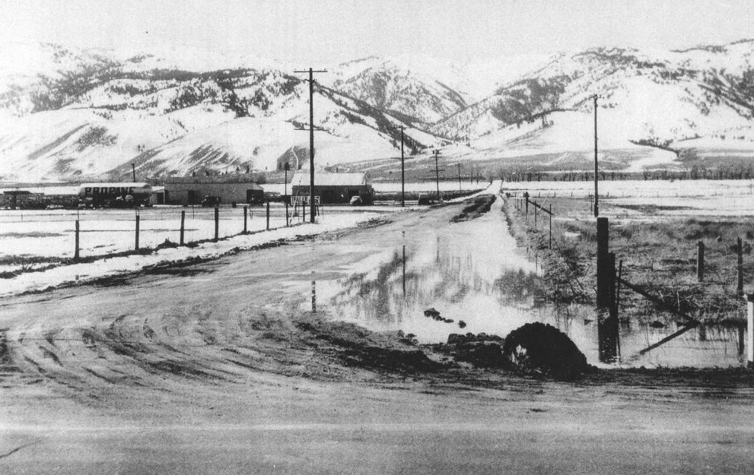

Slide 4
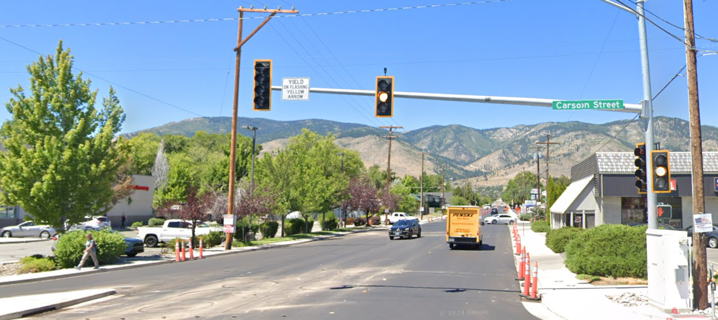

Slide 5


Carson City is the only consolidated municipality in the State of Nevada
Some people will make the argument that Nevada only has 16 counties and 1 consolidated municipality
Former Governor Robert List, who was the District Attorney of Ormsby County, helped lead the push to consolidate Carson City and Ormsby County
On April 1, 1969, Carson City and Ormsby County merged into one consolidated entity.
This led to consolidation of some of the city and county offices into one office for efficiency
This also gave Clark County and Las Vegas the idea for consolidation, but it didn’t go too far:
Las Vegas Police Department and Clark County Sheriff’s Office consolidated into one organization in 1973: the Las Vegas Metropolitan Police Department
This is unique because a Sheriff’s Office is led by an elected Sheriff, and a Police Department is led by an appointed Chief

Slide 6

Why are Carson City’s history and status as a consolidated municipality important?
Carson City consists of approximately 146 square miles of area
In comparison:
San Francisco City/County is 46.87 square miles
Washington, D.C. is 68.34 square miles
Carson City has a portion of Lake Tahoe
A bit of trivia: Carson City is one of two capital cities in the United States that borders another state
Carson City borders California by way of Lake Tahoe
Trenton, New Jersey is the other capital city that borders another state (Pennsylvania, by way of the Delaware River, another water border)

Slide 7

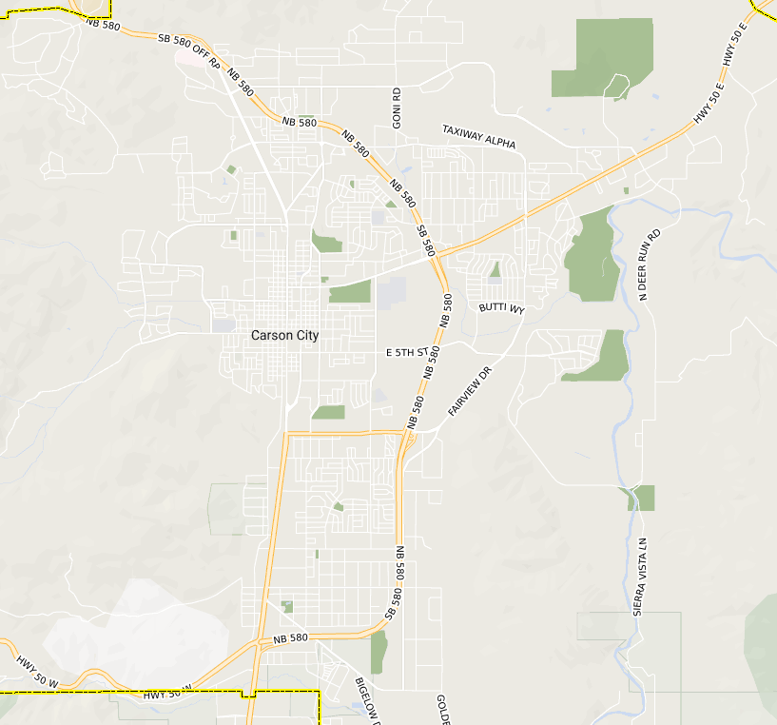
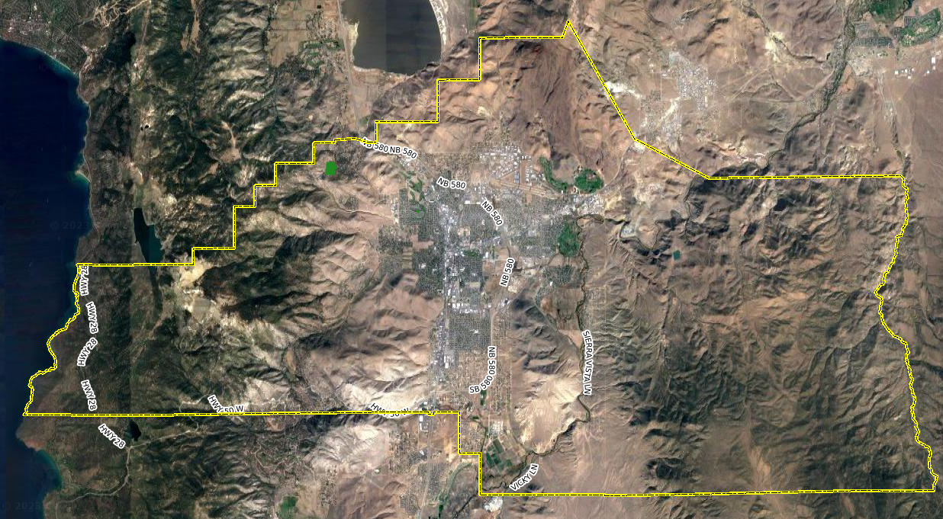
Most people see Carson City for its “city” features such as its historic West Side, Capitol Complex, airport, and industrial areas, and don’t realize how much mountainous and uninhabited areas it contains.
˂-- view from “Carson City” overlooking Marlette Lake and Lake Tahoe.

Slide 8
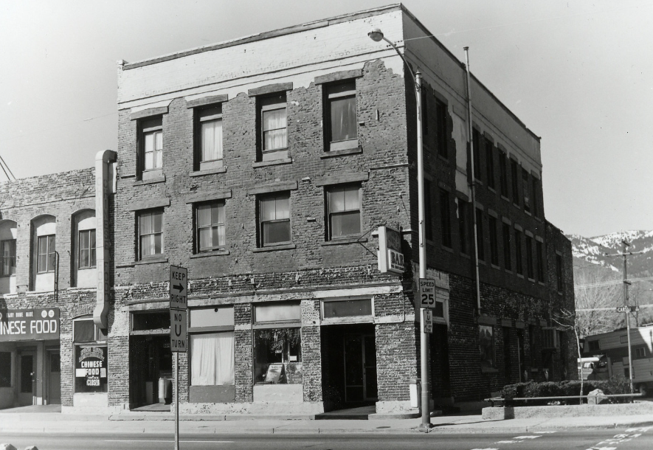
SUMMARY OF REAL PROPERTY TAX COLLECTION IN CARSON CITY
For tax year 2026 (7/1/25 to 6/30/26) Carson City has:
A total of 20,585 taxable real property parcels *
for a taxable amount of $72,426,674.31*
A total of 864 tax-exempt parcels*
That’s a total of 21,449 taxable and exempt parcels.
864 real property parcels for which Carson City can’t receive property tax revenue, or roughly 4.02% of the combined taxable and tax-exempt parcels in Carson City
*source: Devnet (Carson City’s tax assessment and billing system)

Slide 9
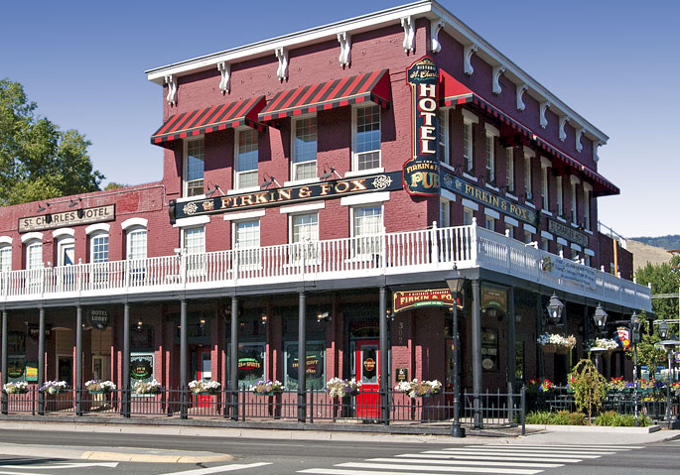

Slide 10
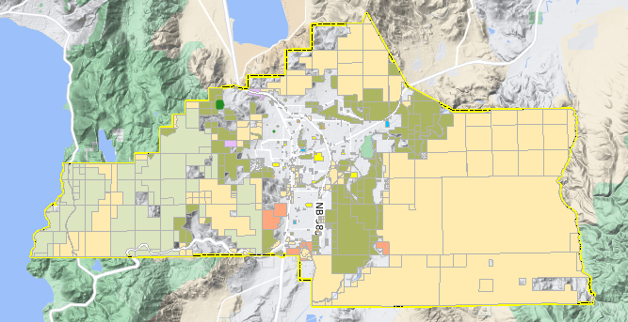
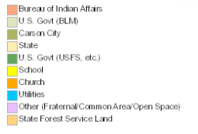
864 parcels, or 4.02% doesn’t seem like much, but consider the size of some of these properties and land areas that don’t pay real property taxes to Carson City, but still utilize or impact Carson City services such as:
Law Enforcement
Fire
School/education
Public Works
Health and Human Services
Landfill
Parks and Recreation

Slide 11
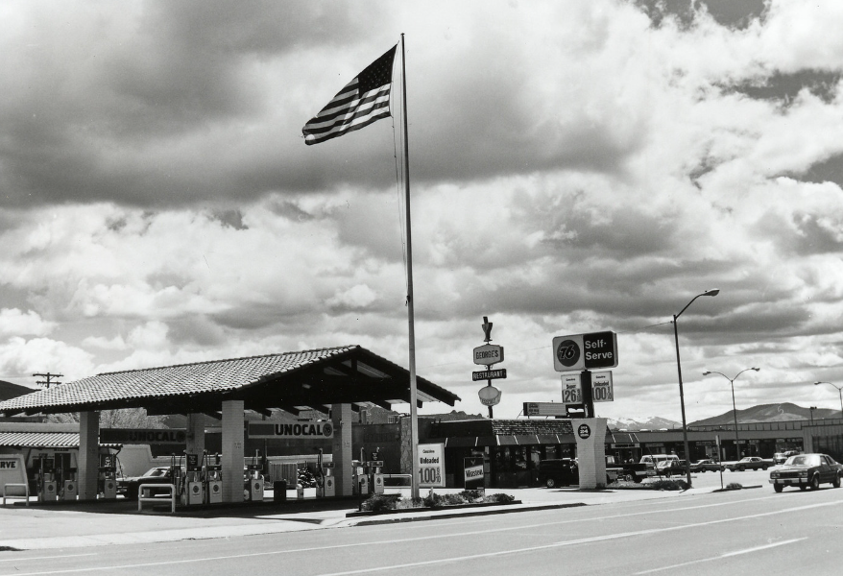
Many portions of Carson City consist of:
Federally owned or controlled land
U.S. Forest Service, Bureau of Land Management
Washoe Tribal lands
State owned land:
Various state government lands, buildings, and properties
NRS 361.055: state properties are exempt from taxation
NRS 361.157 provides a caveat for some exempt properties that can be taxed
City owned properties
City government offices and properties
School District properties
Carson City loses out on considerable taxable property due to numerous federal, state, and City properties not subject to property taxes
This is in addition to the many churches and non-profit organizations that have tax exemptions for their real properties

Slide 12
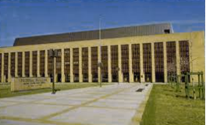
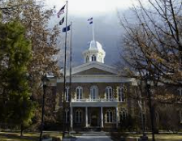
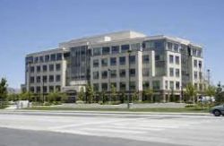
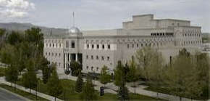
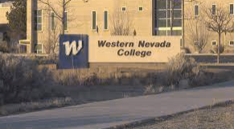
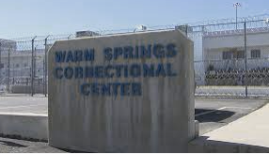
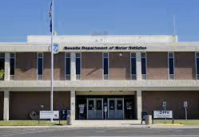
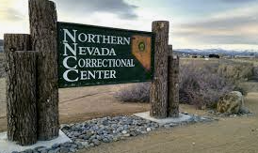
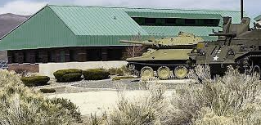
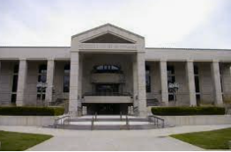
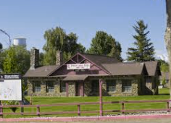
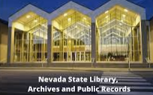
Just a few of the state and federal building/facilities in Carson City that don’t pay real property taxes

Slide 13
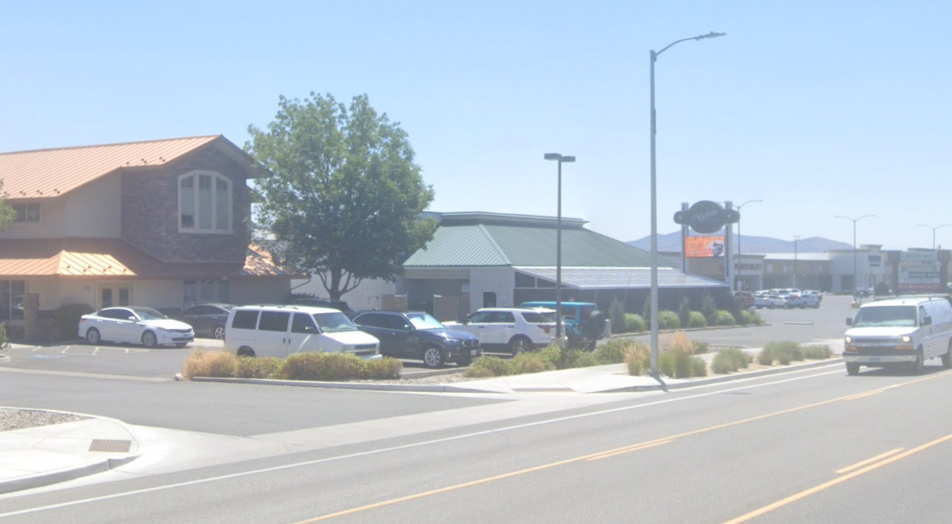

Slide 14
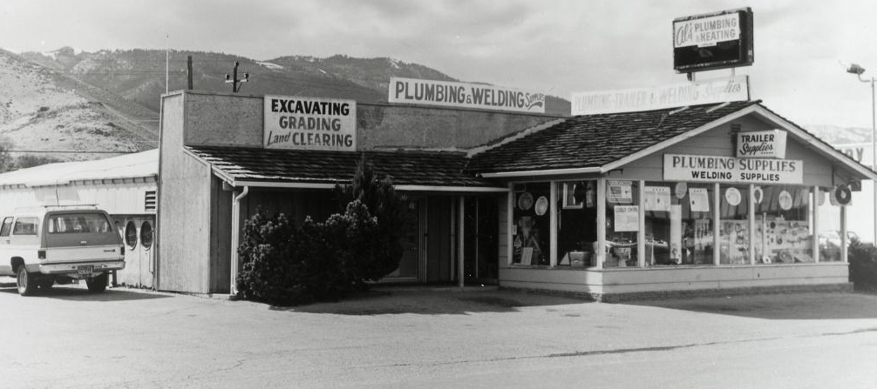

Slide 15
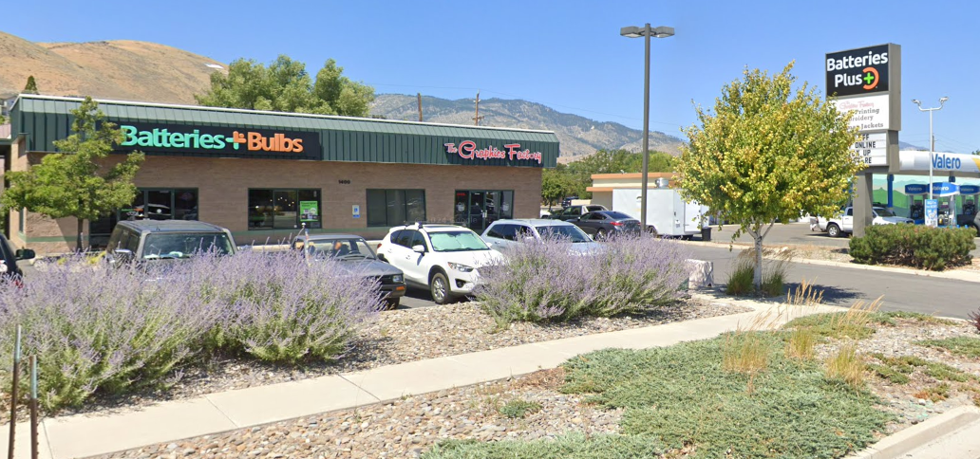

Slide 16
SUMMARY OF REAL PROPERTY TAX COLLECTION IN CARSON CITY TAX COLLECTION DURING THE LAST 7 YEARS source: Devnet (Carson City property tax system)
TAX YEAR | TAXABLE PARCELS | TOTAL AMOUNT DUE IN PROPERTY TAXES
2025-2026 | 20,585 | $72,426,674.31
2024-2025 | 20,402 | $68,096,635.39
2023-2024 | 20,301 | $62,228,253.84
2022-2023 | 19,826 | $57,666,286.82
2021-2022 | 19,724 | $54,358,763.72
2020-2021 | 19,374 | $52,016,649.16
2019-2020 | 19,155 | $49,290,136.95
2018-2019 | 19,066 | $46,682,692.10
2017-2018 | 18,828 | $44,149,381.30

Slide 17
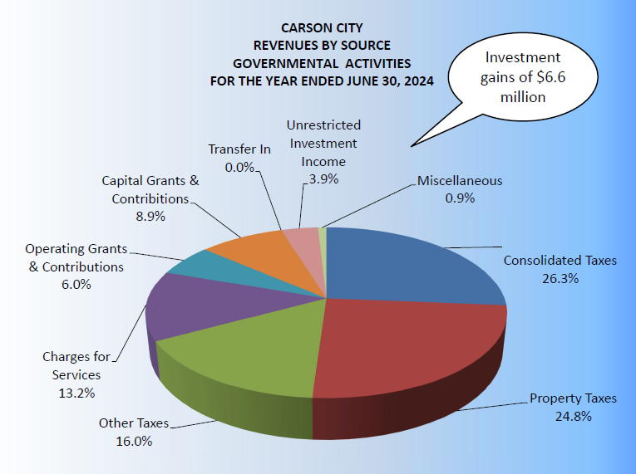
PROPERTY TAX COLLECTION AND REVENUE SOURCES IN CARSON CITY
As a note: consolidated taxes currently make up the largest revenue source for Carson City at 26.3%, but this tax source is also the most volatile. Consolidated taxes consist of:
Cigarette Tax
Liquor Tax
Government Services Tax (GST)
Real Property Transfer Tax (RPTT)
Basic City County Relief Tax (BCCRT)
Supplemental City County Relief Tax (SCCRT)

Slide 18
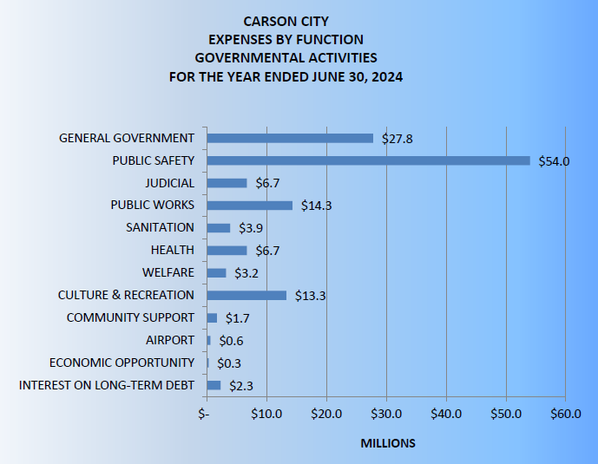
SUMMARY OF CARSON CITY EXPENSES BY DEPARTMENT/OFFICE FUNCTIONS

Slide 19
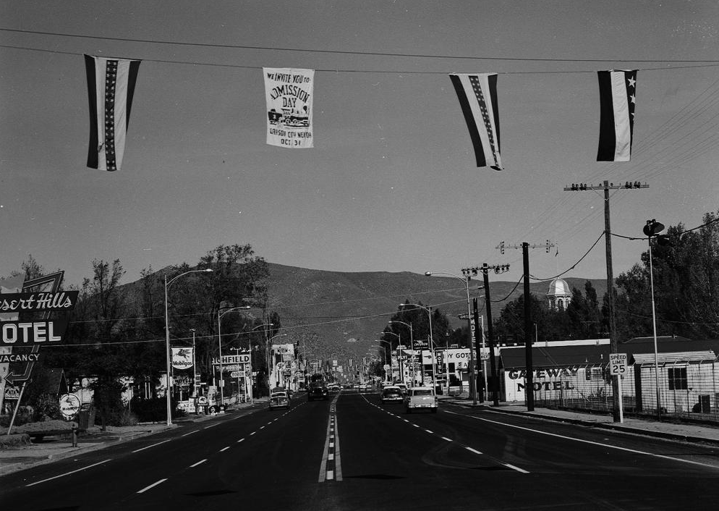

Slide 20
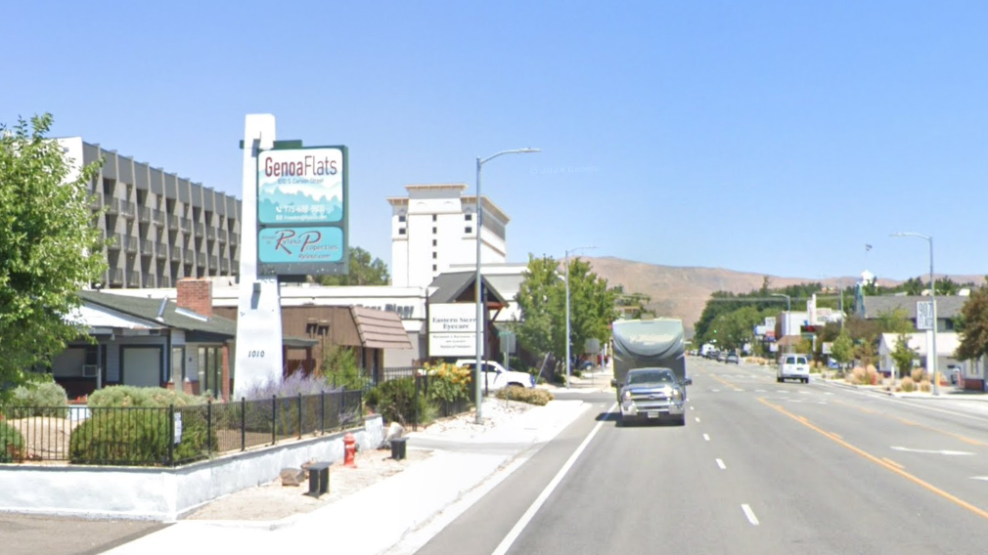

Slide 21
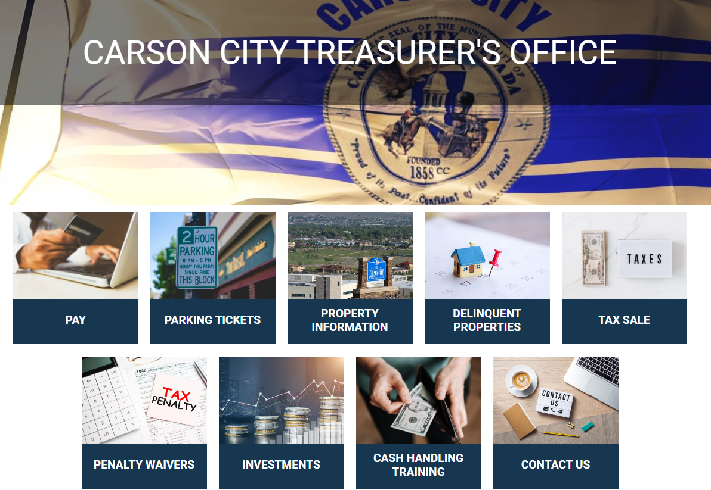
OVERVIEW OF THE CARSON CITY TREASURER’S OFFICE
Primary responsibilities of the Carson City Treasurer’s Office
Duties outlined in NRS 249 and Section 3.045 of the Carson City Charter
Billing of real property taxes
Collection of property taxes
Collection of water/sewer payments
Oversee and manage Carson City’s banking contracts
Bank accounts
Credit card vendors
Review of banking or financial contracts submitted between Carson City government offices and vendors

Slide 22
OVERVIEW OF THE CARSON CITY TREASURER’S OFFICE
Monthly payments on Carson City’s bond and debt-service payments
Investment of Carson City surplus funds
Annual review and update of Carson City’s cash handling policy
Ensure that those Carson City government offices that accept or process payments from the public are following the policy through the use of random audits
Assist with the review and development of Carson City’s Payment Card Industry (PCI) compliance policy
Annual review, update, and submission of Carson City’s investment policy to the Board of Supervisors for yearly approval
Monthly report to the Carson City Board of Supervisor per NRS 354.280

Slide 23
OVERVIEW OF THE CARSON CITY TREASURER’S OFFICE
Like any organization, Carson City government needs to be efficient.
HOWEVER, government finance differs from private business and individual finances
Government finance must operate according to many local, state, and federal laws, as well as policies and procedures
Many citizens understand that a county treasurer handles government finances, but don’t understand what part and the scope
County treasurers in Nevada typically handle finances at the larger level:
Taking in revenue for the county
Making payments on behalf of the county
At the lower level, it is generally a county’s finance office that handles the day-to-day accounting of the county’s finances such as accounts receivable and accounts payable
Carson City is no different

Slide 24
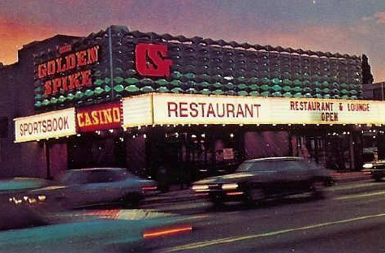

Slide 25
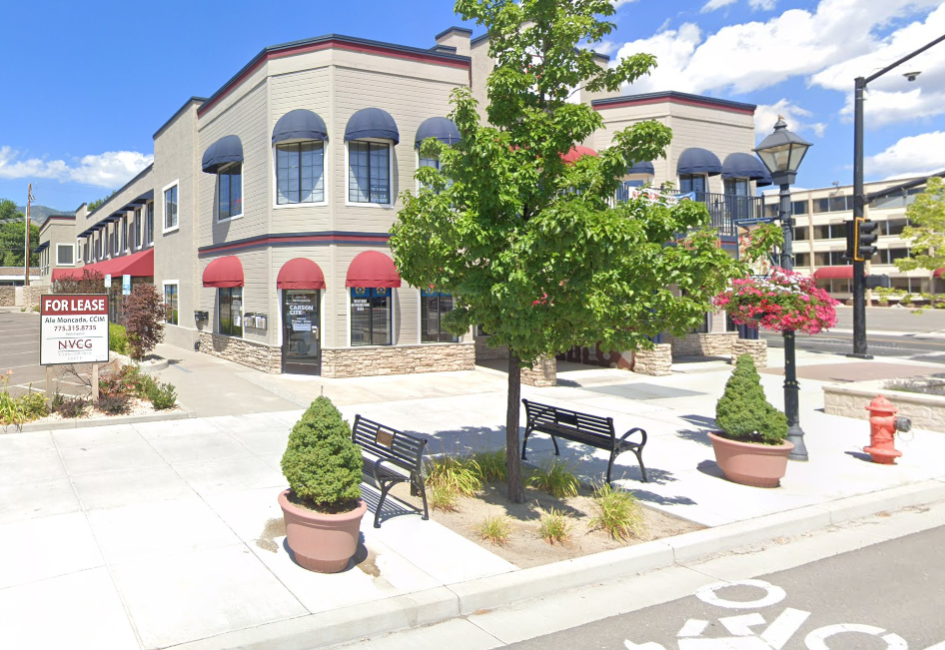

Slide 26
OVERVIEW OF THE CARSON CITY TREASURER’S OFFICE
Carson City used to have a combined clerk-treasurer until 1989
In 1989, the Carson City Clerk-Treasurer office was separated into two elected offices
Ted Thornton: continued as the Carson City Treasurer
Alan Glover: became the Carson City Clerk-Recorder
There is a difference between a Clerk-Treasurer and a “regular” Treasurer
Clerk-Treasurer handles elections, recordings, and treasurer duties
Treasurer handles “regular” treasurer duties
In Nevada, 7 of the 17 counties have combined the two elected offices of clerk-recorder and treasurer into one office (Clerk-Treasurer):
Pershing, Churchill, Mineral, Esmeralda, Storey, Lyon, and Douglas Counties have combined the Clerk-Treasurer into one elected office
Notice that these counties are smaller in population (with the exception of Douglas County)

Slide 27
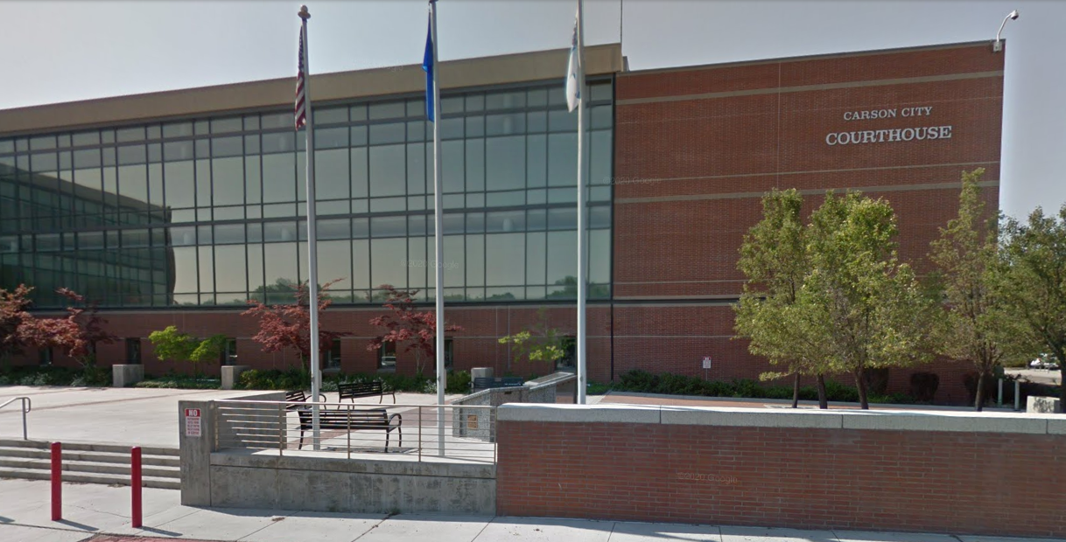
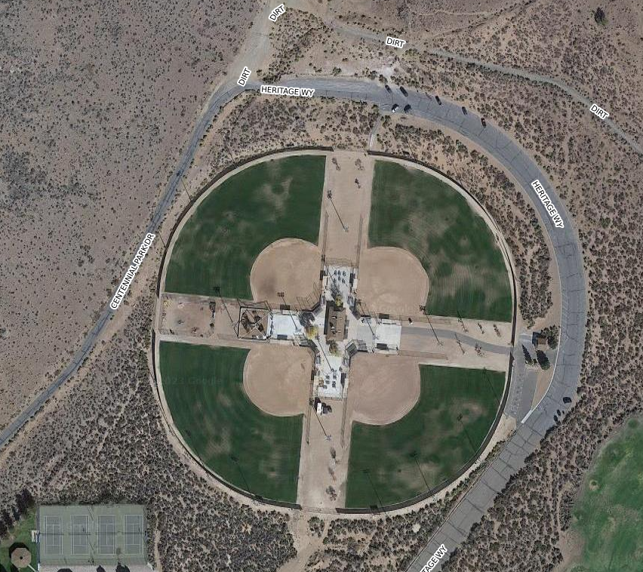
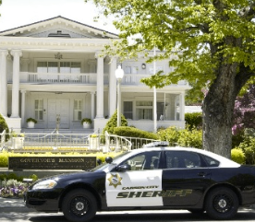
The Treasurer’s Office has many regular duties:
Revenue collection
Many of Carson City’s government offices collect fees
Parks and Recreation
Rifle range
Youth and adult sports
Aquatic center
Cemetery
Courts
Fines and Fees
Restitution
Juvenile Court and Probation
Carson City Sheriff’s Office
Bail money
Inmate commissary
Records
Copies of records, incident reports, and other documents
Civil Division
Fingerprints
Background checks
Work cards
Concealed Weapons Permits

Slide 28





The Treasurer’s Office regular duties (continued):
Revenue collection:
Health and Human Services
Environmental Health
Clinical Services
Business and Licensing
Building permits
Business licensing and fees
Community and Code Enforcement
Parking citations
Public nuisance
Public Works and Landfill
On-site payments
Business accounts
Jump Around Carson

Slide 29
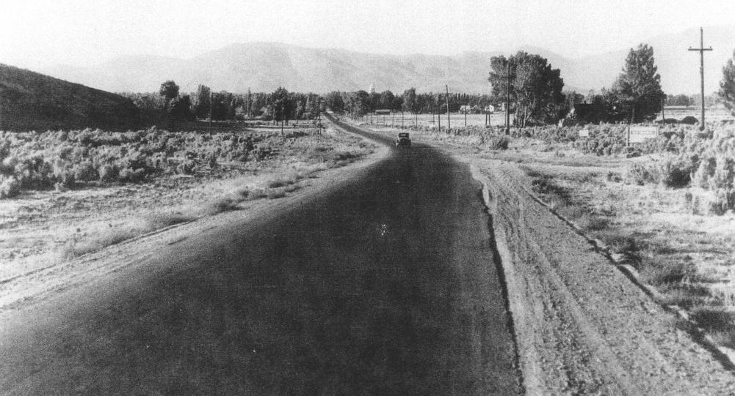

Slide 30
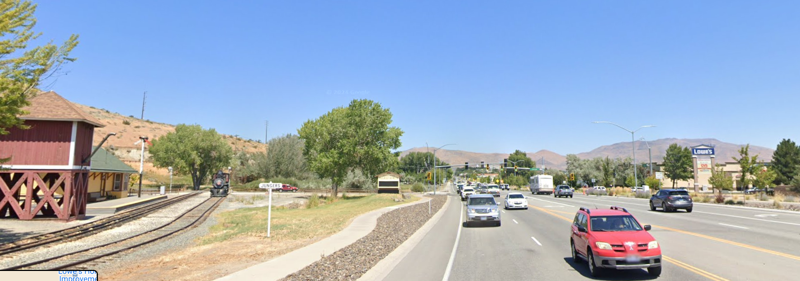

Slide 31
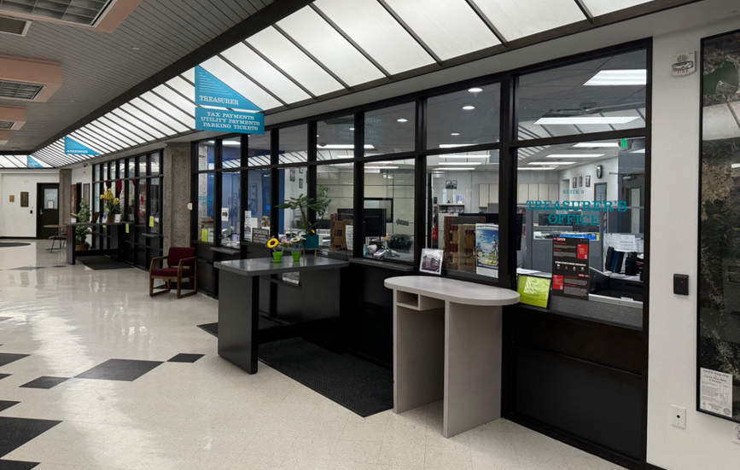
The Treasurer’s Office regular duties (continued):
Tax collection
Real property taxes
Personal property taxes
Delinquent tax sales
Aircraft and aircraft hangar accounts
Commercial accounts
Utility (water and sewer) collection
Banking and revenue reconciliation
Investment of excess funds
Ensuring payment of Carson City’s bond obligations

Slide 32
INVESTMENT OF EXCESS FUNDS/AVAILABLE REVENUE
Another responsibility of the Carson City Treasurer is the investment of funds not currently in use or are awaiting use at a future time
Excess tax revenue
Bond proceeds
Special funding like ARPA funds
(American Rescue Plan Act of 2021 was a $1.9 trillion economic stimulus bill)
The Treasurer’s Office invests Carson City’s money in four areas:
Local Government Investment Pool (LGIP): short term/ liquidity
Buckhead Capital Management: short term to medium term
Meeder: medium to longer term
Government Portfolio Advisors (GPA): long term

Slide 33
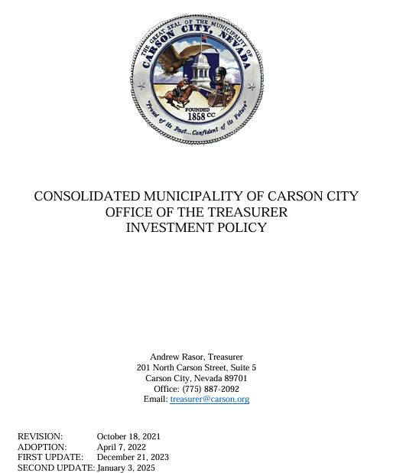
INVESTMENT OF EXCESS FUNDS/AVAILABLE REVENUE
Carson City’s investment portfolio differs from that of a private individual or business
Requires adherence to many state and federal laws
Has its own certified investment policy
Certified in November of 2021 by the Government Investment Officers’ Association (GIOA)

Slide 34
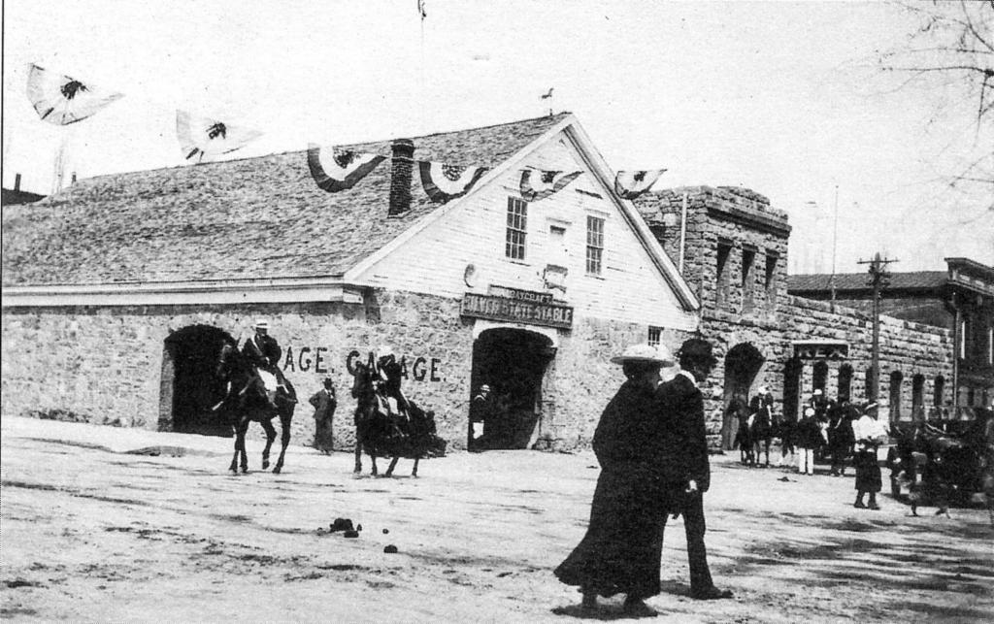

Slide 35
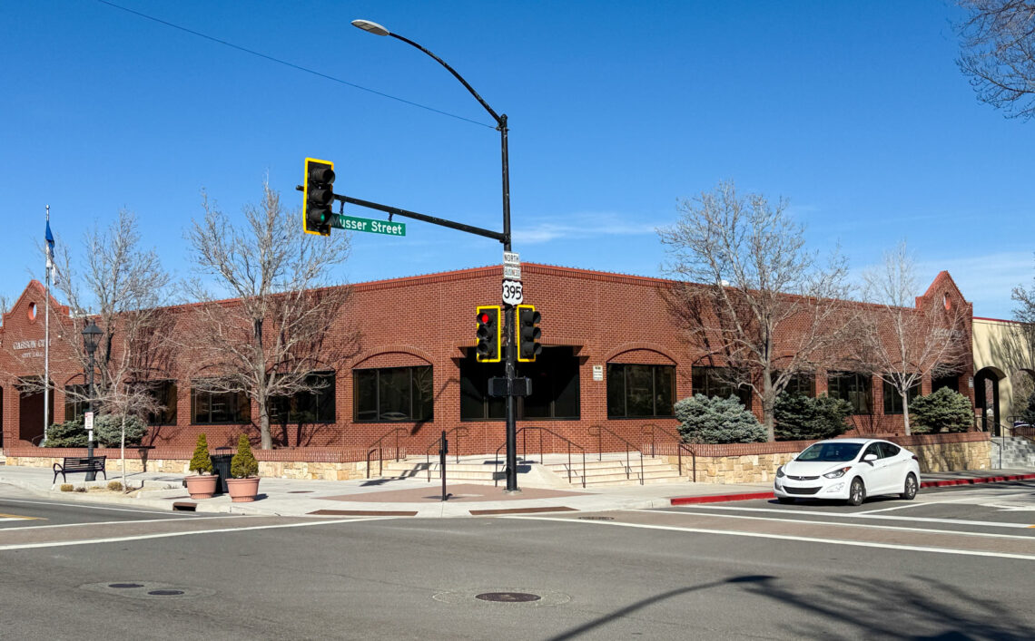

Slide 36
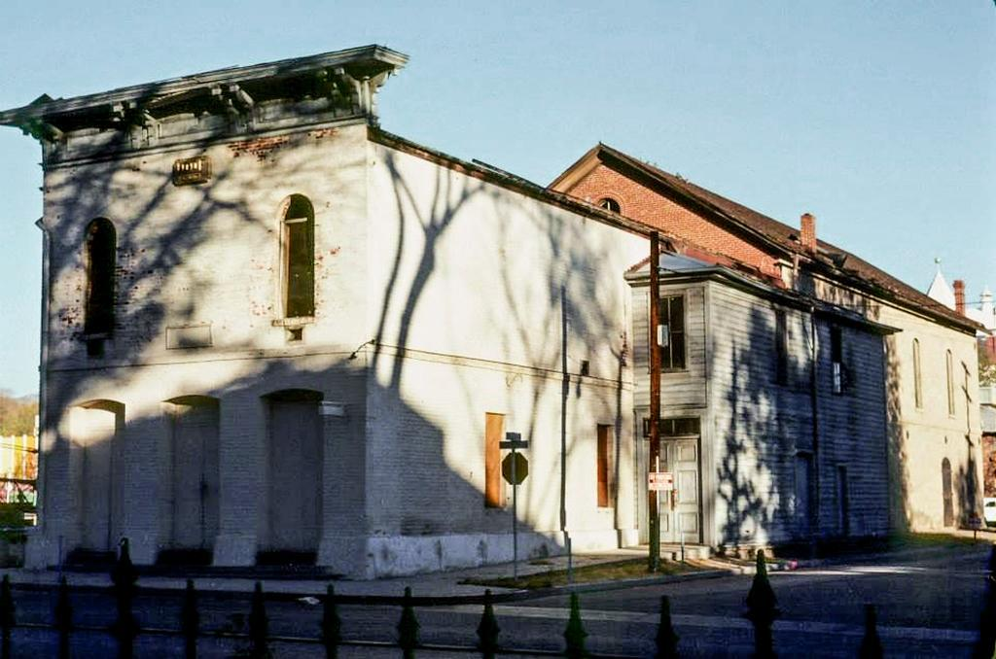

Slide 37
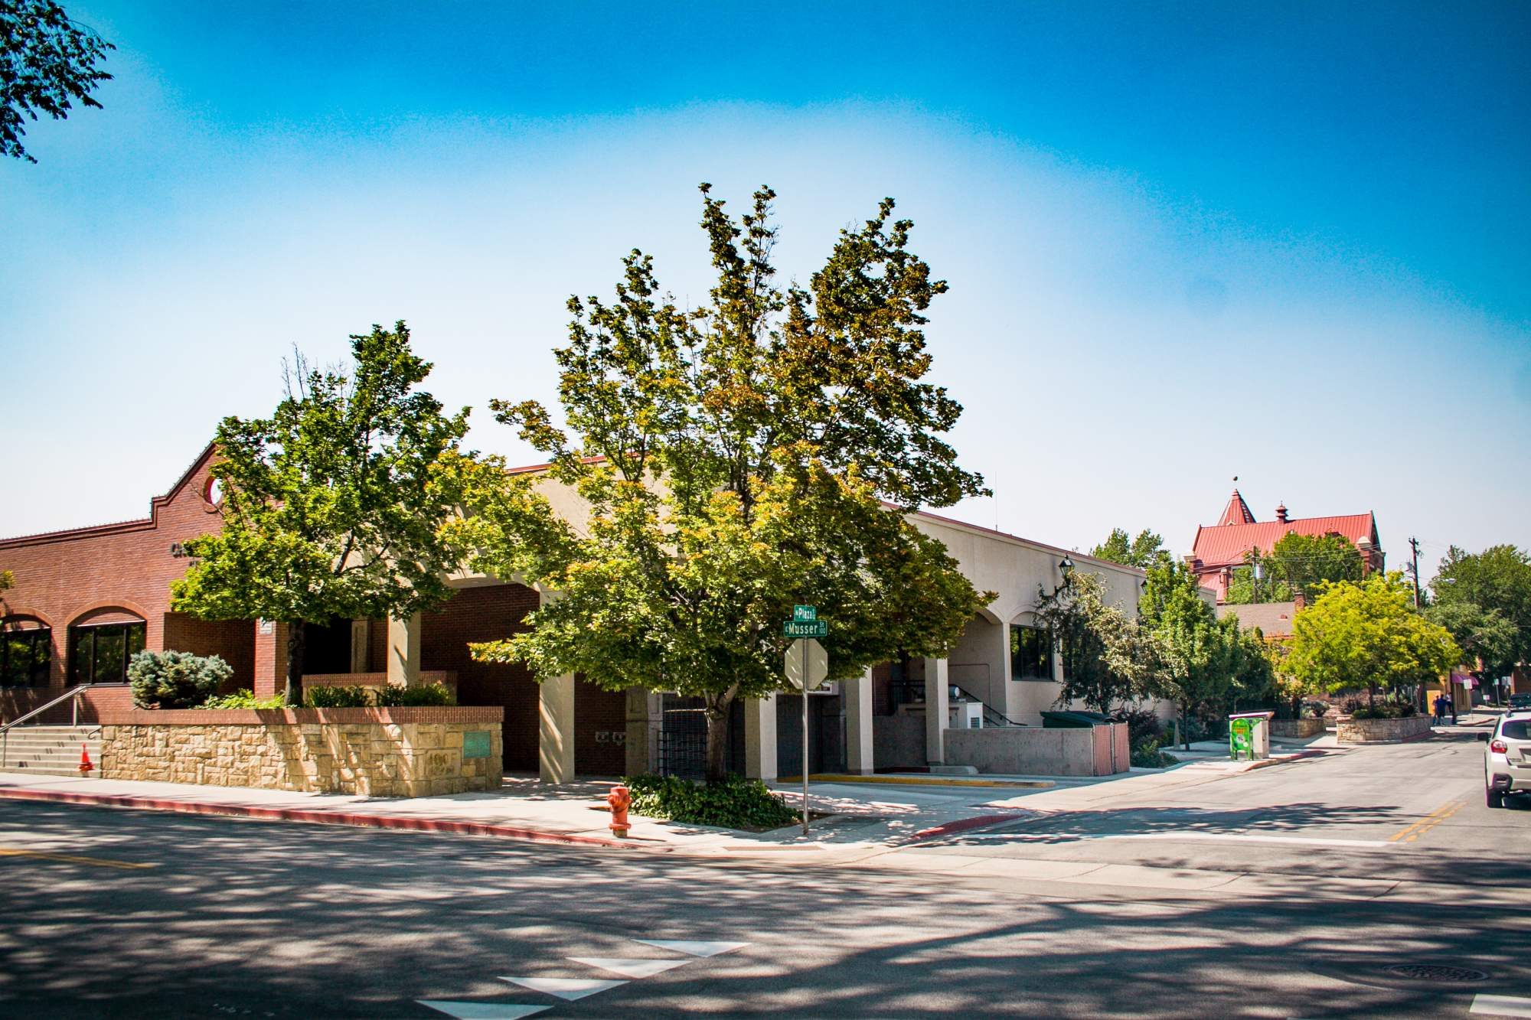

Slide 38
INVESTMENT OF EXCESS FUNDS/AVAILABLE REVENUE
Investment strategy and policy focus on three main objectives:
Safety: safeguarding Carson City’s investment principal
Liquidity: adequate liquidity to meet Carson City’s operating needs
Return on Investment: achieve the highest investment return possible consistent with its investment policy
Carson City’s investment strategy also consists of “buy and hold”
Preferred investments are often:
U.S. Treasuries (3 month T-bills, 2 year T-notes)
U.S. government agency securities (Fannie Mae, Farmer Mac)
Corporate paper and bonds (Amazon, Toyota, commercial banks)

Slide 39
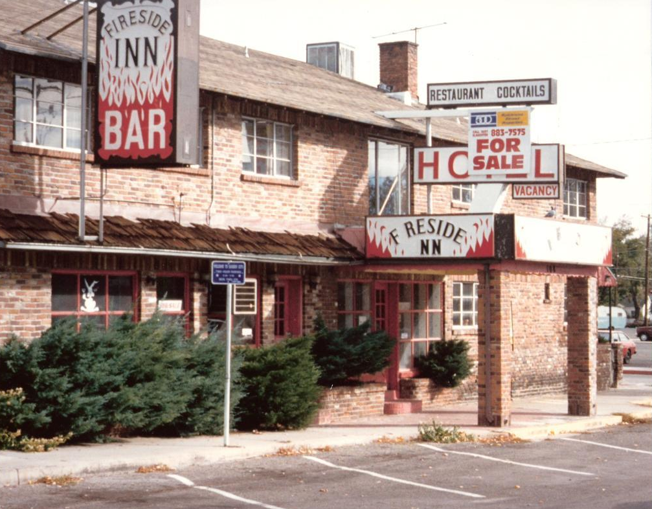

Slide 40
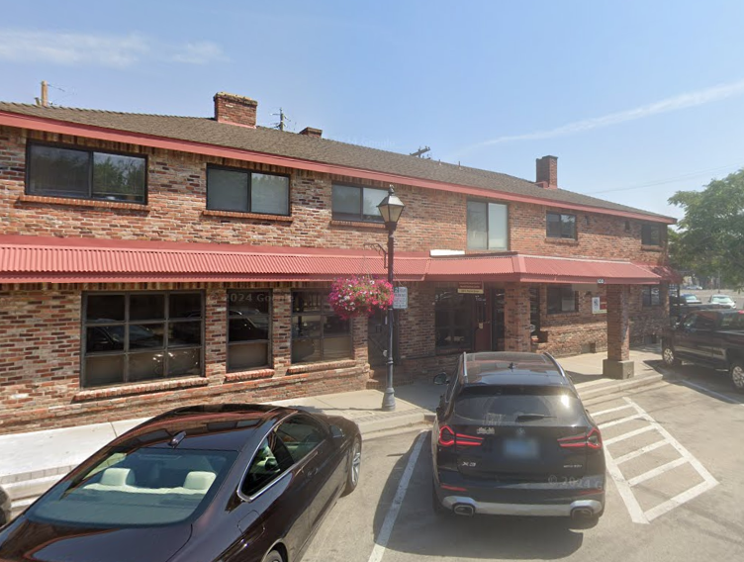

Slide 41
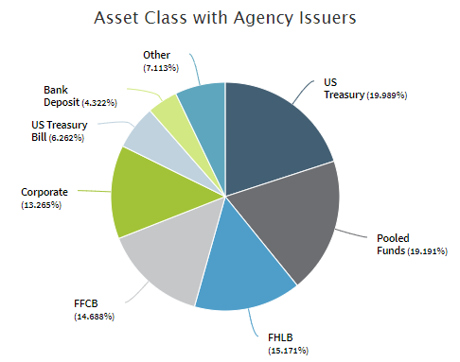
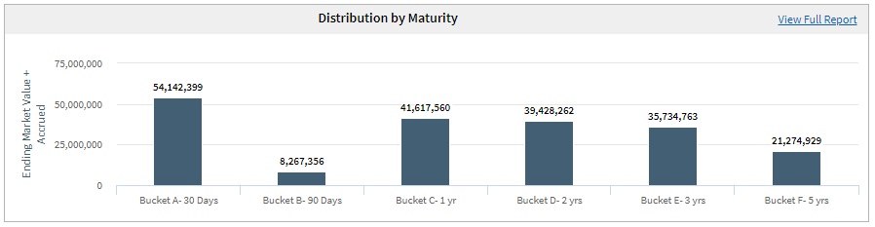
As of Friday, 10/31/25, Carson City’s investment portfolio consists of $248,744,798.71
Local Government Investment Pool:
$ 51,880,492.35
Buckhead Capital Management:
$5,354,415.23
Government Portfolio Advisors:
$98,083,683.88
Meeder:
$ 93,426,207.55
Last year at this time, Carson City’s investment portfolio was: $233,697,495.66 (a difference of $15,047,303.05)
For comparison:
10/31/21: $136,295,162.43 (combined portfolio balance)
10/31/22: $175,103,145.44 (combined portfolio balance)
10/31/23: $199,899,683.76 (combined portfolio balance)
10/31/24: $233,697,495.66 (combined portfolio balance)

Slide 42
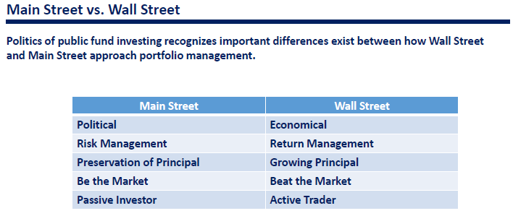

Slide 43
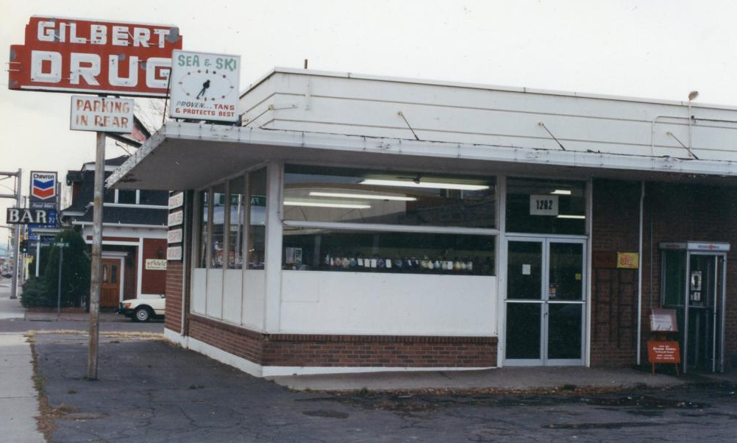

Slide 44


Slide 45
Carson City Treasurer has responsibility to ensure timely payment of debt payments for:
Carson City (as a whole)
Carson City School District
Note: the Carson City Treasurer is the Ex-Officio Treasurer for the Carson City School District
For FY 2025-2026, Carson City will pay $26,774,870.72 in principal and interest for the bonds the City and the School District have financed for various needs
With the current debt payment schedule, Carson City has debt/bond payments every month except for August and February
Debt payments include:
Water/sewer bonds
School bonds
Parks and Recreation bonds
Capital improvement
Highway refunding
Landfill

Slide 46


Slide 47


Slide 48

Timely payments enhance Carson City’s bond rating
On Wednesday, 2/3/22, Moody’s Investor’s Services upgraded Carson City’s bond rating from A1 to Aa3
This upgrade reflects Carson City’s positive financial health and outlook, and helps the City to obtain bonds at better rates now and in the future:

Slide 49
DELINQUENT PROPERTIES
Carson City has a high collection rate for real property taxes, but in some years, it must place on public auction those real properties which are two years or more delinquent on the payment of property taxes.
CCTO staff makes personal contact (in person, phone calls, emails, letters, knocks on the front door) with each of the owners on several occasions.
In 2018, Carson City had 1 property that went to a public tax sale auction; :
Residence: 2810 Mayflower Way
Owner had died; next-of-kin did not step forward to pay the taxes for the residence
In 2022, Carson City had 5 properties scheduled for public tax sale auction; only 1 went to sale:
Residence: 4085 Quinn Drive, Carson City, Nevada
Owner had died; next-of-kin did not step forward to pay the taxes for the residence
In 2025, Carson City had 15 properties scheduled for public tax sale auction; only 1 went to sale:
Residence: 2597 Kit Sierra Way
Owner had died; no known next-of-kin stepped forward to claim the residence

Slide 50


Slide 51

#10

Slide 52
OTHER RESPONSIBILITIES
Oversee and manage Carson City’s banking contracts
Bank accounts
Credit card vendors
Implementation of new credit card payment systems
Review of banking or financial contracts submitted between Carson City government offices and vendors
Annual review and update of Carson City’s cash handling policy
Ensure that those Carson City government offices that accept or process payments from the public are following the policy through the use of random audits
Assist with the review and development of Carson City’s Payment Card Industry (PCI) compliance policy
Annual review, update, and submission of Carson City’s investment policy to the Board of Supervisors for approval
Monthly report to the Carson City Board of Supervisor per NRS 354.280

Slide 53


Slide 54


Slide 55
CHALLENGES
The Treasurer’s Office is a small (BUT MIGHTY) office
Seven full time employees including the Treasurer
1 part-time courier position that works 20 hours per week
Many responsibilities; too few employees
Every envelope, check/money order, and accompanying tax or utility stub must be opened, sorted, and scanned
Daily banking, processing/posting of payments/processing deposits
Identify payments received; determine where to post payments
Identify “finger fumbles” made by customers attempting to make payments
Assisting the public at the front counter, emails, telephone calls
“but Google said I can get a copy of my birth certificate here…”

Slide 56

CHALLENGES
Treasurer’s Office is the “public square” for many citizen:
Complaints
Questions
Requests for assistance
How to make payment for other non-City owned utilities
Gas
Electric
How to locate other City, State, or Federal government services
Social Security card replacement
Vital Statistics (birth and death certificates)
Google sometimes lists Carson City Hall as the place to go for several State of Nevada services
Current state of the economy: how will this impact Carson City?
Increase/decrease of interest rates by the Federal Reserve
Is new construction/building of new homes is slowing? How much new housing inventory?
How will local, national, and international economic conditions and trends impact Carson City’s financial situation
Property taxes
Tax base
Schools
Roads
Etc.

Slide 57

For all its daily interactions with all City offices and its job to keep the money moving to fund government, the Carson City Treasurer’s Office is the crossroads of Carson City government.

Slide 58


Slide 59
QUESTIONS?
OFFICE OF THE TREASURER Consolidated Municipality of Carson City, Nevada 201 North Carson Street, Suite 5 ● Carson City, NV 89701 Office: (775) 887-2092 ● Fax: (775) 887-2102 Email: treasurer@carson.org

